Slide 1
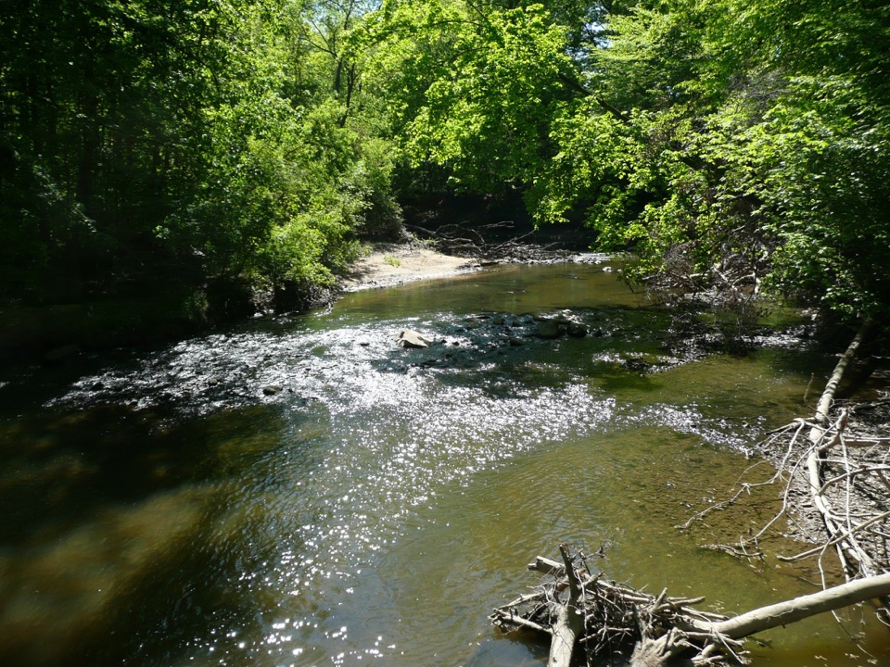
Plaster Creek
Profile of a human-dominated watershed (and what we’re doing to try to restore it)

Slide 2
Outline
Watershed basics
Plaster Creek basics
Some history
Status of the watershed today
How do we restore the watershed?
Plaster Creek Stewards
Native Landscapes

Slide 3
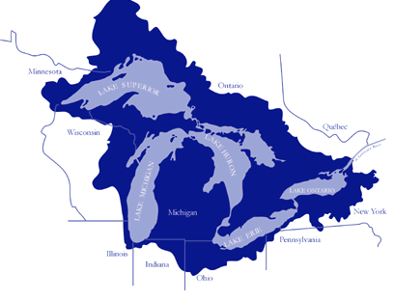
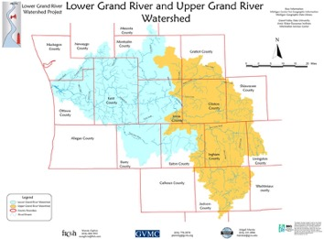
What is a watershed?
An area of land, delineated by topography, where all water drains to the same place
“Everybody lives in a bowl”
A fundamental ecological unit
Nested

Slide 4
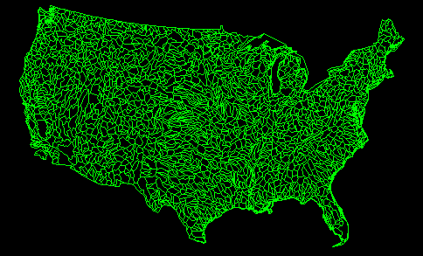

Slide 5
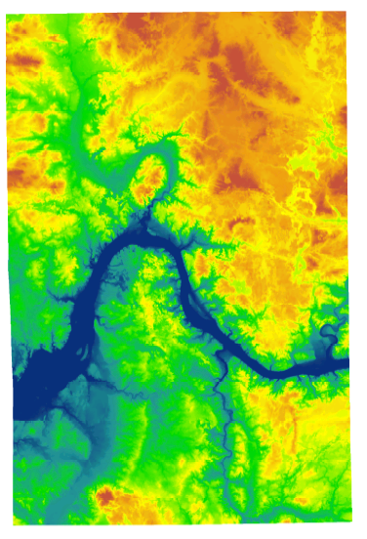

Slide 6
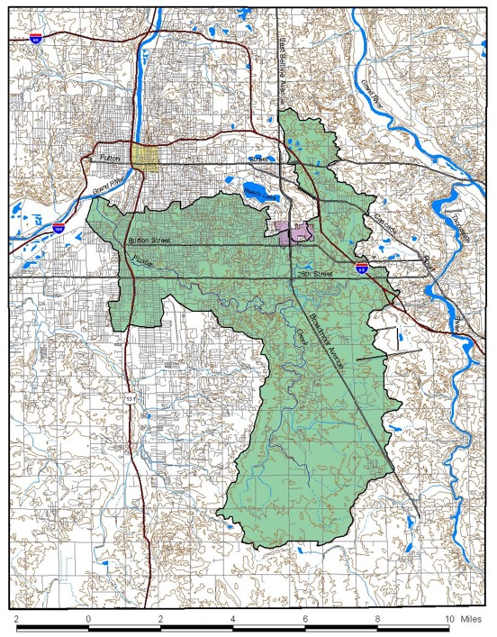


Slide 7
Plaster Creek Basics
Watershed is 58 square miles, all in metro Grand Rapids
Plaster Creek is about 14 miles long
Headwaters are in agricultural areas near Dutton, midsection is mostly commercial and residential, and the lower section is industrial, low-income residential.
Empties into the Grand River a mile south of downtown GR
Calvin sits on the boundary between the Plaster Creek and Coldbrook Creek watersheds—southern part of main campus and some of the ecosystem preserve drains to Plaster Creek.

Slide 8
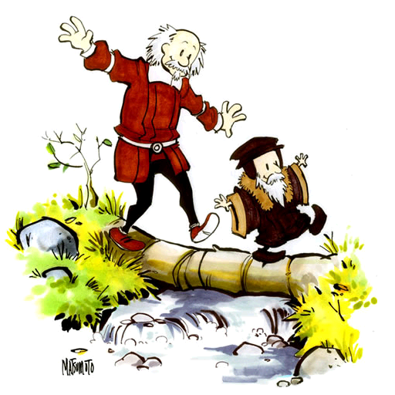
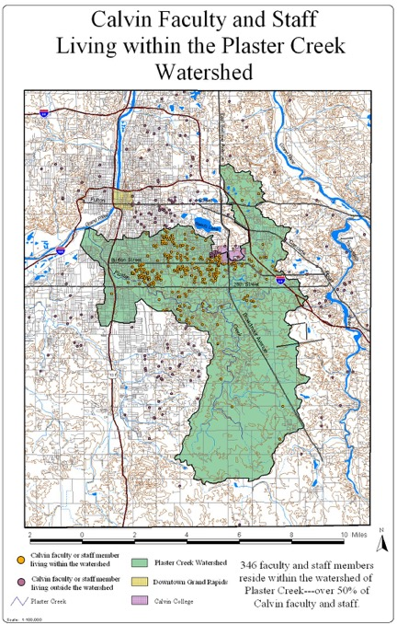
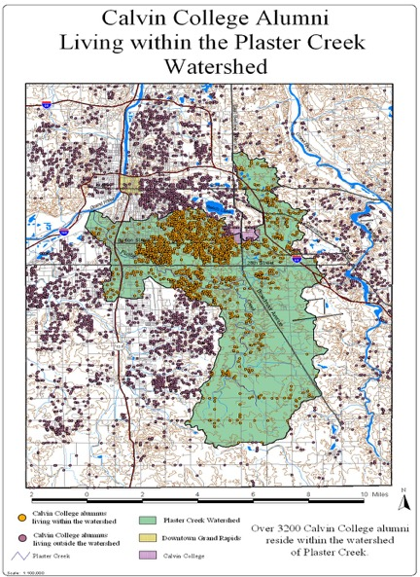
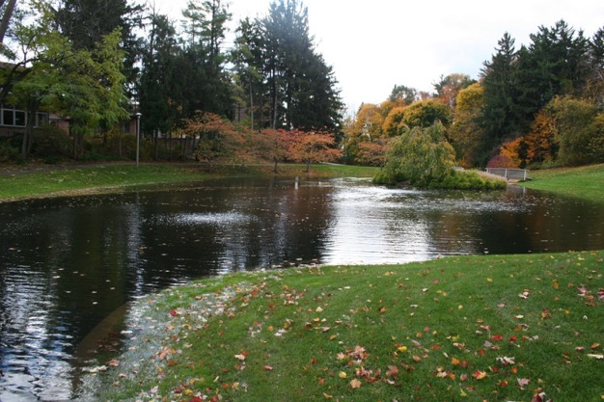
“Most reformed watershed in the world”
More than 50% of Calvin faculty/staff live in the Plaster Creek Watershed
http://spacecoyote.deviantart.com/art/John-Calvin-and-Thomas-Hobbes-68330601
Notes:
Calvinist infusion

Slide 9
Love your (downstream) neighbor
People who live at the lower ends of watersheds cannot be isolationists—or not for long. Pretty soon they will notice that water flows, and that will set them to thinking about the people upstream who either do or do not send down their silt and pollutants and garbage. Thinking about the people upstream ought to cause further thinking about the people downstream. Such pondering on the facts of gravity and the fluidity of water shows us that the golden rule speaks to a condition of absolute interdependency and obligation. People who live on rivers—or, in fact, anywhere in a watershed—might rephrase the rule this way: Do unto those downstream as you would have those upstream do unto you.
Wendell Berry, “Watershed Commonwealth”

Slide 10
Early watershed history

Slide 11
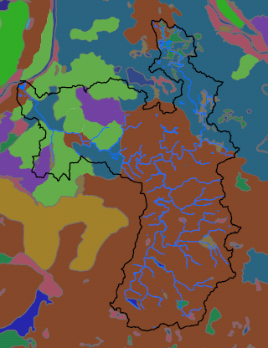
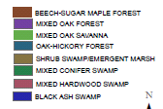
Land cover ca. 1800

Slide 12
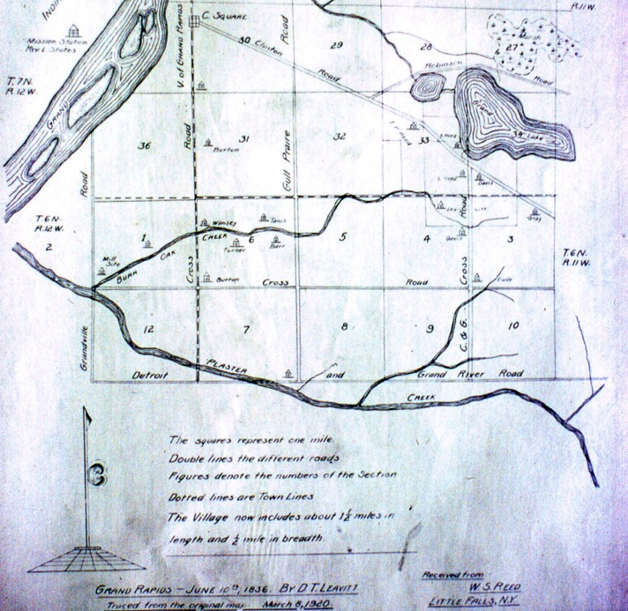
Downtown
Wealthy St.
Hall St.
Burton St.
Calvin
28th Street
Meijer
Division Ave.
Eastern Ave.
Breton St. SE.

Slide 13
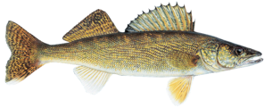
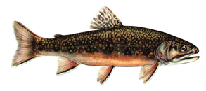
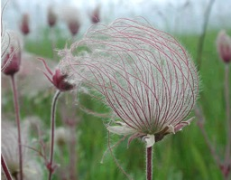
Rare/charismatic species
Walleye (spawning, especially Bur oak/Silver creek)
Brook trout
Prairie smoke on sandy bluffs
Beak grass along creek
Orchids in streamside seeps
Virginia bluebells in riparian woods

Slide 14
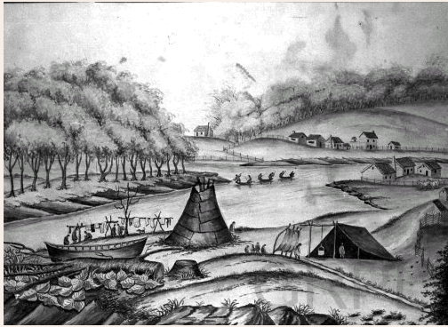
Downtown Grand Rapids, 1831
Notes:
Now I’d like to set the stage for the story of Europeans’ first recorded contact with Plaster Creek. This sketch is an artist’s rendering of Grand Rapids in 1831—four years after the story I’ll tell takes place. It was a mixture of native americans, french fur traders, and a baptist mission on the west side of the Grand river.

Slide 15
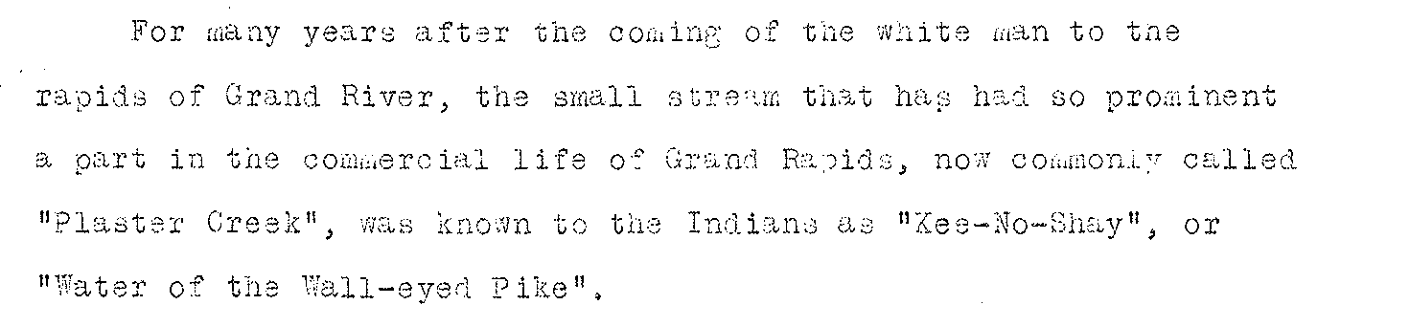

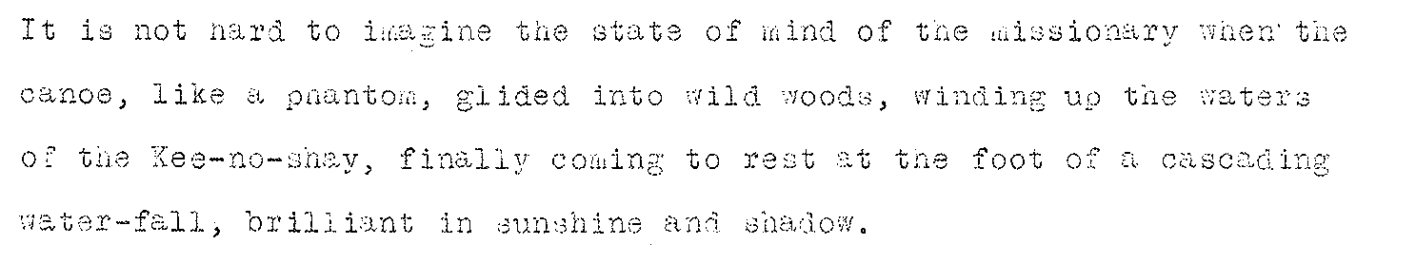
Kee-no-shay, Plaster Creek
By Charles Belknap (1928)
Notes:
These are some excerpts from a story written down by Charles Belknap, just before he died. He was a former Grand Rapids mayor. I’ll read them verbatim, because they’re interesting:
Filling in the plot: Blackbird had a theological argument with the missionary, and wanted to show him an area he thought had spiritual significance. Allegedly, he forced the missionary into his canoe, and paddled downstream on the Grand, and up the mouth of Kenosha (Plaster) Creek.

Slide 16
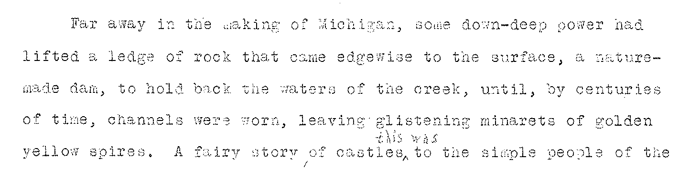
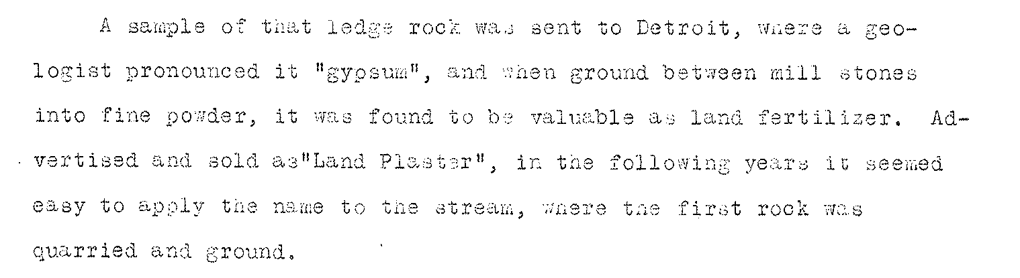
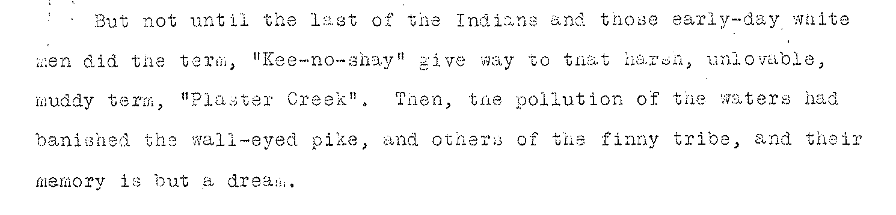

Slide 17
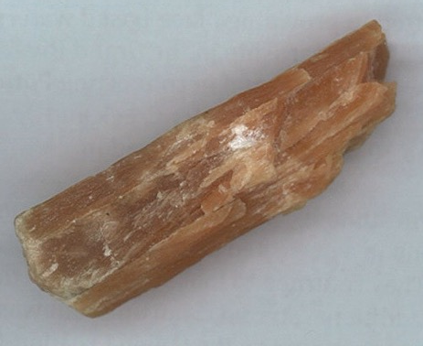
1841: Daniel Ball and Warren Granger set up a plaster mill on the same site, selling 40 tons the first week:
Plaster! Plaster!
The subscribers have now completed their Plaster Mill on Plaster Creek, two miles south of this place which is now in operation. They respectfully inform the public that they have on hand at the mill or at either of their stores at Ionia or this place a constant supply. As the quality of the Grand Rapids Plaster is not equaled by any in the United States, they hope to receive a share of patronage as the price is less than it can be obtained for at any place in Michigan. Wheat, Pork, and most kinds of produce received in payment.
Granger & Ball, December 21, 1841.

Slide 18
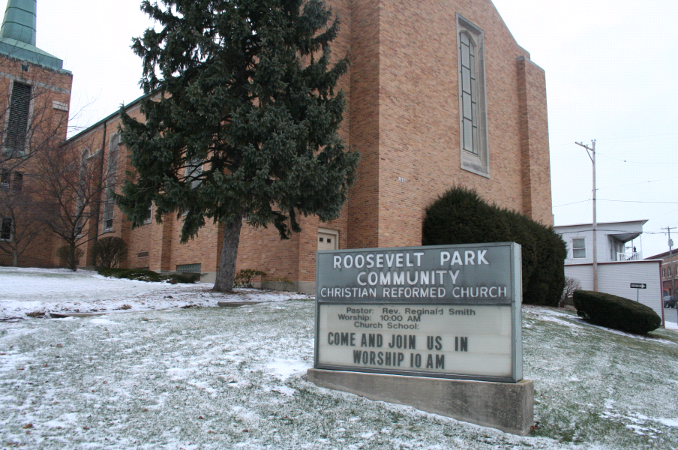

Slide 19
Bur Oak Creek (aka Silver Creek drain)
Notes:
Here is another short narrative that testifies to the changes the watershed has undergone over time—just a convenient one because I happen to have pictures of it.

Slide 20
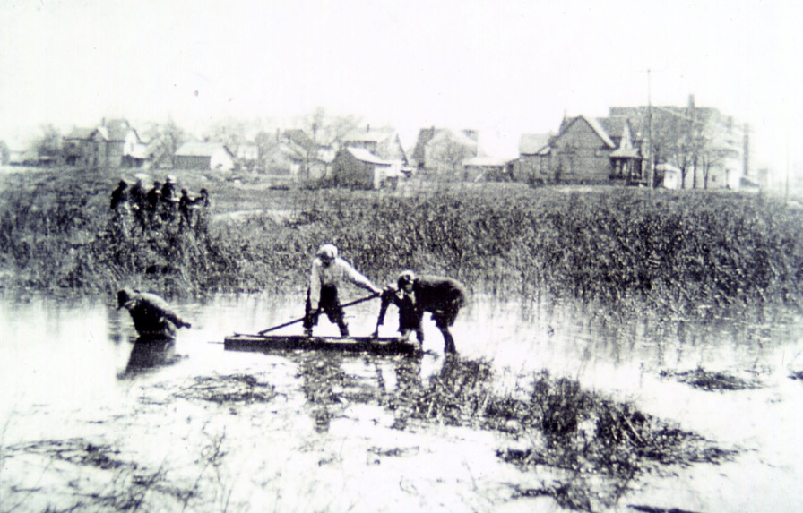
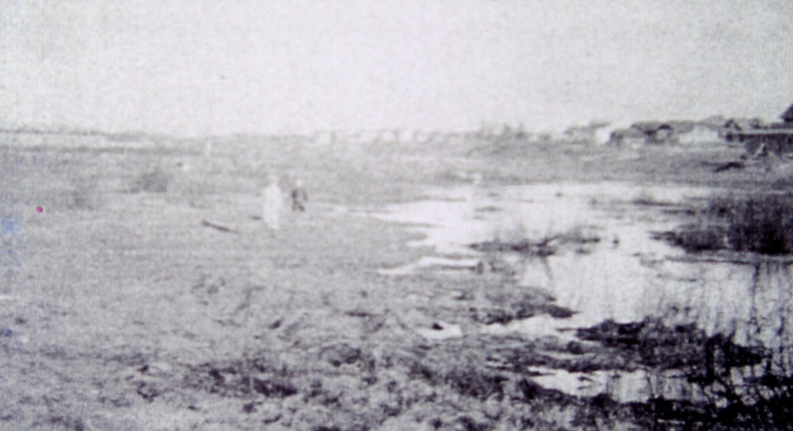
Silver Creek, 1930

Slide 21
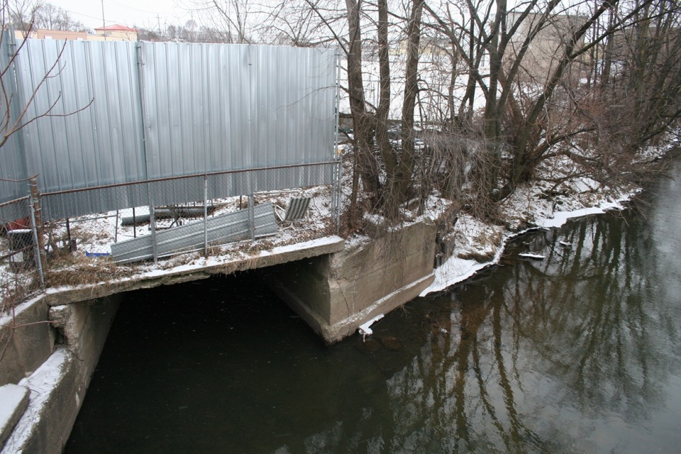
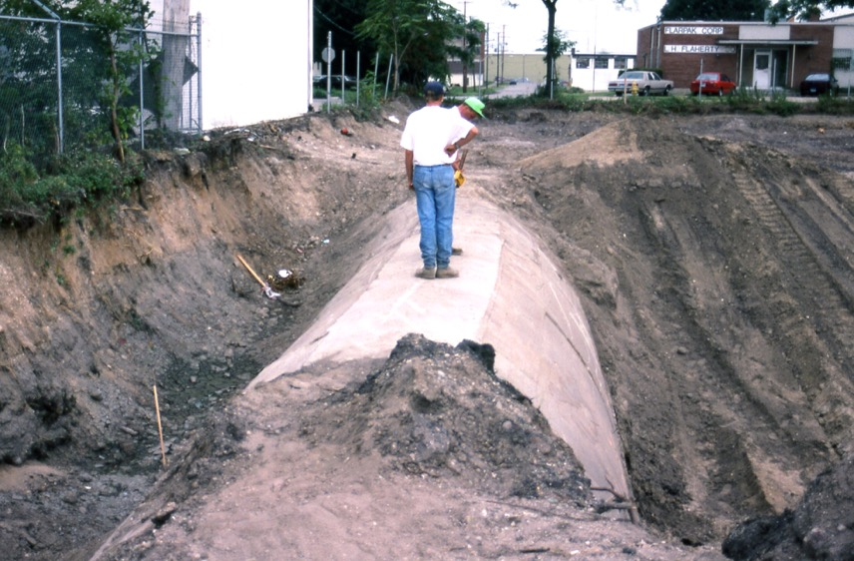
Silver Creek, 1995

Slide 22
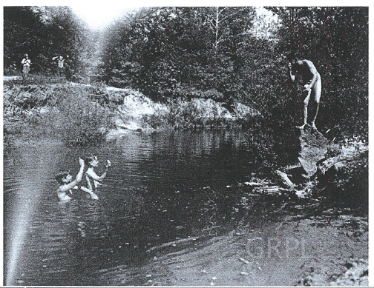

Slide 23
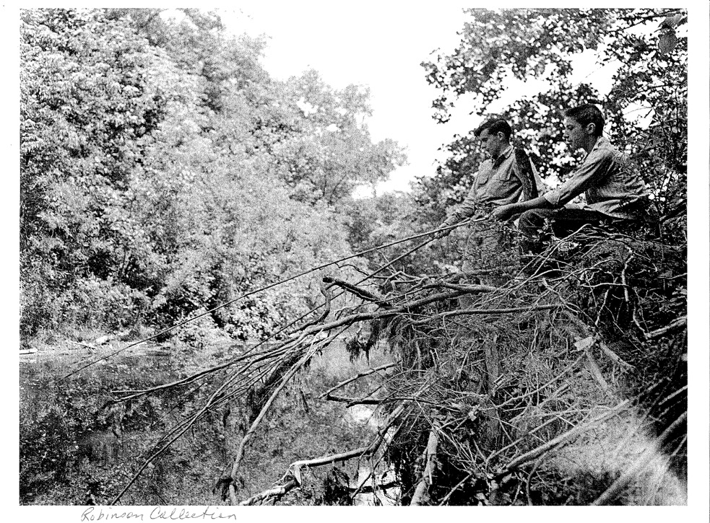

Slide 24
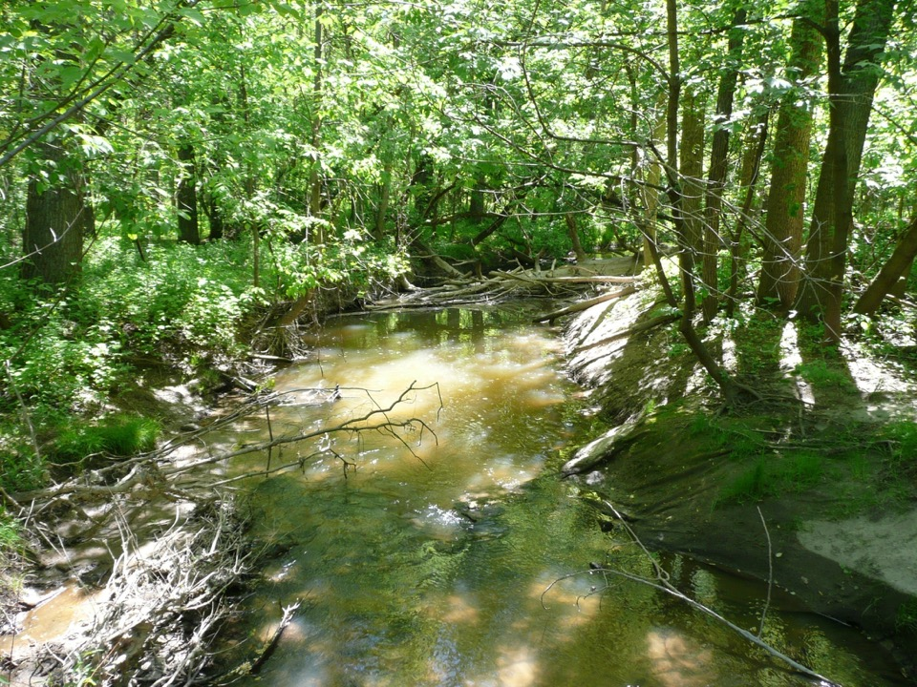
Status of the watershed today

Slide 25
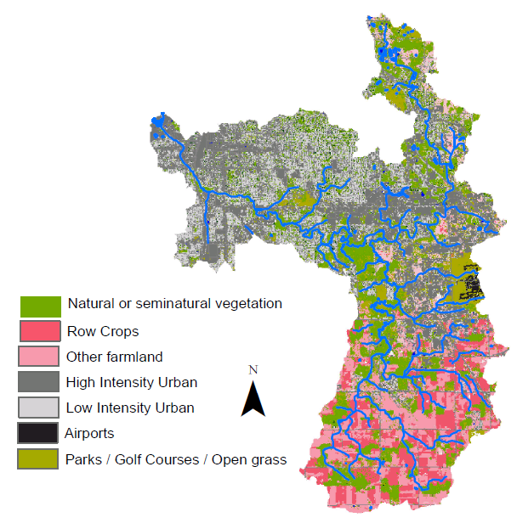
Addition of M-6 (!)
Notes:
Habitat loss
Habitat fragmentation—consequences for extinction rates, genetic diversity, invasibility of terrestrial ecosystems

Slide 26
Rare/charismatic species
Walleye (spawning, especially Bur oak/Silver creek)
Brook trout
Prairie smoke on sandy bluffs
Beak grass along creek
Orchids in streamside seeps
Virginia bluebells in riparian woods
Last seen in 1897
State special concern
State endangered

Slide 27
“Designated uses” of Plaster Creek
Use | Status
Indigenous aquatic life/wildlife habitat | Impaired
Warm water fishery | Impaired
Partial body contact recreation | Threatened
Total body contact recreation | Impaired
Agriculture (irrigation) | met
Source: Plaster Creek Watershed Management Plan. Fishbeck, Thompson, Carr, & Huber, Inc. 2008
An environmental issue and a social justice issue
Notes:
Explain that from here on my discussion is based loosely on the FTC&H report, which is the ‘official’ management plan for the watershed…

Slide 28
What causes these impairments?
E. coli contamination
Nutrient pollution
Thermal pollution
Toxic substances
Sediment

Slide 29
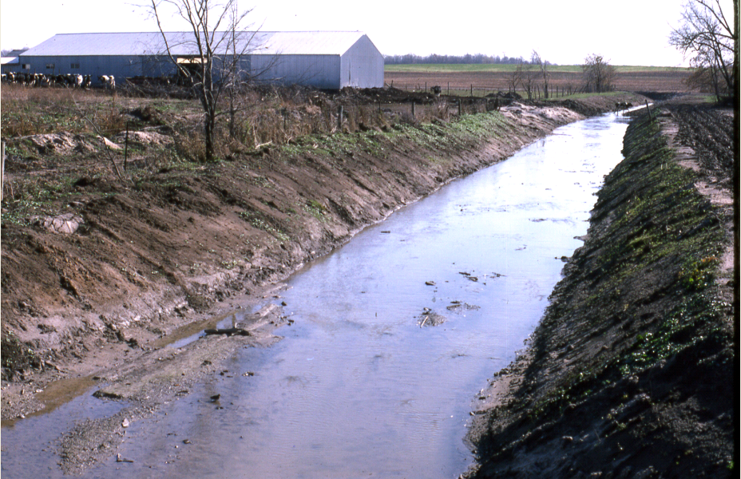
E. coli
Sources
  Cattle access to the creek
  Runoff from animal agriculture/feedlots
  Pet waste
  Faulty sewer connections and septic tanks
  Wildlife
Need molecular markers
Result: 12 of the Creek’s 14 miles are unsafe for human body contact
  WQS For safe full body contact: <130 E. coli per 100ml as a 30-day mean, with no more than 300 in any single reading. (dry weather max=24,200; wet weather=104,620
Notes:
Explain TMDL

Slide 30
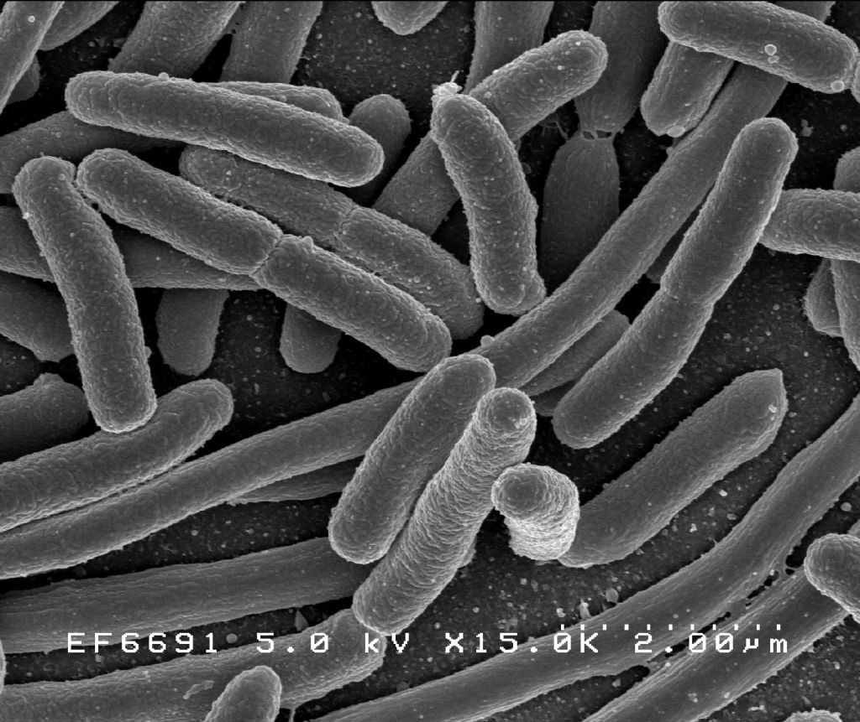

Slide 31
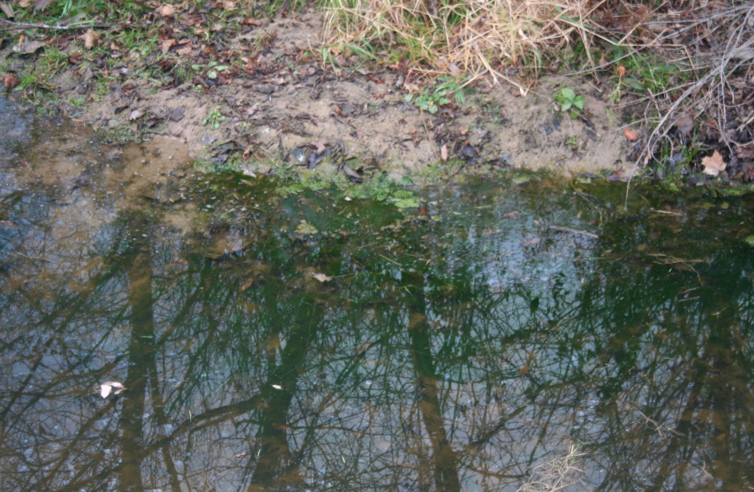
Nutrient pollution

Slide 32
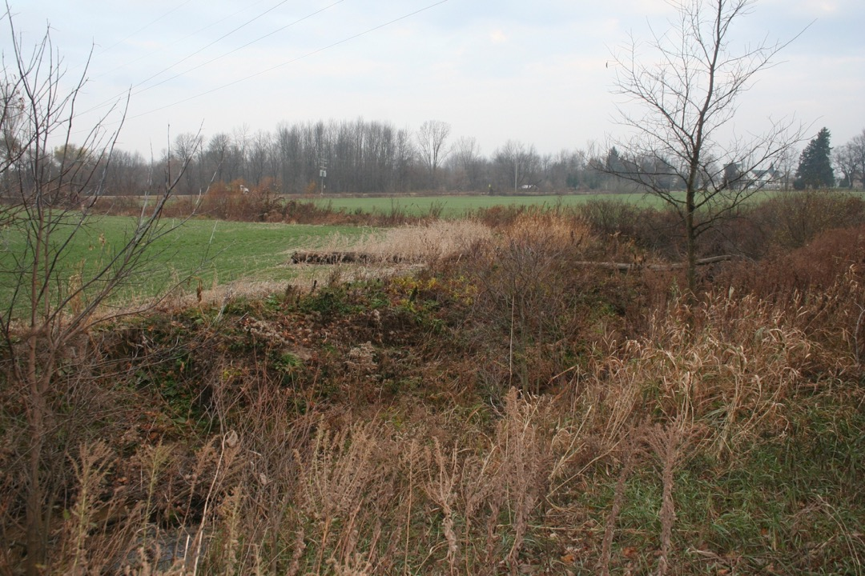
Nutrient pollution
Causes:
Sediment
Animal manure (agricultural, pets, wildlife)
Other fertilizers (agricultural, residential, golf courses)
Sewers and septic systems
Notes:
Something about behavior of nitrogen and phosphorous. Mention phosphorous ban, and which types of land it affects.

Slide 33
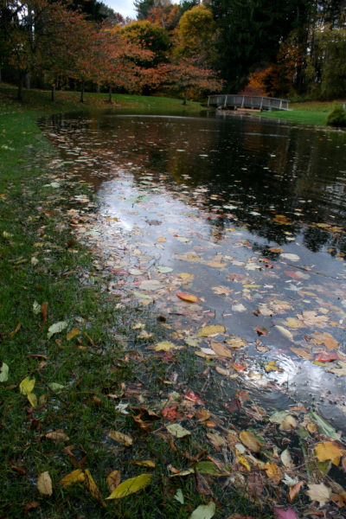
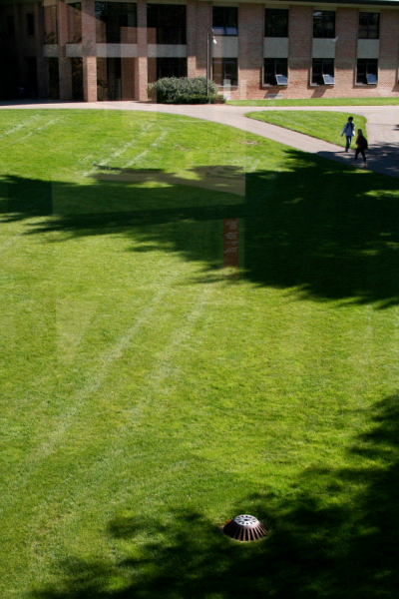

Slide 34
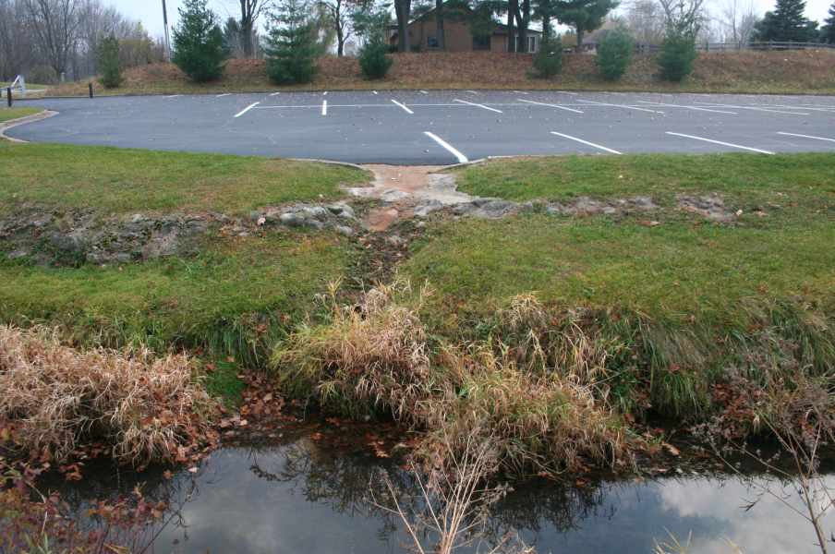
Thermal Pollution
Notes:
Include figures with temperature over time for a healthy watershed and a nasty one

Slide 35
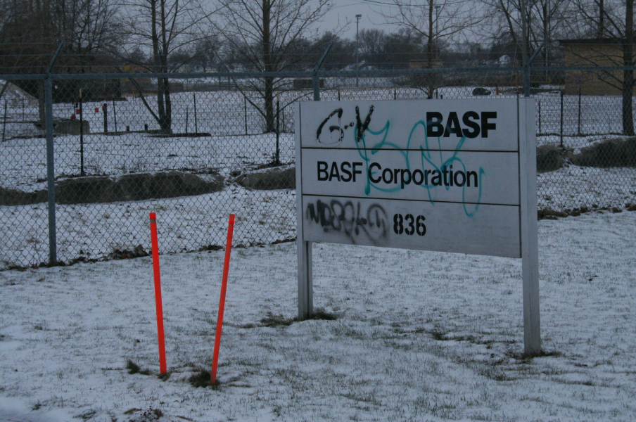
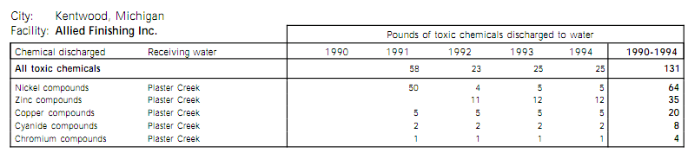
Toxic substances
Point source: Former automotive plastics plant on Plaster Creek at Breton & 32nd was listed in 2008 as the 3rd most toxic factory site in Kent/Ottawa counties
Non-point source: Roads, automobiles, runoff from impervious surfaces throughout the watershed
Former BASF plant on Plaster Creek at Chicago drive was listed in 2008 as the 8th most toxic factory site in Kent/Ottawa counties

Slide 36
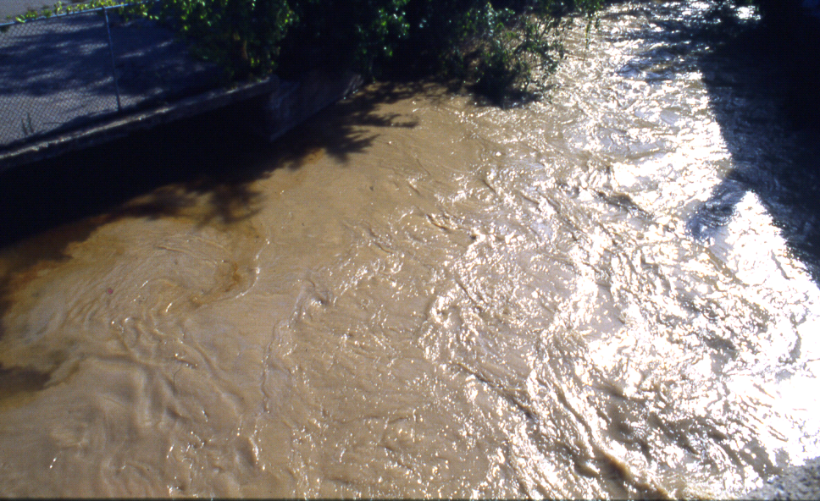
1988

Slide 37
Siltation
Sediment load estimate: 180 tons per year

Slide 38
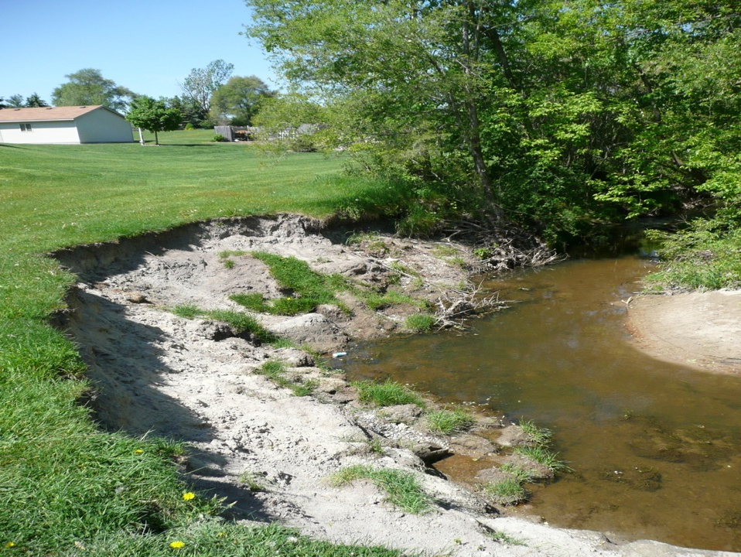

Slide 39
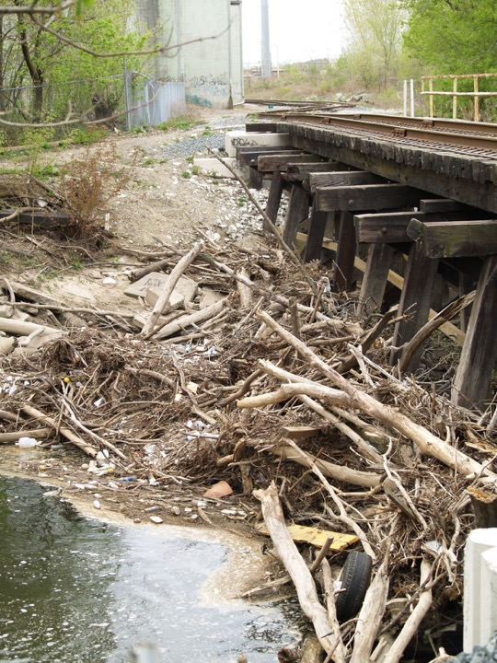
Bank erosion
Flooding
Log jams

Slide 40
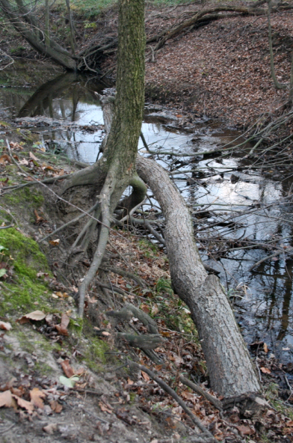

Slide 41
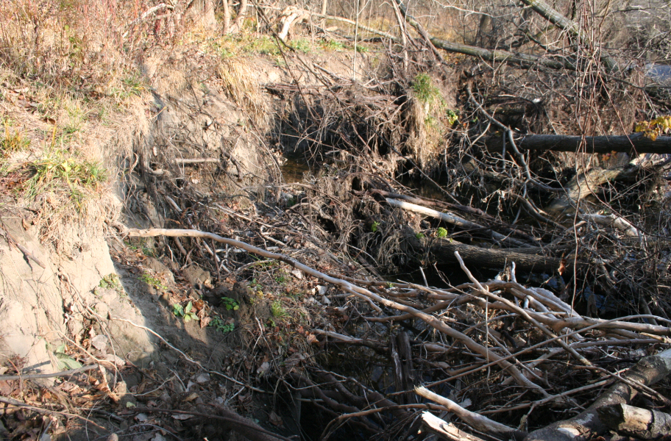

Slide 42
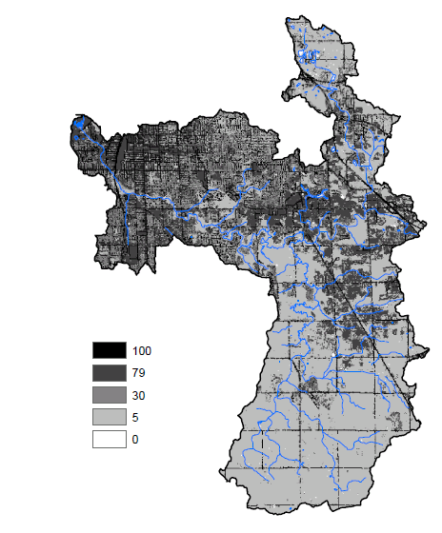
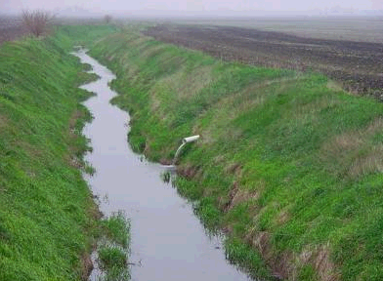
Runoff causes flashy flow rates and flooding
Approximate % impervious surfaces
Tile drains!
Compaction!
http://esciencenews.com/articles/2010/09/27/tile.drainage.directly.related.nitrate.loss
Notes:
Another interesting note: many of the farmers in the upper watershed are facing pressure from development. This has two effects; first, the amount of paved and developed surface in the upper watershed is likely to increase drastically in coming decades. Second, since farmers intend to sell their land instead of passing it on to their children, they are less likely to be interested in updating practices to be environmentally friendly or take a long-term view in terms of land management.

Slide 43
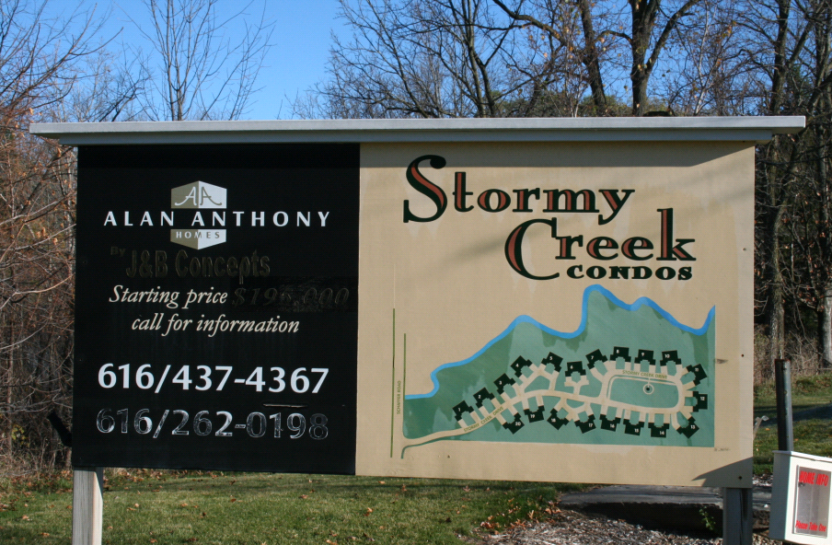

Slide 44
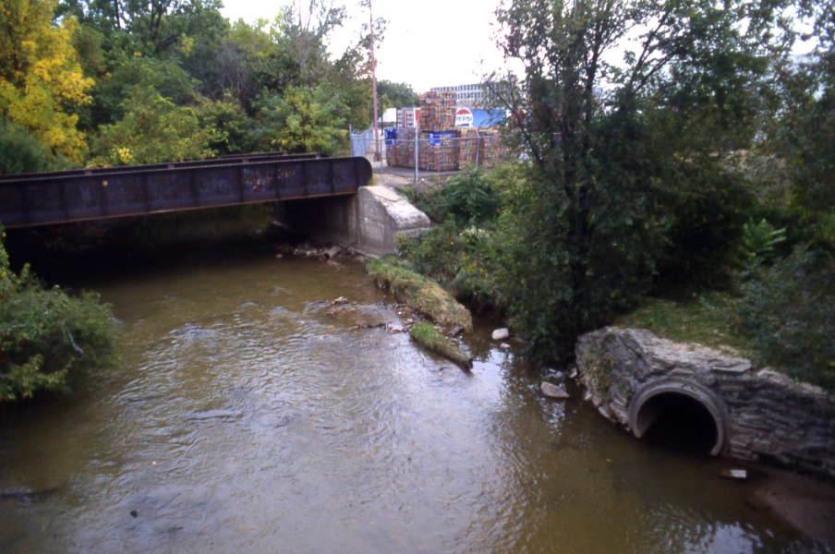


Slide 45


Slide 46
A lament for the Creek:
… That stream was my playground. …We knew the individuality of a great many trees, the location particularly of the sycamore that had been eaten out by decay and provided a safe retreat for us on every occasion when it rained. We knew the deep hole which was afterward turned into a swimming place in summer and a skating rink in winter; we knew the kinds of fish that made their home in that creek. We even had a boat a paddled up the stream for miles and enjoyed each summer the beauties of that most delightful natural playground.
[Plaster Creek] has almost nothing now in the way of tree growth from its source to ifs confluence with the Grand River, and instead of being the beautiful evenflowing stream throughout the year, as in my childhood, it is now a most fitful affair, full to the brim and running over at times, yet most of the year it is only a trickling rill.
The playground is gone. Where there was one child then to enjoy that playground there are now eight thousand children who ought to have a playground like this, but a near sighted utilitarianism has snatched it away. We have stolen their rightful heritage from them.
-Charles W. Garfield, “The Peoples Play Grounds” Fortieth Annual Report of the Secretary of the State Horticultural Society of Michigan, 1910.

Slide 47


Slide 48


Slide 49


Slide 50


Slide 51


Slide 52


Slide 53
COMPACTED AGRICULTURAL SOIL
No riparian vegetation
TILE DRAINS
IMPERVIOUS SURFACES
RUNOFF
Flashy flow
Log jams
Streambank erosion
Cattle Access
Siltation
Notes:
In sum…

Slide 54

Streambank erosion
Pollutant priority
Urban runoff
Sediment
Higher
Agricultural runoff
Construction
E. Coli contamination
Animal waste
Septic systems
Nutrient pollution
Faulty sewer connections
Thermal pollution
Lawn fertilizer
Toxic substances
Lower
No riparian vegetation
Illicit dumping in storm sewers
Notes:
Many complex, interacting factors

Slide 55
Best Management Practices (BMPs) identified in the Plaster Creek Watershed Mgt Plan
Streambank erosion
Urban runoff
Wetland restoration
Agricultural runoff
Low impact development (LID)
Construction
Protect green spaces
Fences
Animal waste
Streambank stabilization
Septic systems
Education on manure spreading and feedlot runoff
Faulty sewer connections
No-till agriculture, cover crops
Lawn fertilizer
Pet waste stations
No riparian vegetation
Filter strips
Label storm sewers
Illicit dumping in storm sewers

Slide 56
Plaster Creek Stewards

Slide 57
Plaster Creek Stewards is a collaboration of community partners, churches, and Calvin College faculty and staff working to restore health and beauty to the Plaster Creek Watershed.

Slide 58
Three parts
Research
  Which areas of the watershed should we prioritize?
  Which problems occur in which areas? Which restoration activities are appropriate in which areas?
  Monitoring
  Historical research
  Biol 250!
Education and Outreach
  Spring and fall events—education and volunteer components
  Summer workshops
  Partnerships among churches, environmental organizations, government, businesses… (WMEAC, DNRE, Friends of Grand Rapids Parks, KCD, Pioneer Construction…)
On-the-ground restoration
  Hydrology & habitats
Roosevelt Park CRC
Woodlawn CRC
Alger Park CRC
Madison CRC
Christ Church
Church of the Servant

Slide 59



Summer workshops
Notes:
Outline what happens at summer workshops… I haven’t been to one yet

Slide 60



Slide 61

“Implementation arm”
Native Landscapes provides:
  Landscape consulting
  Site designs
  Native plants (241 species collected this year… greenhouse additions soon…)
  ‘Installation’
Includes the Plaster Creek Watershed, but also greater Grand Rapids
Profits:
  Funding for Plaster Creek Stewards
  Subsidize native gardens for schools, etc.
Plaster Creek Stewards
Native
Landscapes
Notes:
‘complimentary initiative’

Slide 62


Restore biodiversity, restore ecosystem function
Resources for crop pollinators
Poa pratensis
Wildlife habitat
Resources for natural enemies of ag pests
Carbon sequestration
Nutrient uptake
Erosion control
Microbial diversity

Slide 63





Slide 64


Slide 65


Slide 66


Site designs…

Slide 67




Slide 68

Catalyst Partners

Slide 69


Slide 70





Slide 71




Slide 72
Ways to get involved
Plaster Creek Stewards spring event (April 30)
Come to the Plaster Creek Stewards summer workshop (June 14-15)
Learn about your own watershed
Lots of volunteer opportunities
  Help plant gardens
  Other workdays (e.g. seedling transplants)
Speak up
Nate Haan: nlh3@calvin.edu

