Slide 1
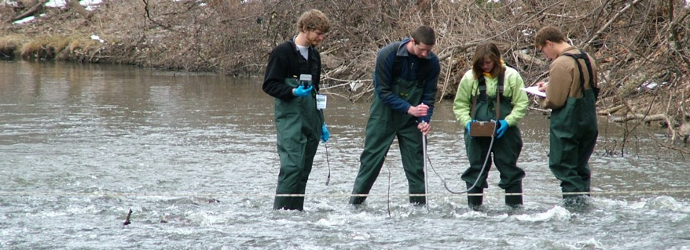
Loving Our Downstream Neighbor:
Plaster Creek Stewards
Watershed Restoration
Initiative
Dave Warners, Gail Heffner,
Michael Ryskamp
Calvin College
Notes:
(Gail) We’re grateful for this opportunity to tell you about the exciting work that is unfolding and gaining momentum. This is a project that emerged about 8 years ago as an effort to engage faculty and students in an issue of community concern.
(Dave) This is a watershed restoration initiative and it’s interdisciplinary in scope. Mention our backgrounds.
(Gail) Everyone lives in a watershed. Every school, every church, etc….exists in a watershed. Life happens in watersheds. Some cultures recognize this much better than others (i.e. New Zealand). Calvin’s property straddles the divide between 2 watersheds---to the North water flows off our campus to Reeds Lake and is part of the Coldbrook Creek watershed. To the south water flows from the Preserve through Whiskey Creek under the East Beltline and into the Sem Pond, then under Burton Street and eventually into Plaster Creek. What was startling for us to discover is that Plaster Creek is the most polluted stream in West Michigan. Plaster Creek Stewards has emerged as an initiative to address this huge problem. We are a Reformed Christian college and our primary mission is teaching and research that contributes to addressing the brokenness in our world. (and leads to transformation)… Add something here about embodied faithfulness

Slide 2
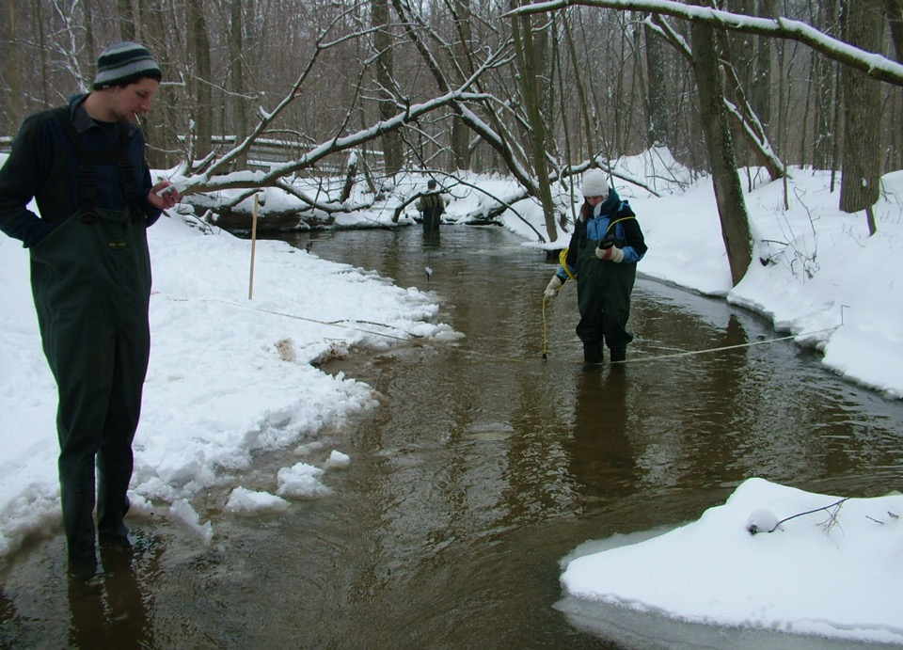
Outline
Context
Watershed Basics
Plaster Creek Watershed
Plaster Creek Stewards
Restoration Beginnings

Slide 3
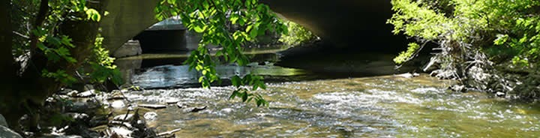
Context
Pedagogy of Place: Educational approach that encourages active, inquiry-based learning in a way that enhances the social, economic, political and ecological life of the places in which the education occurs.
Reconciliation Ecology: The science of restoring, creating and maintaining habitats, and conserving biodiversity in the places where people live, work, or play. Re-inventing the human presence to better accommodate, affirm, and fit into the landscape of biodiversity which surrounds us.

Slide 4
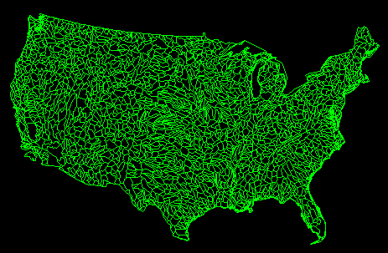

Slide 5
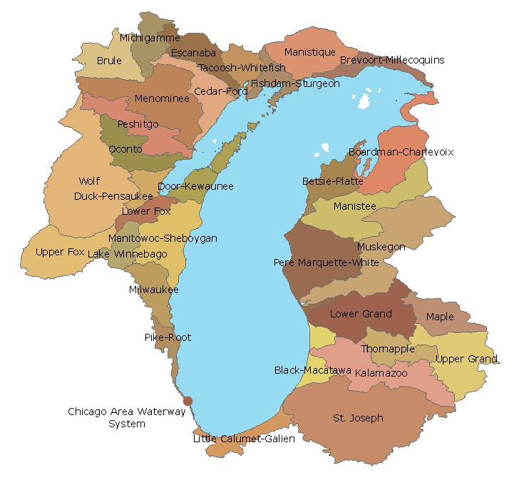
Lake
Michigan
Watershed
Notes:
Lake Michigan too has a watershed which at this scale is often referred to as a ‘drainage basin.’

Slide 6
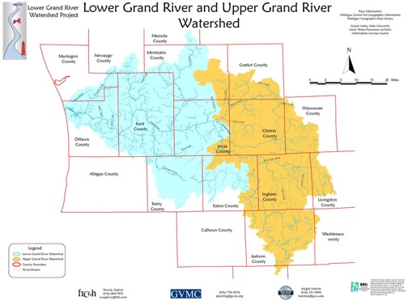
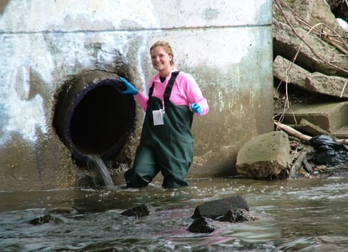
Plaster Creek Watershed and Place-based Reconciliation Ecology
Watershed: Area of land that drains to a common point
Watersheds are wonderful integrators
Plaster Creek Watershed:
- Most contaminated watershed in
West Michigan
Notes:
Transition to next slide: Now, if we focus in on Kent County we can show you where the PC Watershed is specifically located

Slide 7
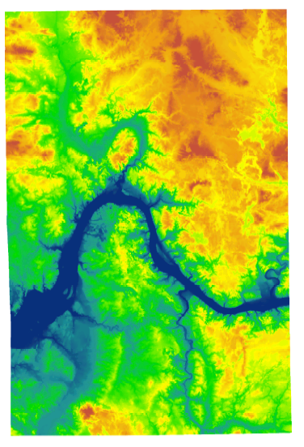
Notes:
Digital elevation map that shows the contours of Kent County . . . Rogue River here, Thornapple river here and (press button) this is the PC watershed

Slide 8
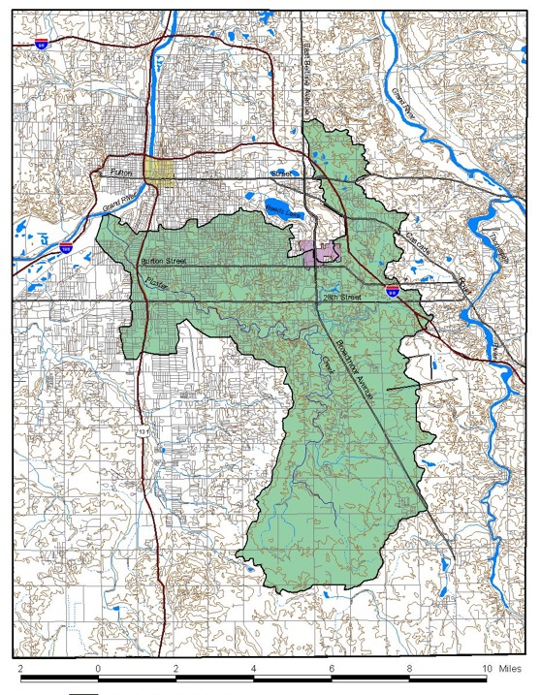
Plaster Creek &
Its Watershed
Landscape elements:
Substrate: deep glacial till,
mix of sand, clay, gravel
Historic land cover: forest
ecosystems – oak, maple
Present land cover:
agricultural, suburban,
commercial, lower-income
urban, industrial
>50% of Calvin faculty and staff, >3200 alumni

Slide 9
People who live at the lower ends of watersheds cannot be isolationist—or not for long. Pretty soon they will notice that water flows, and that will set them to thinking about the people upstream who either do or do not send down their silt and pollutants and garbage. Thinking about the people upstream ought to cause further thinking about the people downstream. Such pondering on the facts of gravity and the fluidity of water shows us that the golden rule speaks to a condition of absolute interdependency and obligation. People who live on rivers might rephrase the rule in this way: Do unto those downstream as you would have those upstream do unto you.
-From Watershed and Commonwealth
by Wendell Berry

Slide 10
History of Plaster Creek
16,000 ya Glacier recedes
2,000 ya Native Americans - Hopewell
1500 Odaawaa Indians
1615 Samuel de Champlain
Kee-No-Shay Creek, Burr Oak Creek
Early 1800s – Chief Blackbird
1826 - Grand Rapids founded by missionaries
1841 – First plaster mill
1900 – Brook trout from Plaster Creek
1940s – Silver Creek culverted
2009 – Plaster Creek Stewards
2011 Green Grand Rapids Master Plan

Slide 11
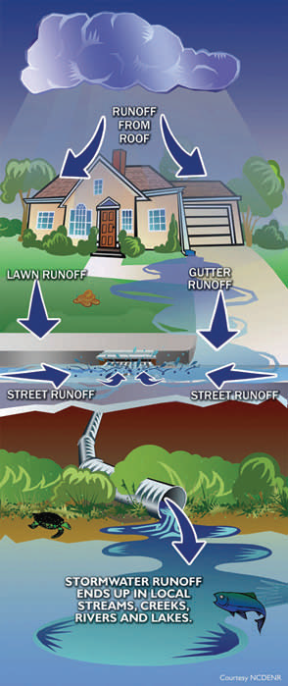
Urban Residential Influences
In urban areas, the cumulative effect of water coming off individual homes and yards significantly impacts an urban waterway in many different ways.
The quality of water draining out of a watershed teestifies to how careful people are living within that watershed.

Slide 12
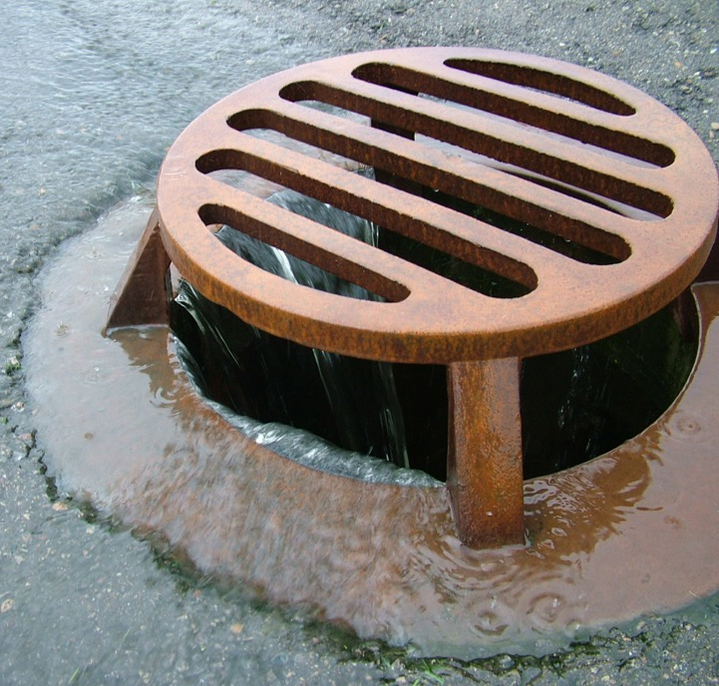

Slide 13
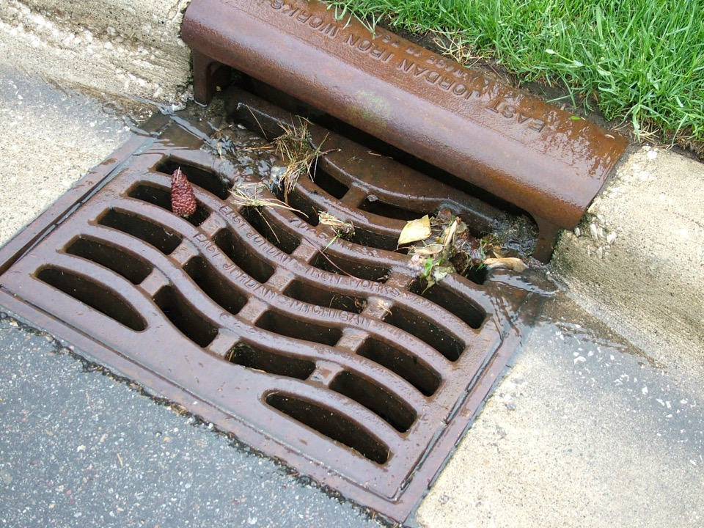

Slide 14
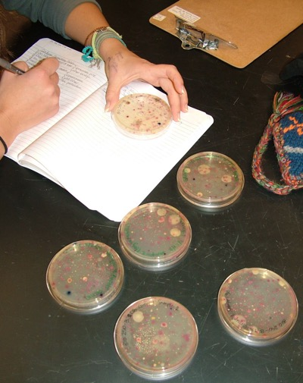
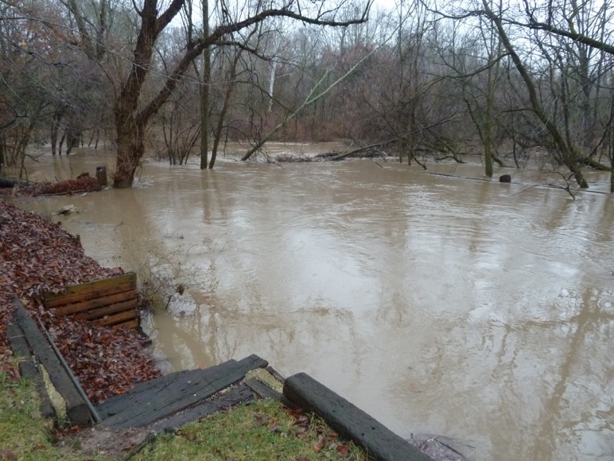
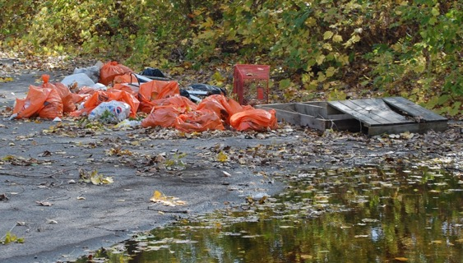
Plaster Creek Problems
Flow dynamics (volume)
Sediment
Bacterial contamination
Nutrient pollution
Thermal pollution
Trash and Toxic substances

Slide 15
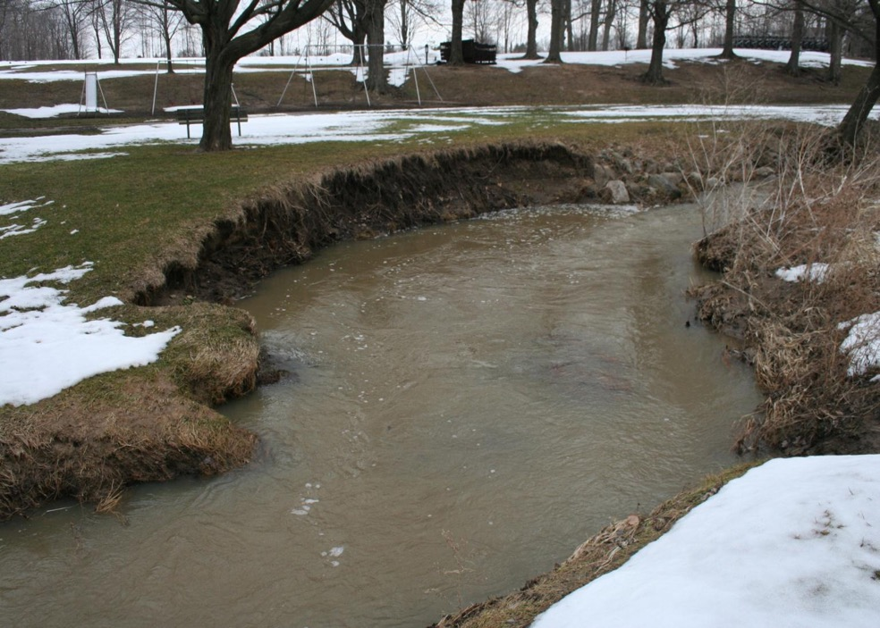

Slide 16
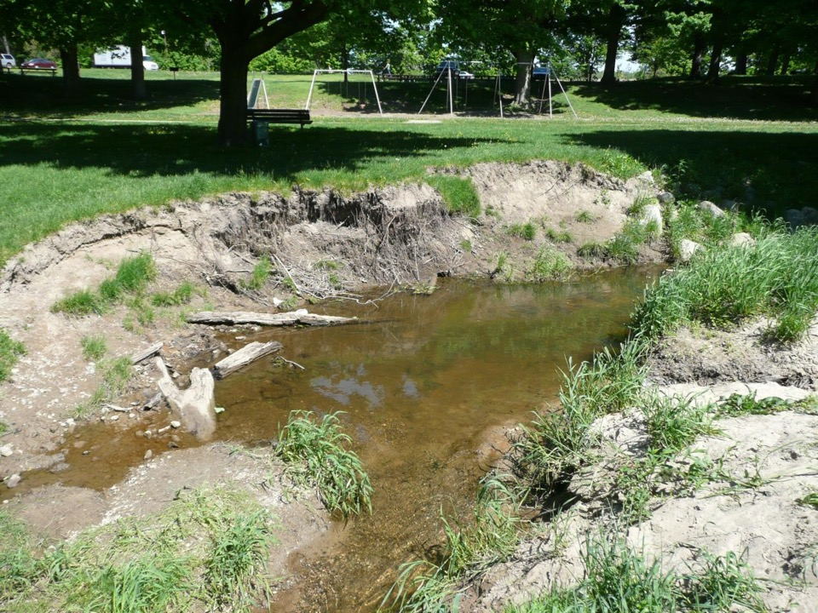

Slide 17
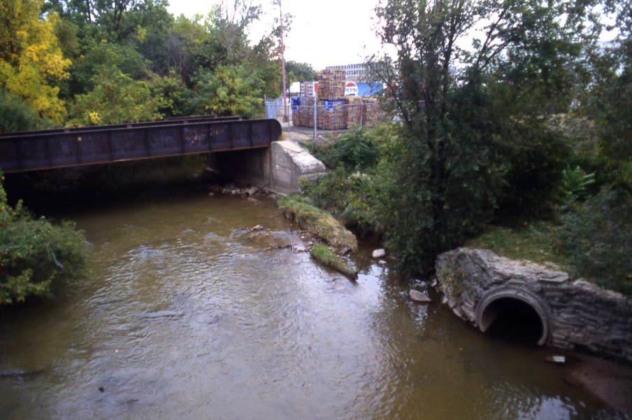
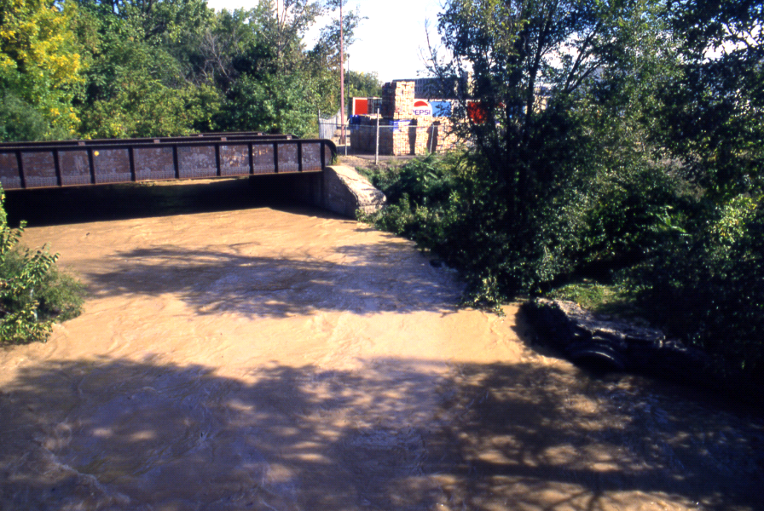

Slide 18
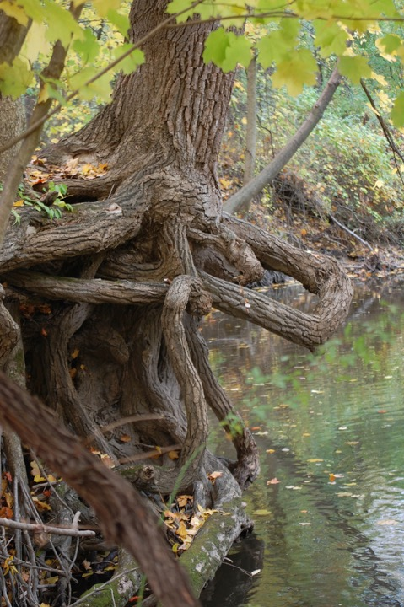
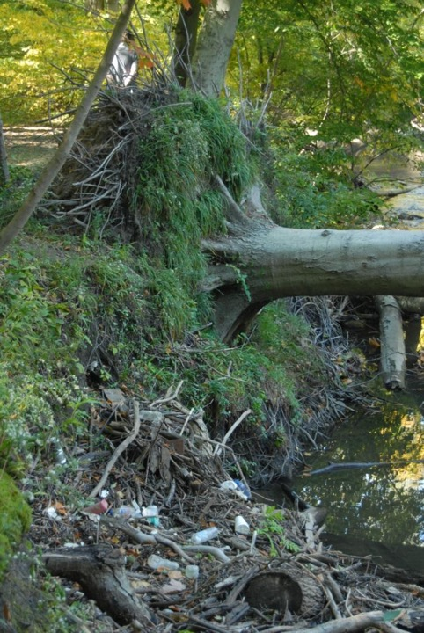

Slide 19
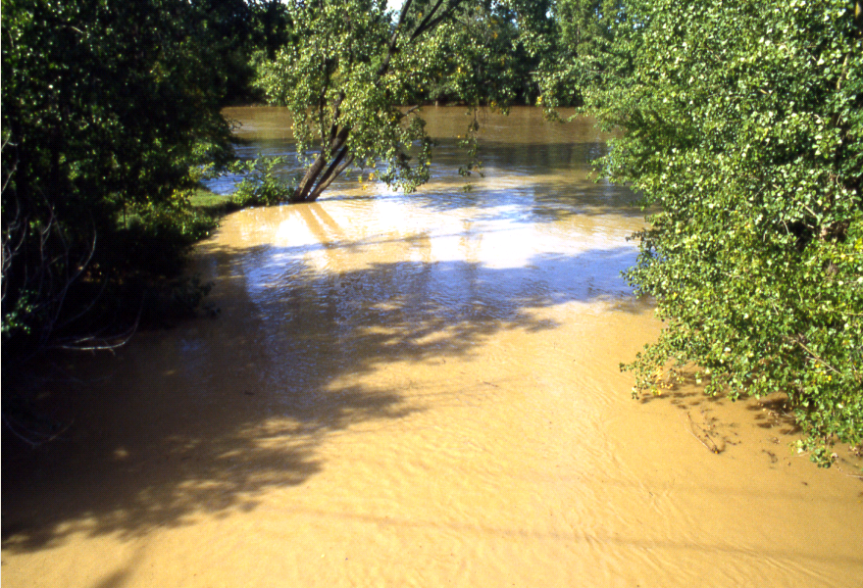

Slide 20
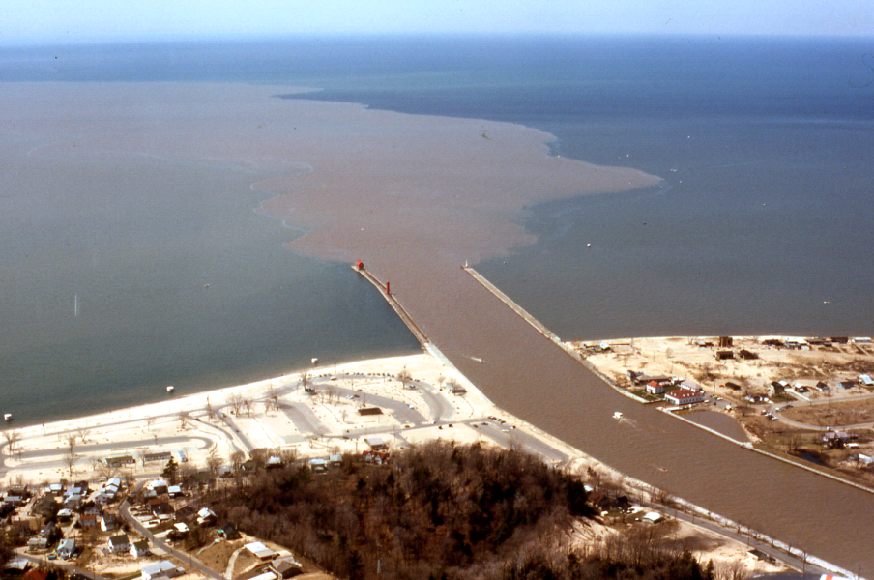

Slide 21
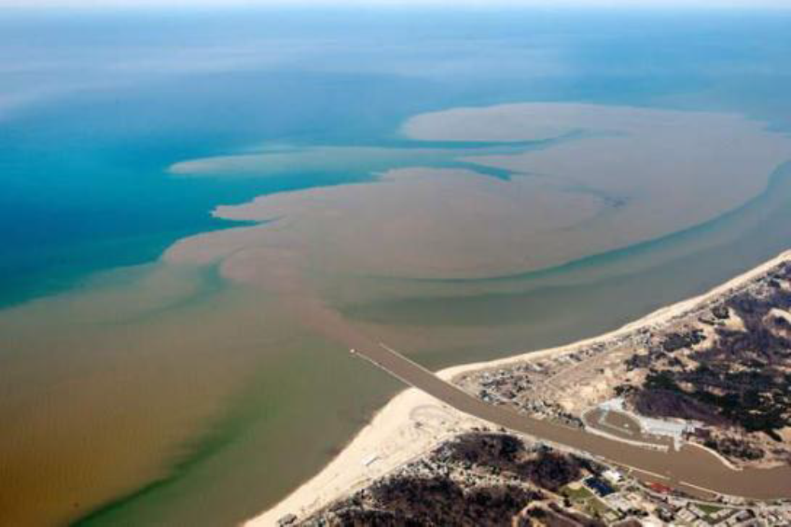

Slide 22
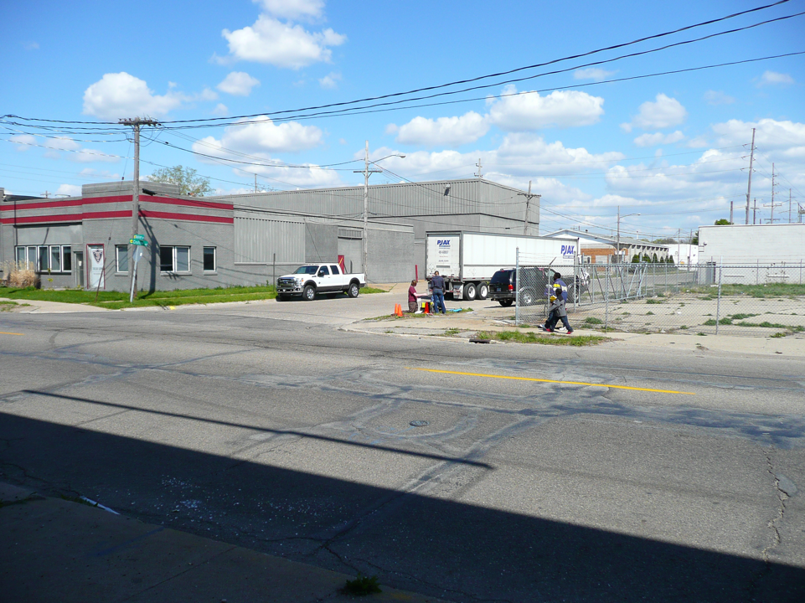
How do we begin restoring health to the watershed?

Slide 23
History of Plaster Creek Stewards
Early service learning projects (2002)
Plaster Creek Working Group (2004)
Regular Meetings with Community Partners
  MDEQ Question (fall 2008)
Creation Care on the Home Front (2009)—funded by CCCS
  ‘Plaster Creek Stewards’ origin
  GR Press and $10,000 anonymous donation
  Hired part time Program Coordinator
Doing Justice To Plaster Creek Summer Workshops (2010- 2012)
Small grants to build new greenhouse (2010)
Strategic planning: focus on research, education, restoration
River Network Grant (2011)— $58,500
Clean Water Act (319) Grant (2013-2015)—$386,162
  With WMEAC, Kent Conservation District, CES, City of GR
Notes:
Calvin’s involvement in our local watershed began in 2002 with service-learning projects (through the Calvin Environmental Assessment Program) designed to develop basic botanical and vertebrate inventories of the stream corridor. These early efforts led Calvin College faculty to dialogue with community partners to consider what could be done in the watershed to address the degraded condition of Plaster Creek.
River Network—1 of 5 funded nationally; particularly interested in PCS because we are based in a college (unique model); we are engaging the local faith community creating upstream-downstream partnerships; focused on restoration on-the-ground
MDEQ—particularly interested in PCS because we are educating students and the public about how to care for water/manage stormwater; because we are convening many community partners to work with us in their areas of expertise.

Slide 24
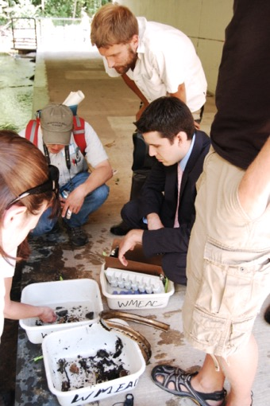
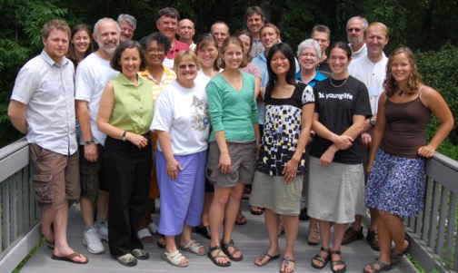
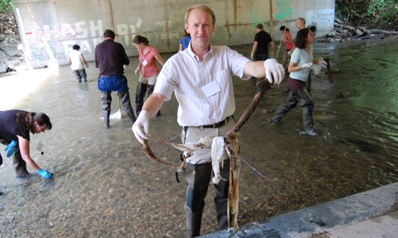
Plaster Creek Stewards
A collaboration of Calvin College faculty, staff, and students working together with local schools, churches, and community partners to restore health and beauty to the Plaster Creek Watershed.
Notes:
So Plaster Creek Stewards has really emerged out of this awareness and concern
These are pictures from our first summer workshop. Among these participants are Calvin students and faculty, community partners, representatives from the denominational building, four local churches, including an assistant from Carl Levin’s office (suit) . . Some of you may recognize Pastor Mike Abma here

Slide 25
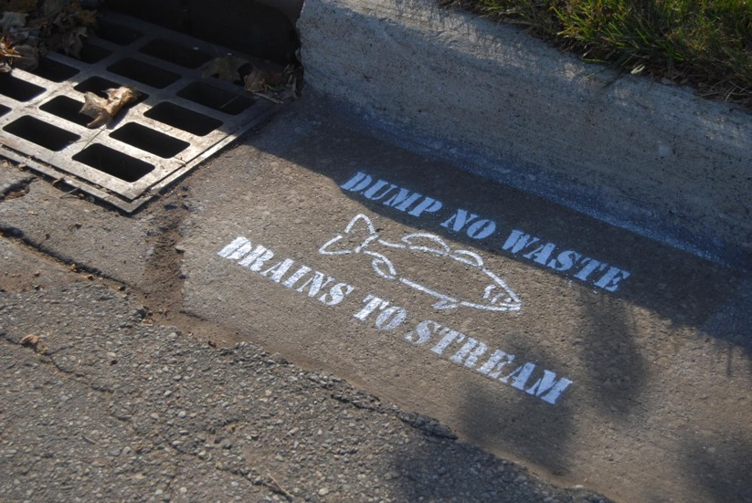
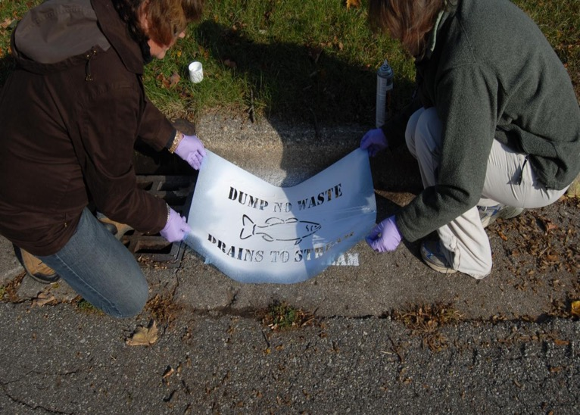
Education and Outreach builds
awareness and concern

Slide 26
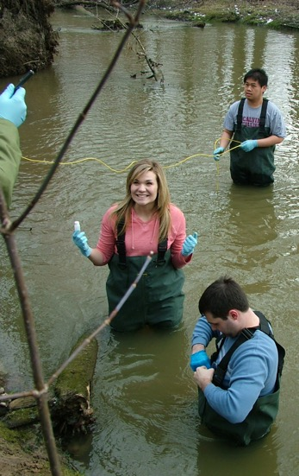
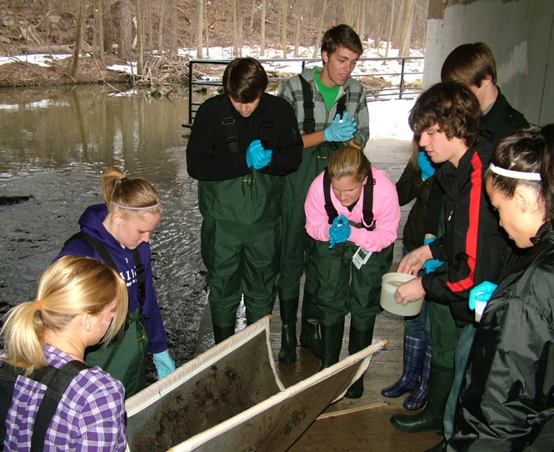
Biological Research leads to better
understanding how best to help the creek
Notes:
Mention GLISTEN – Great Lakes Initiative for Sustainability Through Education Network (???)

Slide 27
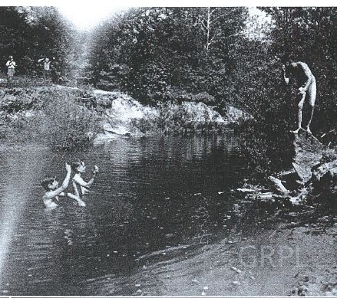
Social Research
Oral History Project: Remembering and
recording stories about
the creek ….
Documenting oral histories becomes a way to engage people in watershed protection
Stories are submitted to the Community Voices archive at the GR Public Library
Notes:
We are conducting biological research as well as social research.
As we have watched the Plaster Creek Stewards project blossom, residents began to tell stories of their memories of Plaster Creek. An English professor teaching an honors class focused the whole class on the theme of water and students visited Plaster Creek to learn something about its history and current condition. Their final assignment was an oral history project where students met with past and present residents to hear their recollections and tales of the role Plaster Creek has played and still plays in their lives and in the life of their community. Documenting these stories has helped engage students and community members to stretch their imaginations about what is possible in watershed care. These oral history interviews have been collected and are now part of the Community Voices archive at the Grand Rapids Public Library. We see this project as one example of a critical pedagogy of place building momentum for reconciliation ecology.

Slide 28
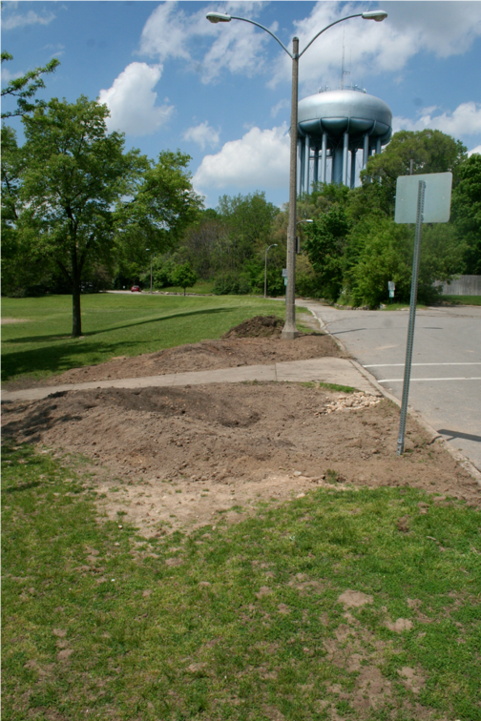
Restoration
Implementing healthier watershed practices and improving native biodiversity

Slide 29
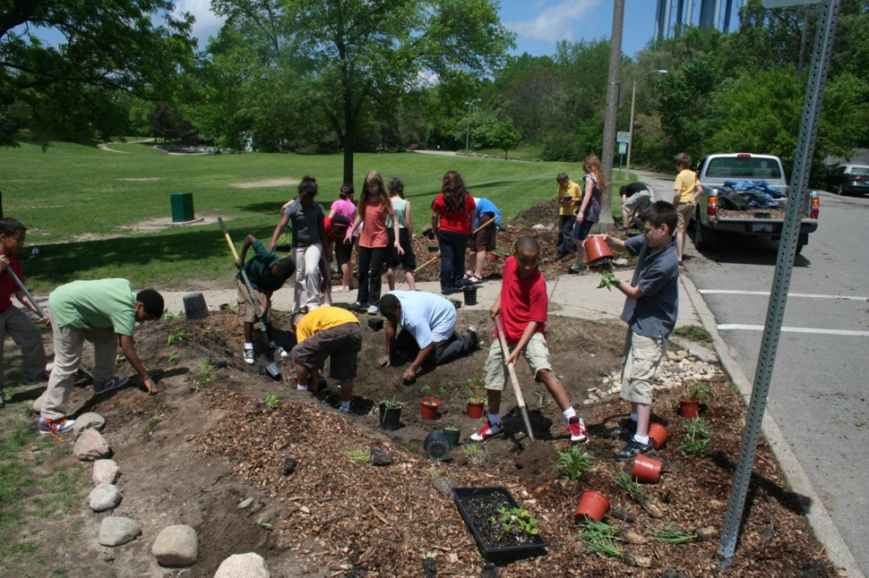

Slide 30
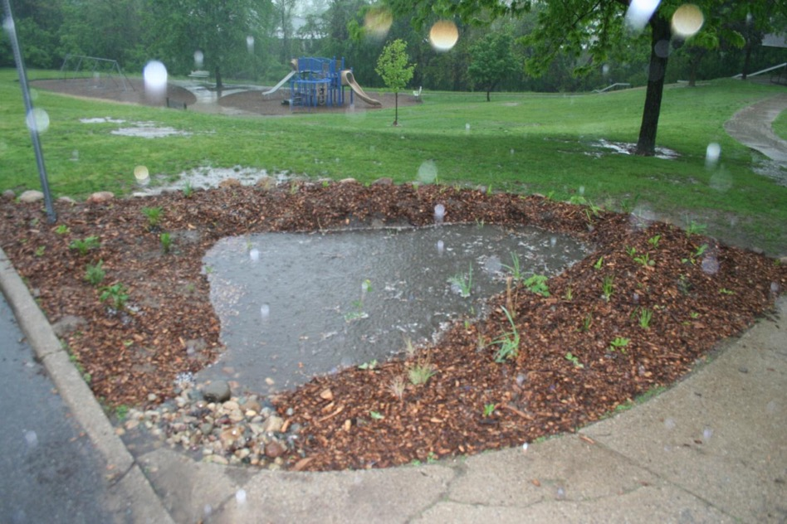

Slide 31
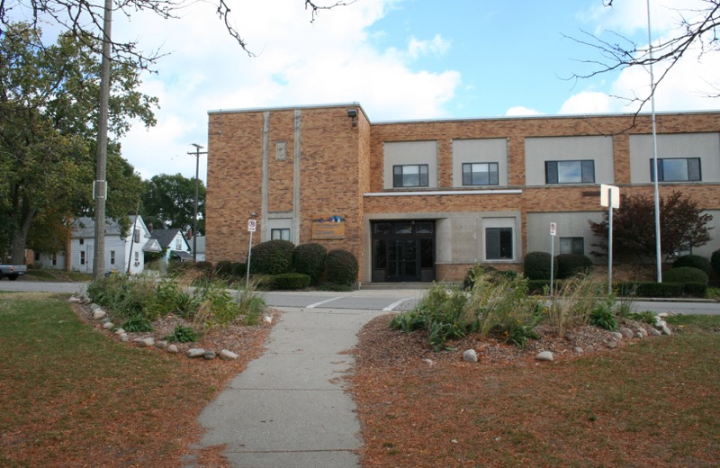

Slide 32
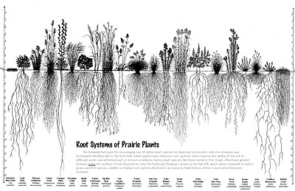
Why native plants?
Deep roots, soak up large volumes of water
Filter excess nutrients, trap excess sediment
Low maintenance - Adapted to local conditions
Biodiversity magnets for insects, birds, other wildlife

Slide 33
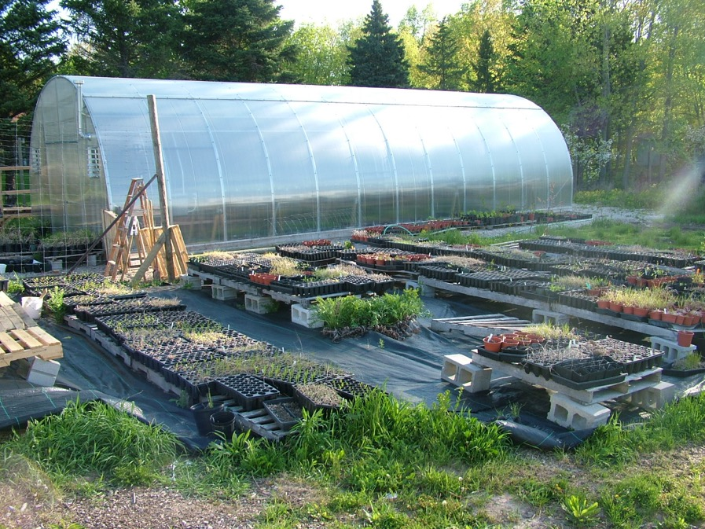

Slide 34
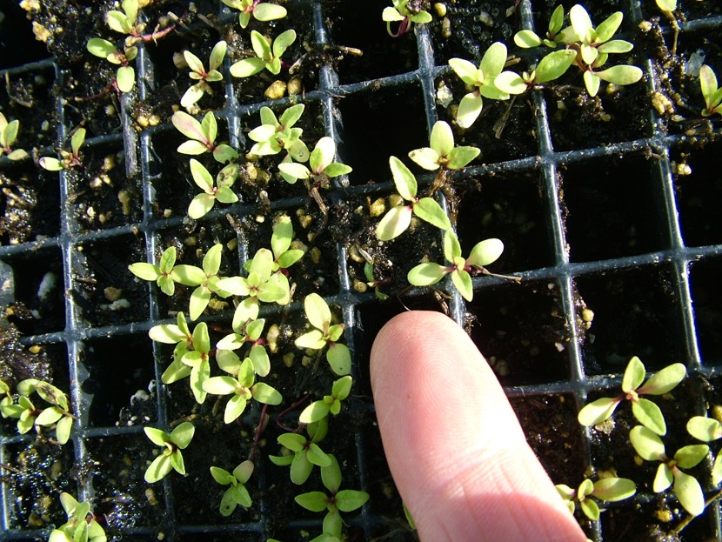

Slide 35
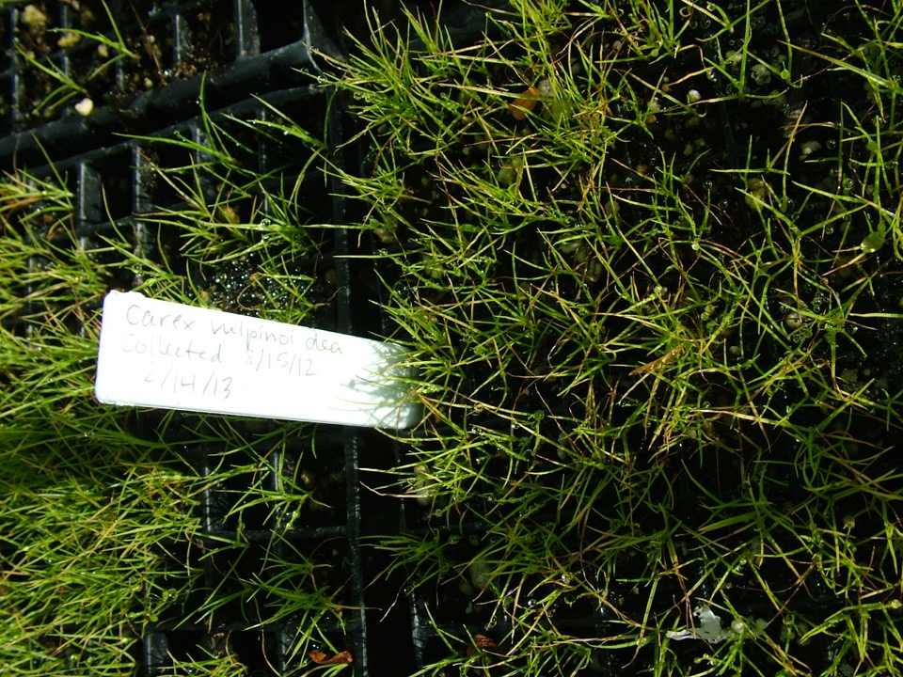

Slide 36
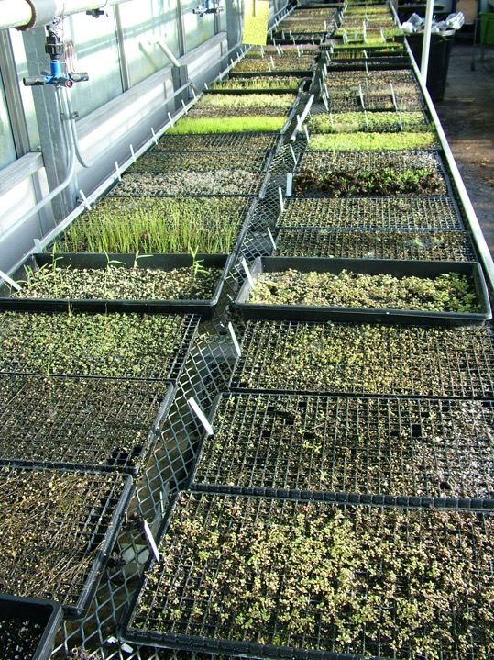

Slide 37
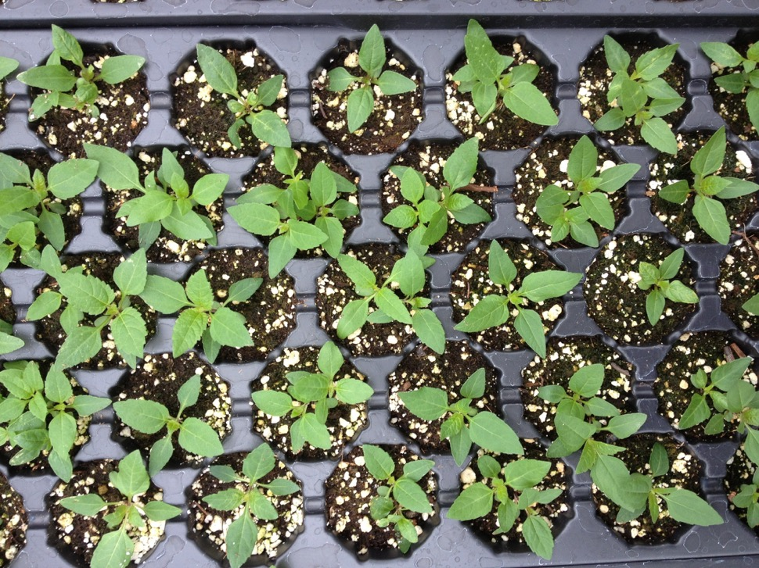
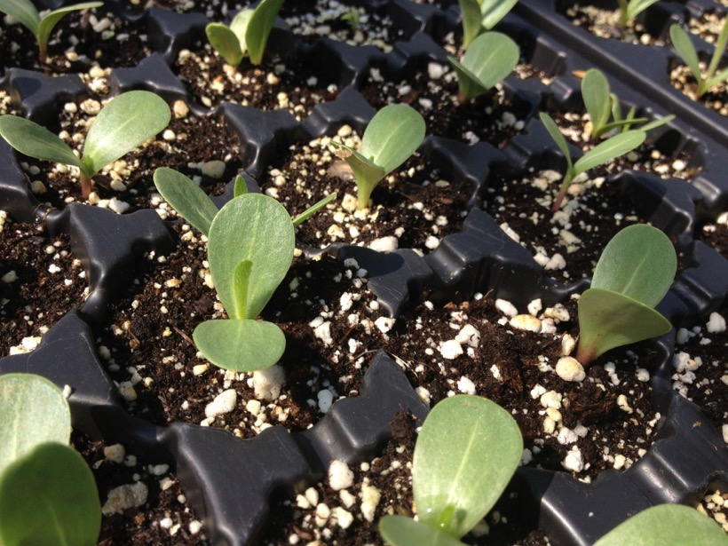

Slide 38
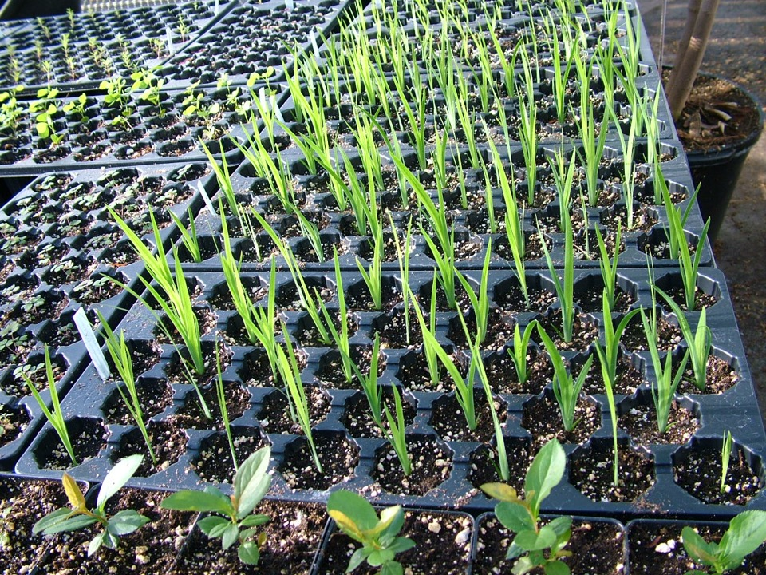

Slide 39
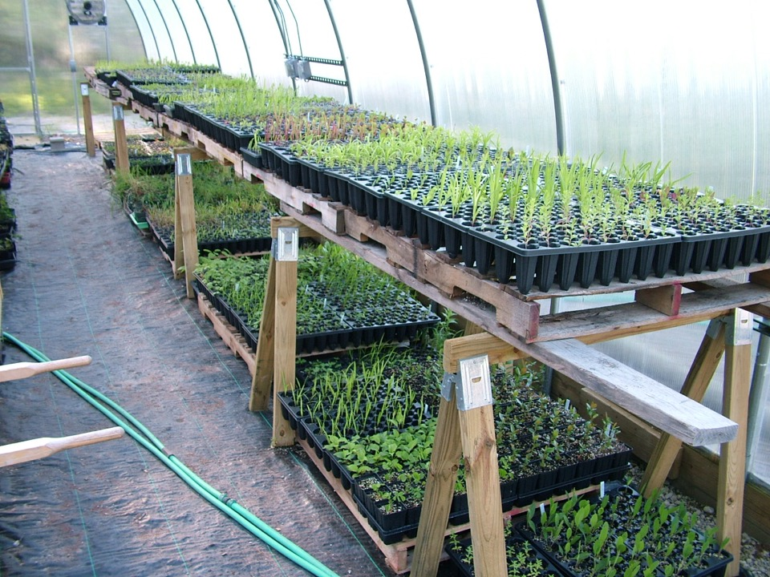

Slide 40
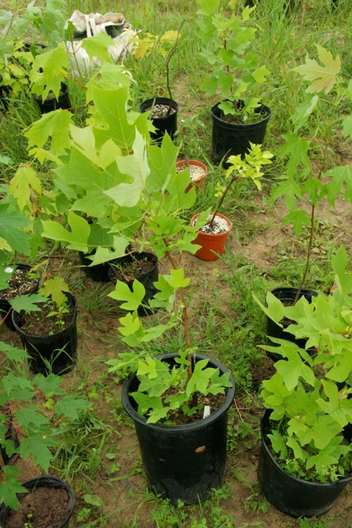
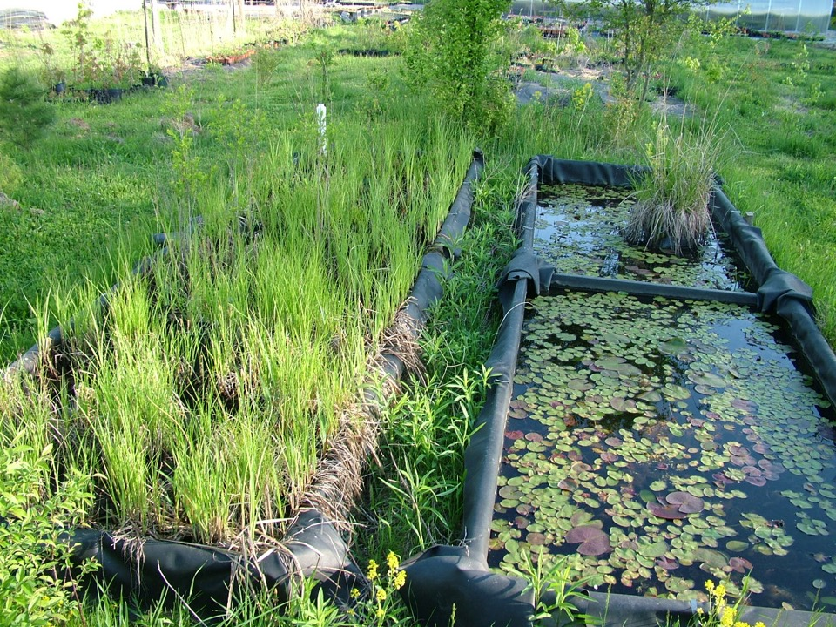
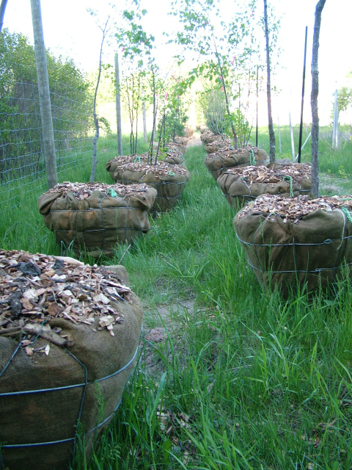

Slide 41
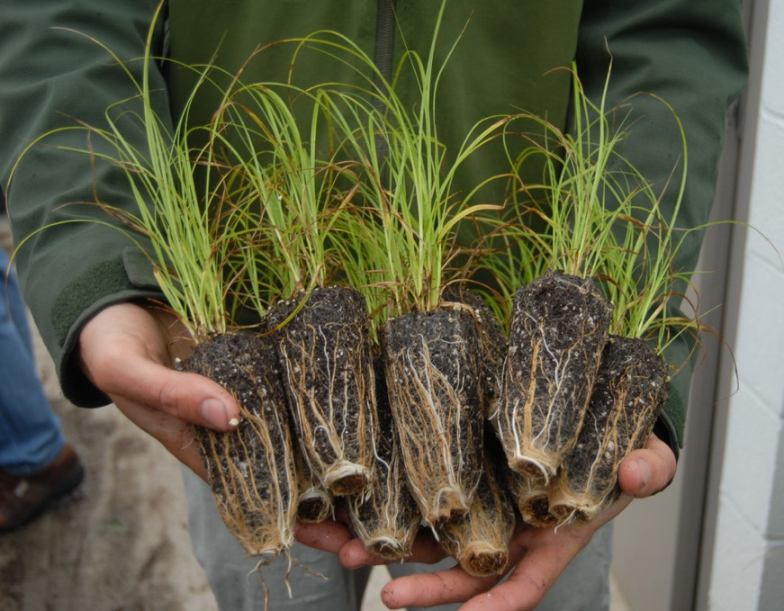

Slide 42


Slide 43

Notes:
With 319 Grant we’ll be doing some educational outreach and training, as well as constructing 4 very large bioswales full of native plants to collect stormwater runoff

Slide 44



Slide 45



Slide 46



Slide 47


Slide 48





One plant
One place
One half hour:
Solidago rigida (Stiff goldenrod)

Slide 49

Another good way to get noticed….

Slide 50



Slide 51

What we can all do
Think about the water we use and what impacts it has on those downstream
Manage our stormwater by using rain barrels and planting rain gardens
Learn about our own watershed
Connect with Plaster Creek Stewards by signing up to receive our biannual newsletter or just follow us at:
www.calvin.edu/go/plastercreekstewards
or google ‘Plaster Creek Stewards’
Notes:
Like us on Facebook

Slide 52



Hopeful
Vision

Slide 53

Thank You!

