Slide 1

My GR City Points
“This first-of-its-kind, local rewards program gives Grand Rapids residents the
opportunity to earn points by recycling and allows residents and non-residents
alike to earn points through volunteering.. Points can then be redeemed for
discounts on products and services at local businesses.”
1. Login or create an account at MyGRCityPoints.com (even if you don’t live in GR!).
2. Redeem your Code: 51WG-BNYS
3. Start earning points by registering your recycling bin and volunteering. Use your points for discounts at participating local businesses and support sustainability in Kent County.
You can earn 500 points volunteering with Plaster Creek Stewards today!

Slide 2
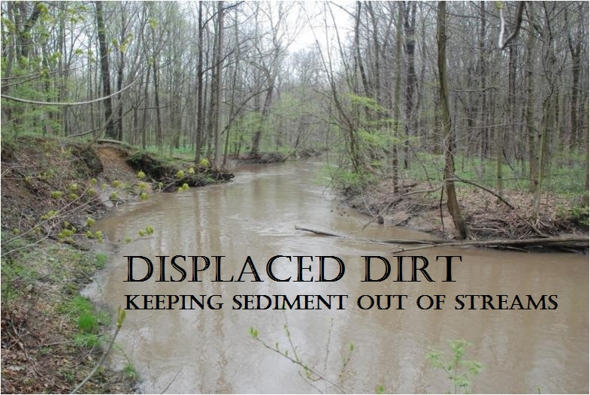
Plaster Creek Stewards
Gail Heffner
Dave Warners
Julie Wildschut

Slide 3
Urban watersheds
What is a watershed?
Everyone lives in a watershed
Watersheds integrate communities
Most urban watersheds are seriously degraded

Slide 4
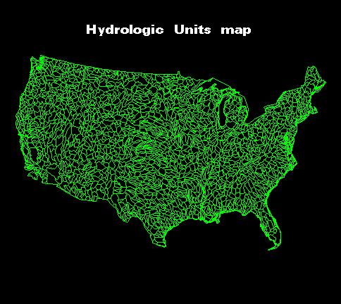
Watersheds are topographical and hydrological units that
integrate the landscape into nested sets of drainages.

Slide 5
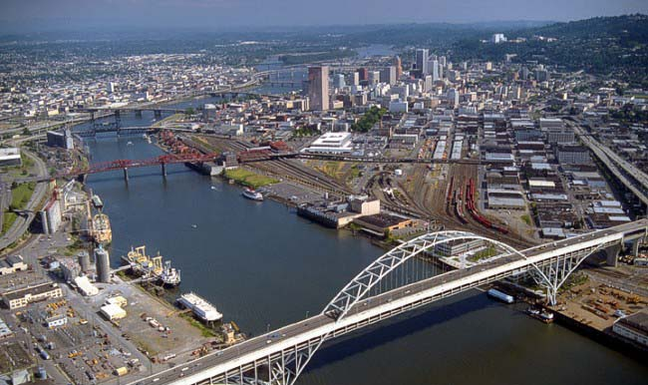
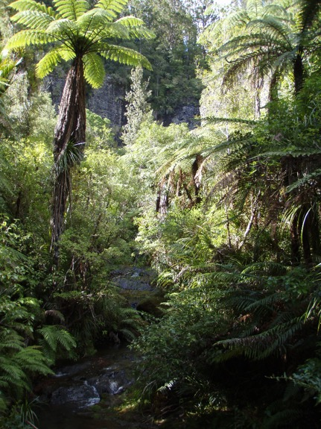
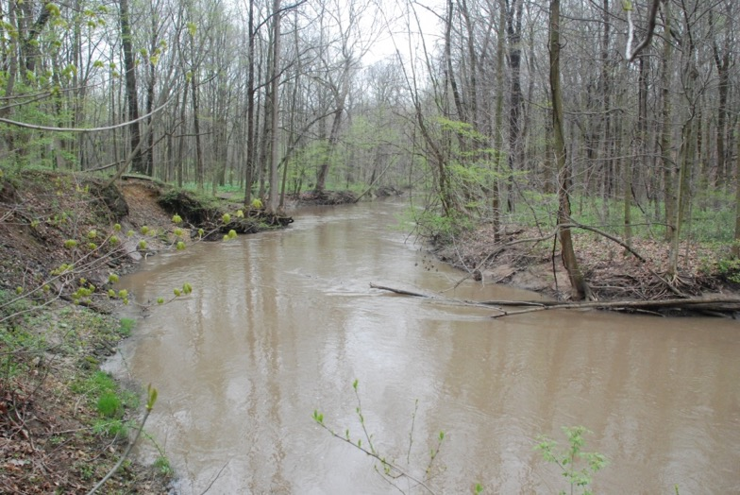
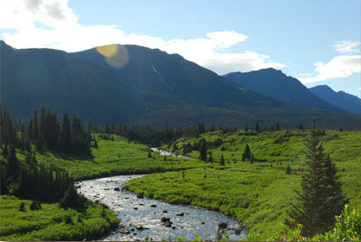
The way a watershed is used will affect the
stream that drains that watershed
Notes:
Have them visualize precipitation and runoff in these varied landscapes and how that might impact the streams to which these watersheds contribute.

Slide 6
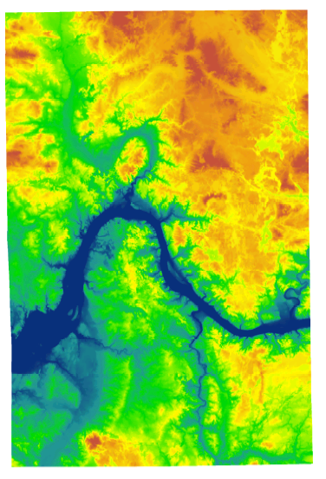
Notes:
Digital elevation map that shows the contours of Kent County . . . Rogue River here, Thornapple river here and (press button) this is the PC watershed

Slide 7
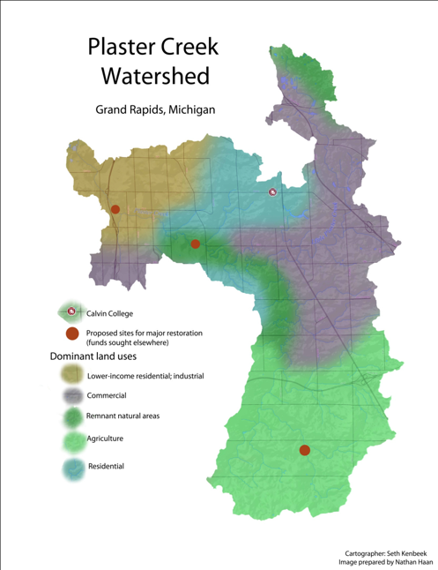
Background statistics:
Length: approx. 14 miles
Watershed area: 58 mi²
Governmental units: 9 (4
municipalities & 5 town-
ships)
>50% of Calvin fac. and staff
3200 Calvin Alumni
> 172 churches and faith communities
Notes:
Watersheds are parcels of the landscape that drain to a common point. They are naturally delineated by topography, and have potential to knit together agricultural, urban, and natural areas into one integrative whole. Every business, school, church, and individual household necessarily exists within a watershed. It follows that the quality of water that flows out of each watershed testifies to the type of activities occurring within that watershed. When community members understand the watershed concept and the particular qualities of their own watershed, such awareness provides a powerful means to connect people and institutions to the importance of taking good care of the land and water.
POINT TO: East Beltline, M-6, U.S. 131 and Calvin
Add to Basic Statistics
172 churches in the watershed (27 are CRC or Reformed)
100 schools

Slide 8
People who live at the lower ends of watersheds cannot be isolationist—or not for long. Pretty soon they will notice that water flows, and that will set them to thinking about the people upstream who either do or do not send down their silt and pollutants and garbage. Thinking about the people upstream ought to cause further thinking about the people downstream. Such pondering on the facts of gravity and the fluidity of water shows us that the golden rule speaks to a condition of absolute interdependency and obligation. People who live on rivers might rephrase the rule in this way: Do unto those downstream as you would have those upstream do unto you.
-From Watershed and Commonwealth
by Wendell Berry

Slide 9
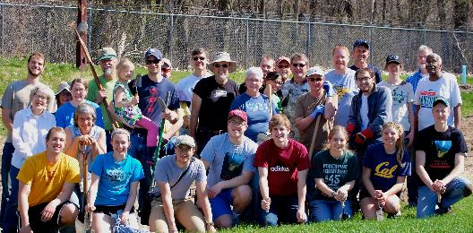
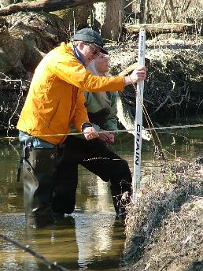
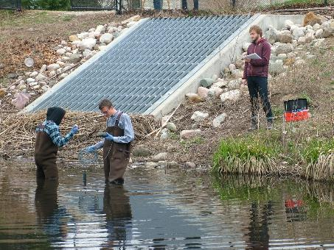
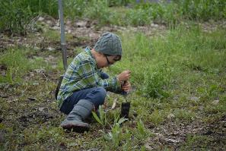
Plaster Creek Stewards
A collaboration of Calvin College, schools, churches, and community partners working to restore health and beauty to the Plaster Creek Watershed.
Notes:
So the three-fold focus of Plaster Creek Stewards is education/outreach; research; and on-the-ground restoration.

Slide 10
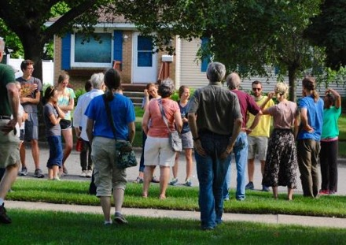
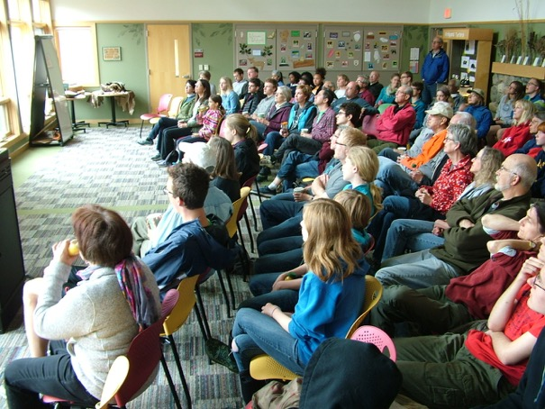
Education and Outreach builds
awareness and concern
Notes:
Our three focus areas: Education and Outreach; Research; Restoration

Slide 11
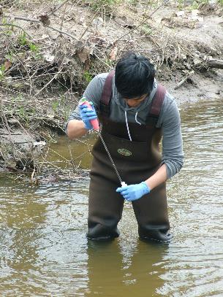
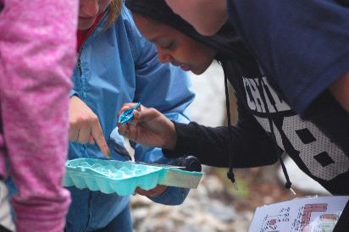
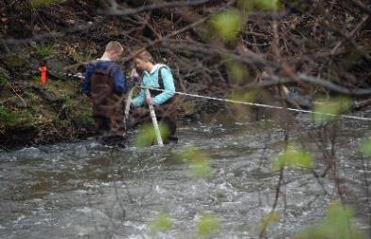
Research
leads to increased understanding of how to do restoration work
Notes:
Biological Research
Bio 250 (60 students this spring)
Water quality monitoring
Social research--Oral history---80 + interviews are completed and are in the process of being transcribed.
Geography/ GIS (Geographic Information Systems) –a faculty member and 2 summer research students developed a web-based application that can be used to examine and profile sections of the Plaster Creek watershed and this can be used to determine possible sites for on-the-ground restoration projects along Plaster Creek and its tributaries.

Slide 12
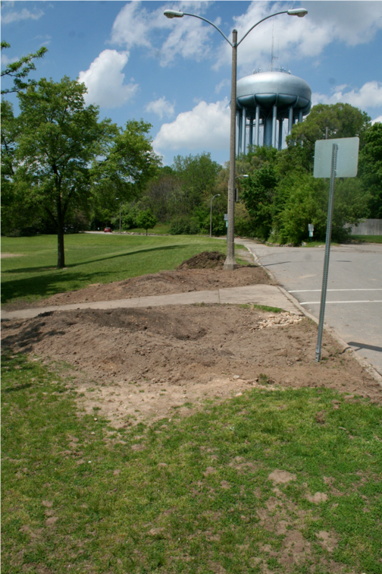
Restoration implements healthier watershed practices

Slide 13
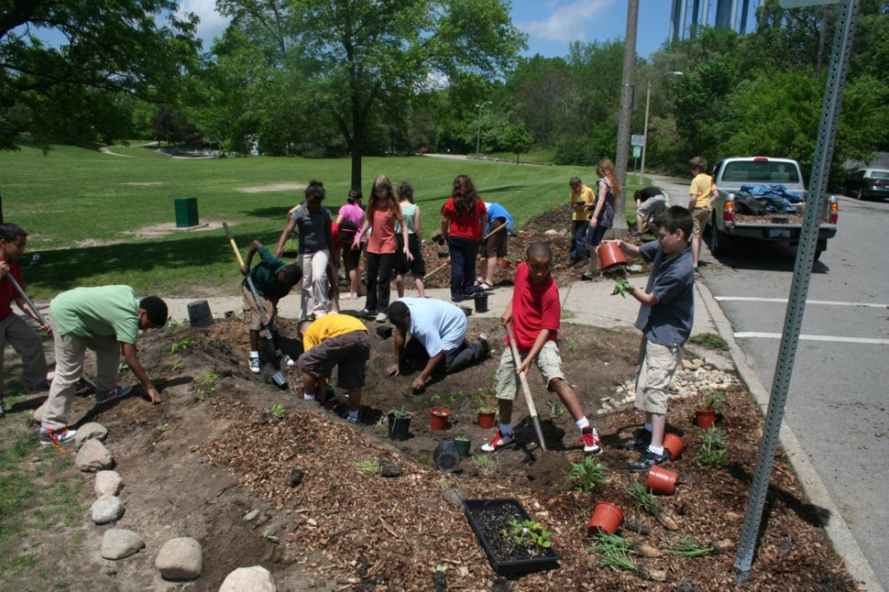

Slide 14
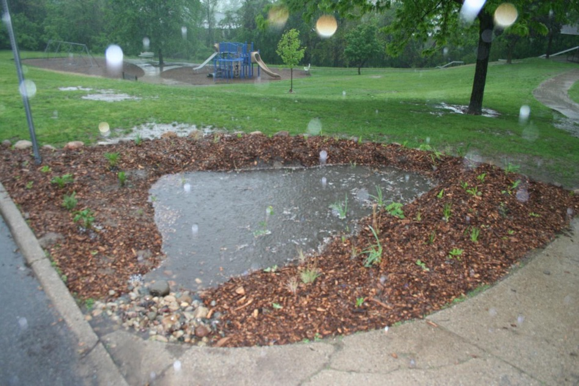

Slide 15
How did Plaster Creek Get Here?

Slide 16
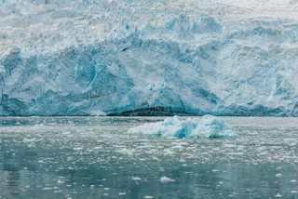
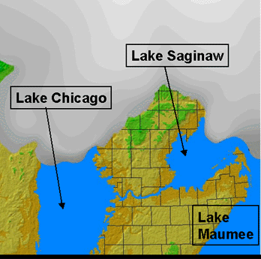
Jan 1 (12,000 years ago or 10,000 BC)

Slide 17
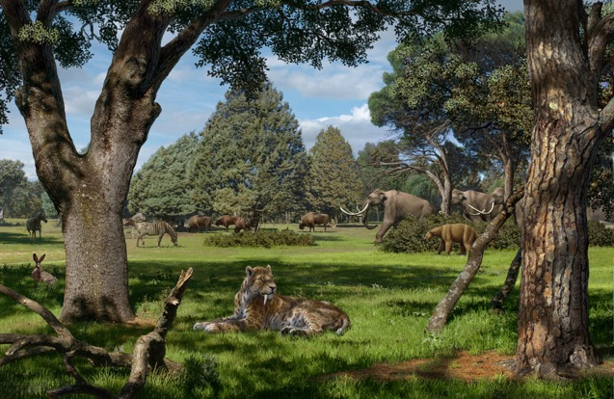
Feb 1 (9,000 BC)
Most Pleistocene Megafauna
extinct, Paleo Indians present,
having migrated into the
continent across the Bering
Straits around 14,000 BC
http://geo.msu.edu/extra/geogmich/index.html

Slide 18
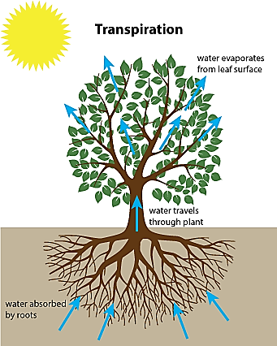
Natural Rainwater Processing
Interception
Evaporation
Infiltration
Transpiration
Groundwater storage
Groundwater discharge
(surface runoff)

Slide 19
March 1 (8,000 BC)
Early Archaic Period
Hunter/Gatherer Groups
Clovis Points

Slide 20
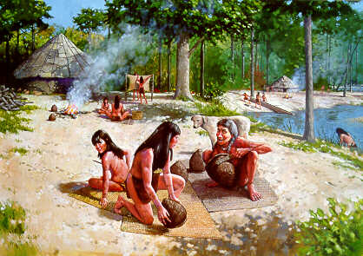
May 1 (6000 BC)
Middle archaic period
Beginning of small alliances
and villages

Slide 21
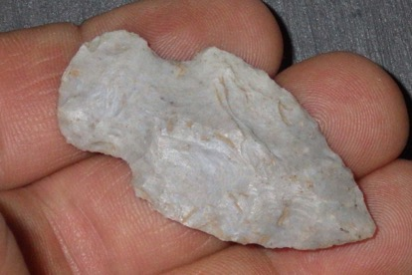
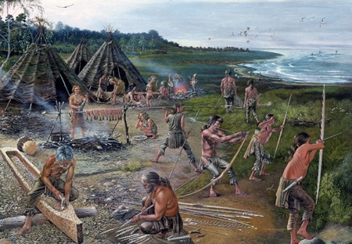
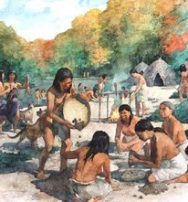
Aug 1 (3000 BC)
Late archaic period
Early agriculture,
Seasonal nomadism

Slide 22
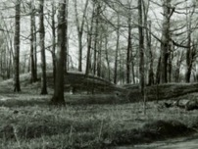
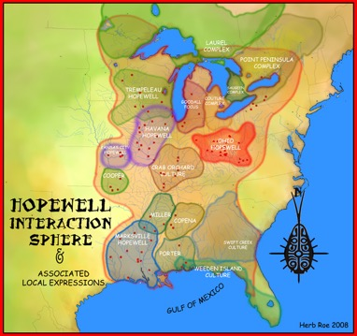
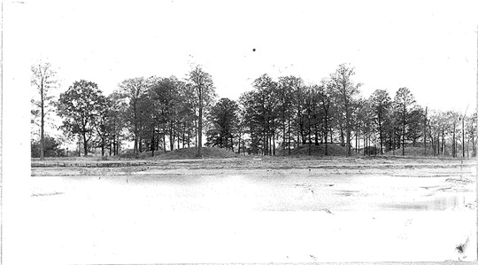
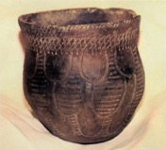
Nov 1 (10BC)
Middle woodland period; Hopewell people constructed Norton Mounds (still present)
and Converse Mounds (lost during construction of Grand Rapids)

Slide 23
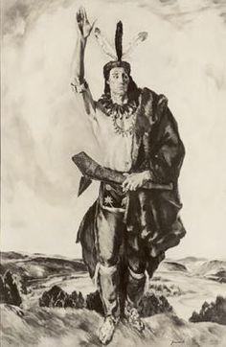
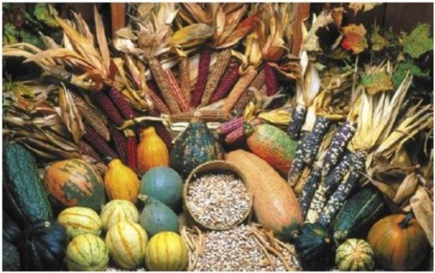
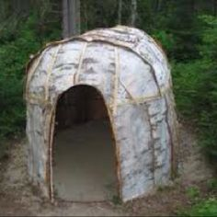
Nov 25 (AD 700)
Odaawaa people cultivated maize, beans, and squash; formed decorative pottery;
lived in large villages; Plaster Creek known as Kee-No-Shay (‘water of the walleye’)

Slide 24
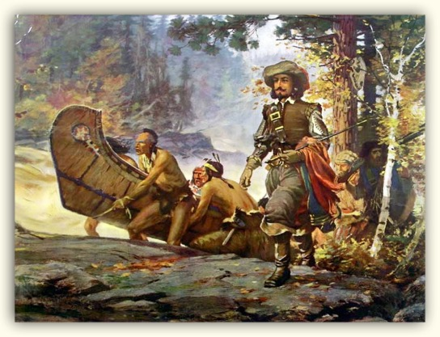
Dec 20 (AD 1615)
First French explorer,
Samuel de Champlain,
makes brief appearance

Slide 25
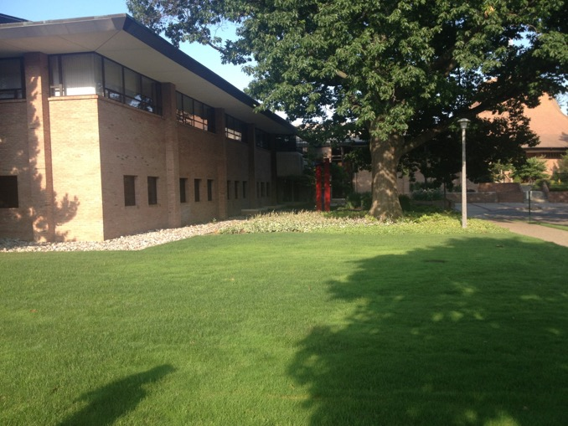
Dec 23 (AD 1750)
Oldest living tree on
Calvin’s campus began
To grow

Slide 26
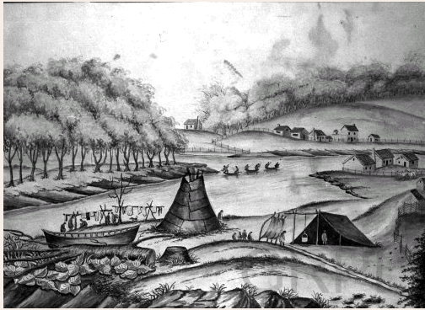
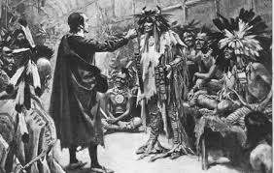
  Dec 25 (AD 1800)
Early interactions between pioneer missionaries and Odaawaa
(Chief Blackbird)
Downtown Grand Rapids Early 1800s
Notes:
Now I’d like to set the stage for the story of Europeans’ first recorded contact with Plaster Creek. This sketch is an artist’s rendering of Grand Rapids in 1831—four years after the story I’ll tell takes place. It was a mixture of native americans, french fur traders, and a baptist mission on the west side of the Grand river.

Slide 27
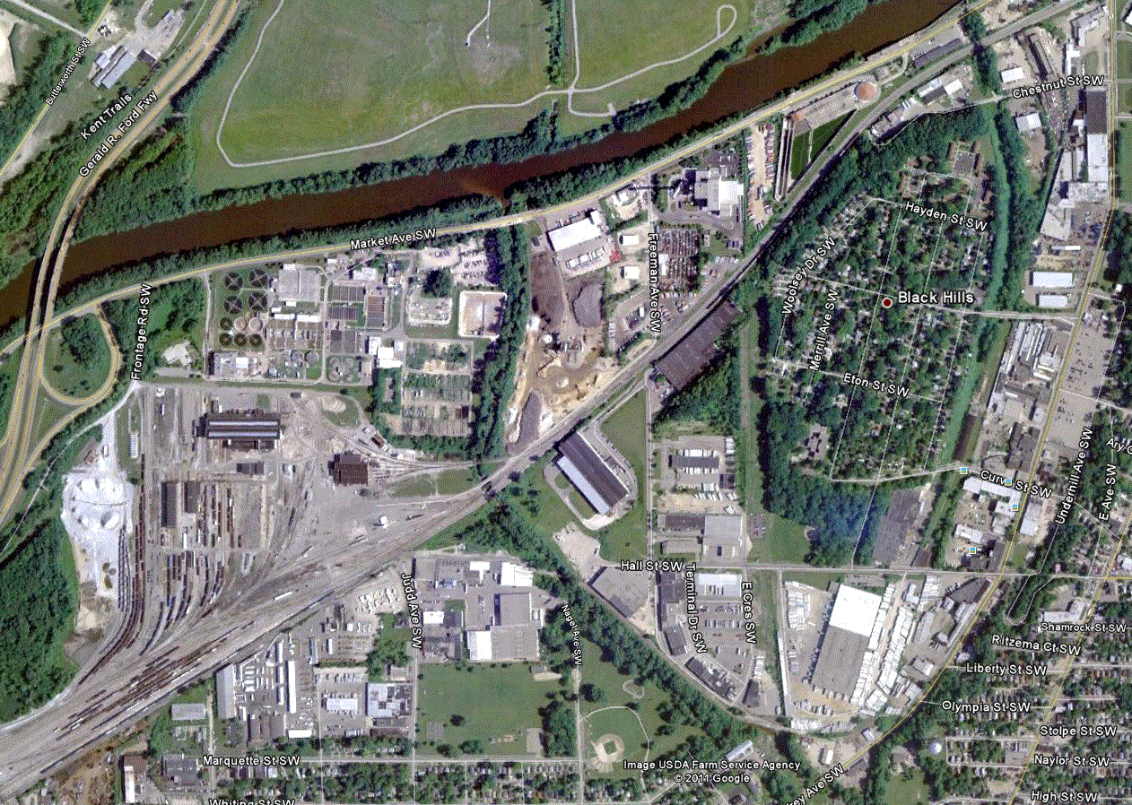
Dec 27 (1841)
  First gypsum mine
  just below the
  convergence of
  Kee-No-Shay and
  Bur Oak Creeks
  (Today this area is
  Roosevelt Park)

Slide 28
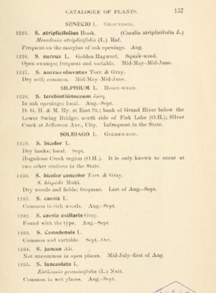
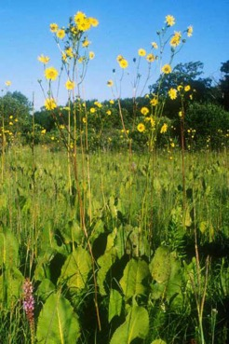
Dec 29 (1901)
  Publication of Emma Cole’s Grand Rapids Flora (describes many local natural areas)

Slide 29
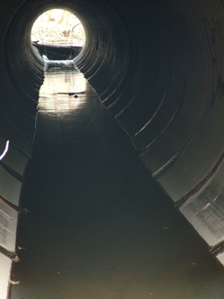
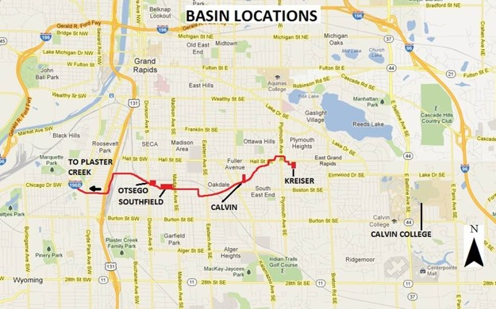
Dec 30 (AD 1930s)
Silver Creek buried,
impermeable surfaces
proliferate as GR expands

Slide 30
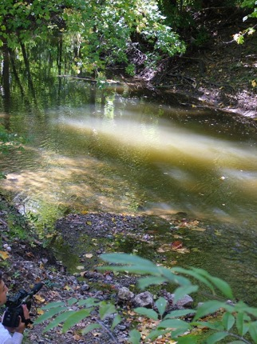
Dec 31, noon (AD 2000)
- Plaster Creek known as most contaminated waterway in West Michigan

Slide 31
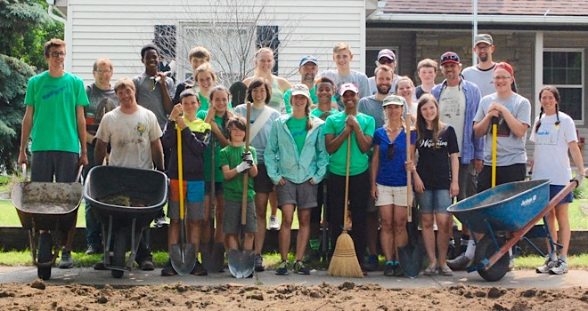
Dec 31, 5:30pm (AD 2009)
Plaster Creek Stewards forms at Calvin College to
‘restore health and beauty to the plaster creek watershed’

Slide 32

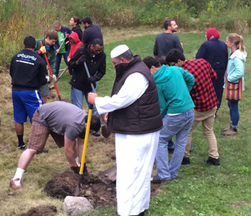
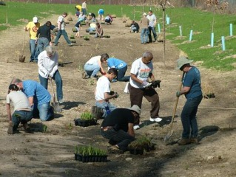
Why does this matter?
We live in a place AND at a point in time
Todays actions affect tomorrow, past actions affect today
Past has lessons – to teach and to inspire
Respect your Elders

Slide 33
How Do We Know What Is wrong with Plaster Creek and What We Should Do to Help?

Slide 34
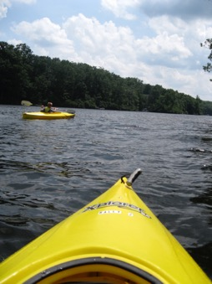
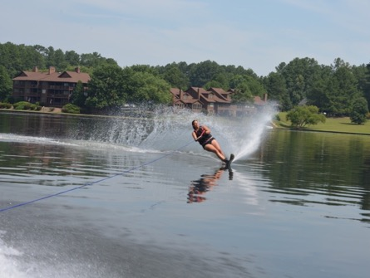






Every waterbody has a purpose – a designated use
Agriculture
Navigation
Industrial water supply
Warm water fishery
Partial body contact recreation
Fish consumption
Other indigenous aquatic life/wildlife
Total body contact recreation (May 1-October 1)
Cold water fishery (specific connecting waters)

Slide 35
Water Quality Standards are state rules established to protect the Great Lakes.
NOT ASSESSED
Agriculture
Navigation
Industrial water supply
Warm water fishery
Partial body contact recreation
Fish consumption
Other indigenous aquatic life/wildlife
Total body contact recreation (May 1-October 1)
Cold water fishery (specific connecting waters)
IMPAIRED
IMPAIRED
IMPAIRED
IMPAIRED
IMPAIRED
IMPAIRED
Notes:
Currently, Plaster Creek does not meet water quality standards for most of its designated uses.
SOME USES ARE NOT ASSESSED.
OTHERS, ARE IMPAIRED

Slide 36



When a lake or stream does not meet Water Quality Standards for its designated use, it is put on the 303(d) list and a Total Maximum Daily Load (TMDL) document is created.

Slide 37
TMDL Document Process
Analyze water quality
Determine causes for impairment
Locate sources of pollutants
PC Biota TMDL
“poor biological communities”
Impaired habitat due to siltation and sedimentation that coated surfaces, flashy flows
Direct storm sewer discharge, erosive stream banks, reduction in riparian zones, increased impervious surfaces

Slide 38

Siltation
Notes:
Agriculture runoff – full of silt, also moves quickly due to drain tiles

Slide 39


Slide 40


Slide 41

Notes:
High flows in creeks destabilized banks, leads to increased erosion

Slide 42

Bank erosion
Flooding
Log jams
Notes:
Trees fall down, block flow path, raises water, leads to increased bank erosion

Slide 43
TMDL Document Process
Analyze water quality
Determine causes for impairment
Locate sources of pollutants
Sets pollutant load and reduction targets
PC Biota TMDL
“poor biological communities”
Impaired habitat due to siltation and sedimentation that coated surfaces, flashy flows
Direct storm sewer discharge, increased impervious surfaces, erosive stream banks, reduction in riparian zones
1) Macroinvert. community score >= -4
2) Habitat quality score of 65 or more
3) Total Suspended Solids<30mg/l

Slide 44
TMDL Document Process
Analyze water quality
Determine causes for impairment
Locate sources of pollutants
Sets pollutant load and reduction targets
Specify possible methods for improvement
PC Biota TMDL
“poor biological communities”
Impaired habitat due to siltation and sedimentation that coated surfaces, flashy flows
Direct storm sewer discharge, increased impervious surfaces, erosive stream banks, reduction in riparian zones
1) Macroinvert. community score >= -4
2) Habitat quality score of 65 or more
3) Total Suspended Solids<30mg/l
Reduce runoff rates and sediment loads from controllable upland sources and reduce streambank erosion

Slide 45
who’s responsible for implementing the tmdl?
“Once a TMDL is developed and approved . . . Nonpoint sources of pollution are reduced mainly through voluntary programs and the work of local stakeholders”

Slide 46
Streambank erosion
Pollutant priority
Urban runoff
Sediment
Higher
Agricultural runoff
Construction
E. coli contamination
Animal waste
Septic systems
Nutrient pollution
Faulty sewer connections
Thermal pollution
Lawn fertilizer
Toxic substances
Lower
No riparian vegetation
Illicit dumping in storm sewers
Notes:
Many complex, interacting factors: focus on the priorities

Slide 47


Today’s Options for Action
Notes:
Our three focus areas: Education and Outreach; Research; Restoration

Slide 48

Enhancing Whiskey Creek Bioswale
A bio-swale beside a large parking lot
Notes:
Urban runoff, thermal pollution – enters bioswale

Slide 49

Why native plants?
Deep roots, soak up large volumes of water
Filter excess nutrients, trap excess sediment
Low maintenance - Adapted to local conditions
Essential for insects, birds, other wildlife

Slide 50



Cleaning up Curb cut RainGardens

Slide 51
Restoration Locations
1. Alger heights-stencil or maintain gardens by adding plants and removing sediment
2. Oakdale- stencil and maintain gardens by adding plants, removing sediment, and installing sediment traps
3. Calvin bioswale- near nature preserve, adding plants to existing bioswale.

