Slide 1
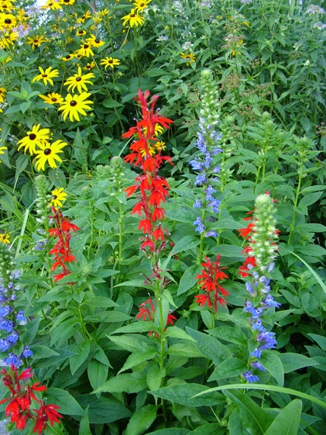
Alger Heights Neighborhood Raingarden Project
Plaster Creek Stewards Summer Workshop
Andrea Lubberts Mike Ryskamp
Gail Heffner David Warners

Slide 2
Project Description
Focused effort within the Alger Heights neighborhood to promote residential rain gardens. Funded by Michigan Department of Environmental Quality Section 319 (Clean Water Act) Funding.
Models: Blue Water Baltimore (Maryland), Deer Creek Rainscaping (Missouri), River Smart Homes (Washington DC), Grayling Rain Gardens (Crawford Co., Mich), Allen’s Creek Rain Gardens (Washtenaw Co., Mich)

Slide 3
Focus Area

Slide 4
Goals for Alger Heights Project
Enhance awareness about stormwater runoff problems in Plaster Creek Watershed within Alger Heights focus area.
Provide residents with practical options for decreasing stormwater runoff from their lots (and inspire implementation).
Help install 20 rain gardens in the Alger Heights neighborhood (as many curb-cut rain gardens as possible).
Track reduction of stormwater runoff from this neighborhood.
Act as a pilot project for potential larger Rainscaping effort with WMEAC and Rogue River Watershed Group

Slide 5
Approach
Alger Heights CRC – center for community education and demonstration site
Planning (designs, borings) done collaboratively with State DEQ, City of GR and Plaster Creek Stewards (permitting)
Plant material – all native species propagated by Plaster Creek Stewards (encourage low growing, showy species)
Homeowner Agreement – help with installation (yr 1); and maintenance (yrs 2, 3); years 4+ homeowner’s responsibility (PCS provides resources for assistance)
Review Grand Rapids ‘weed ordinance’ for Right-of-Way plantings

Slide 6
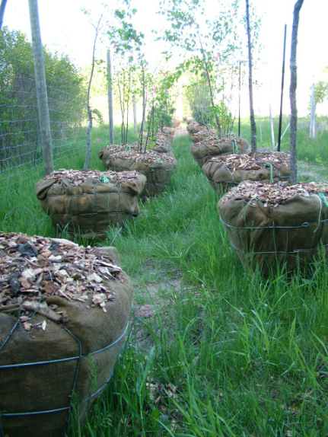
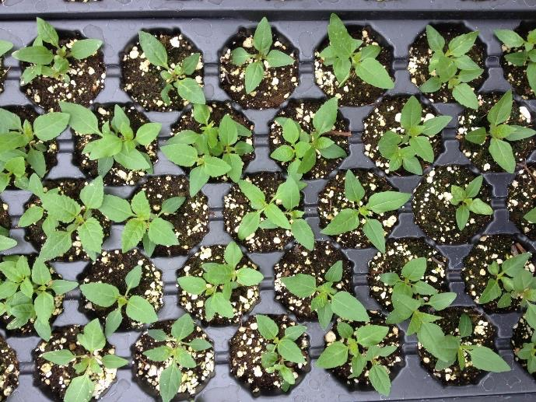
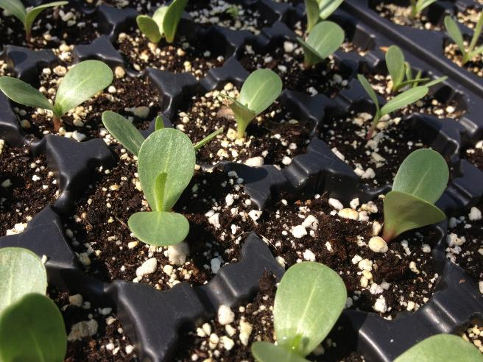
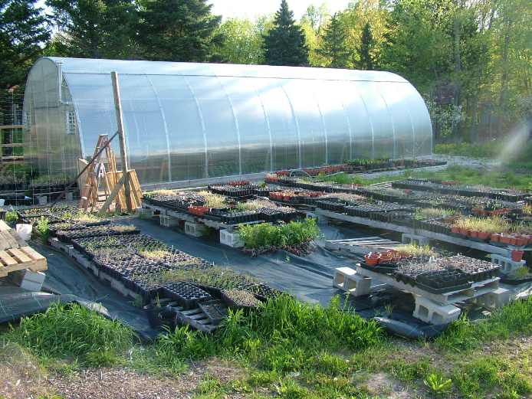
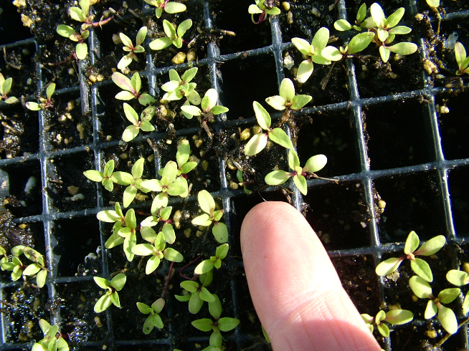
Native Plant Propagation at Calvin College

Slide 7
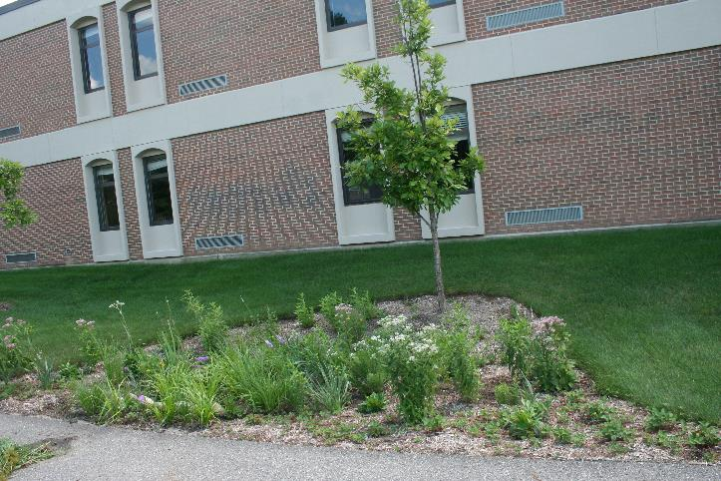
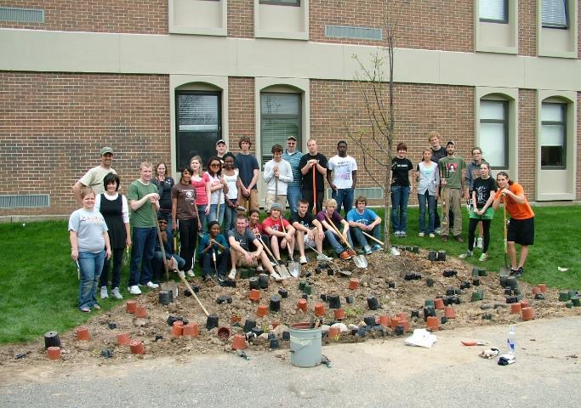
‘Taxonomy’ of Rain Gardens – runoff from hard surfaces

Slide 8
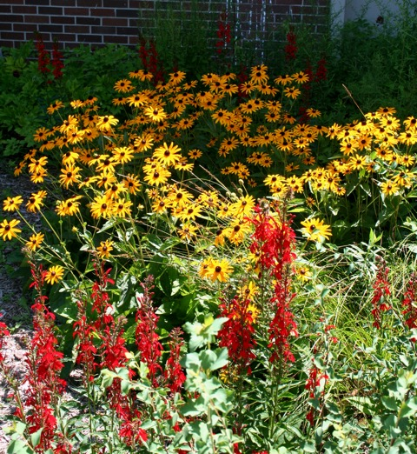

Slide 9
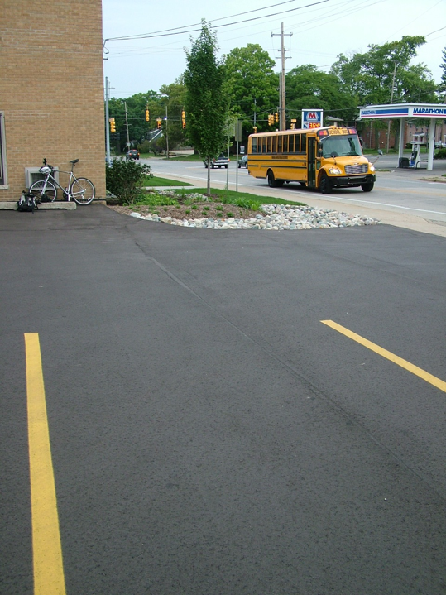
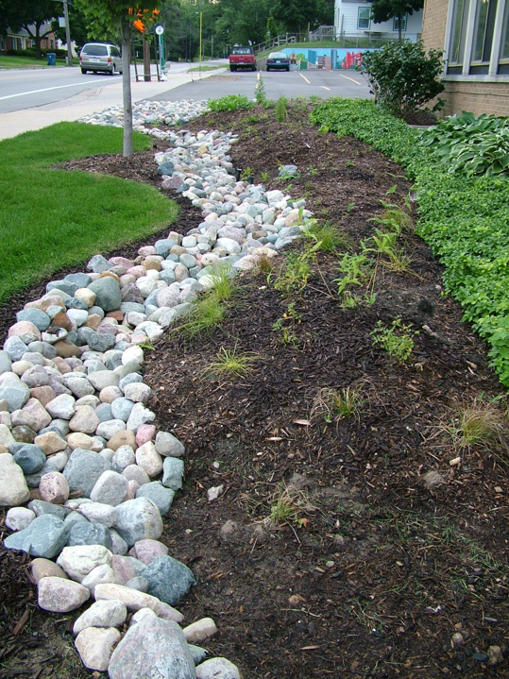
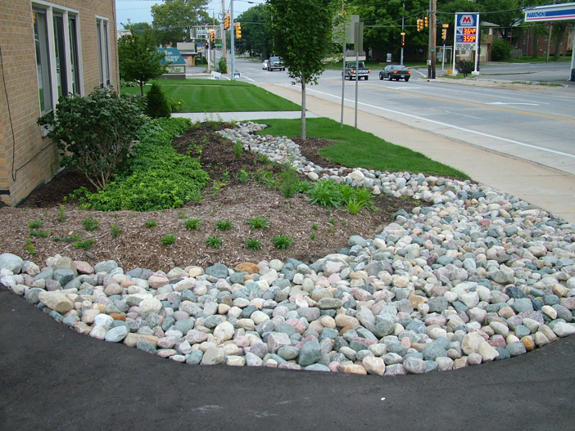

Slide 11
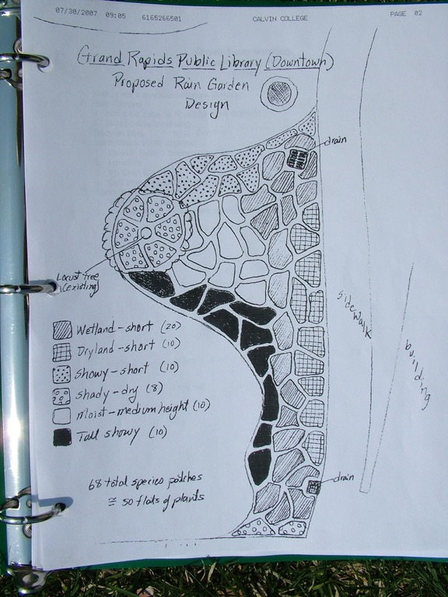
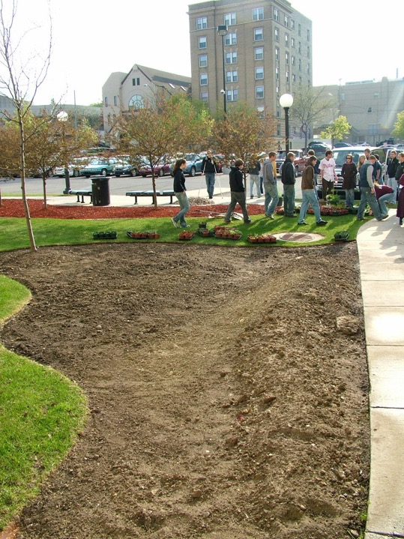
Rain Gardens collecting downspout stormwater - GRPLibrary

Slide 12
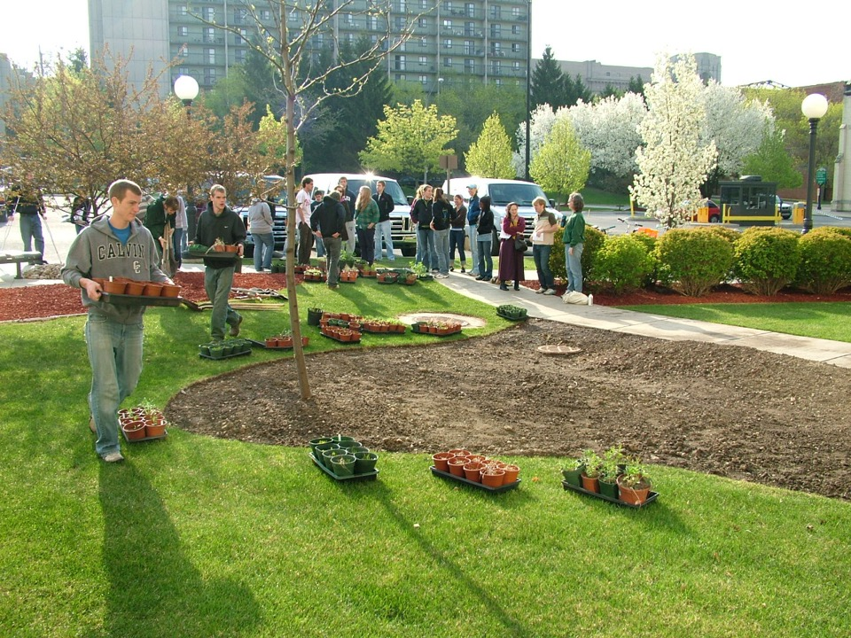
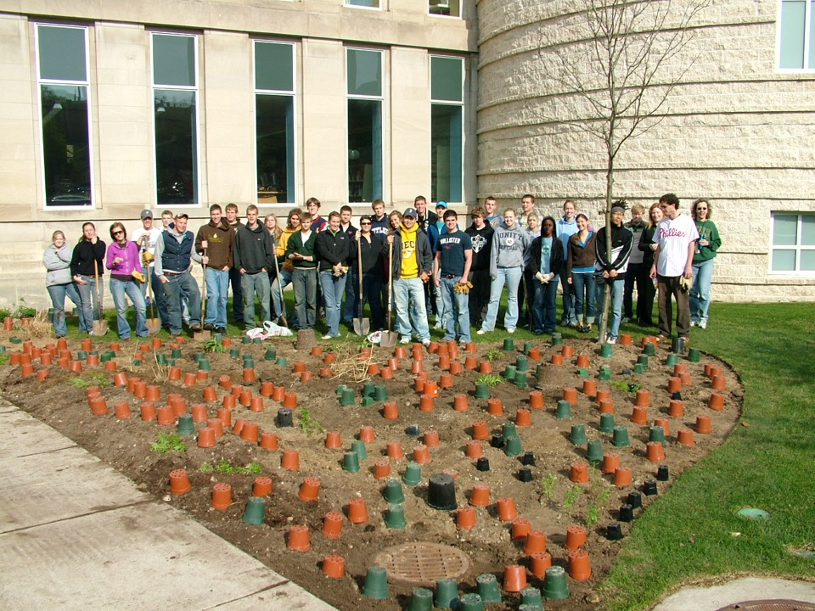
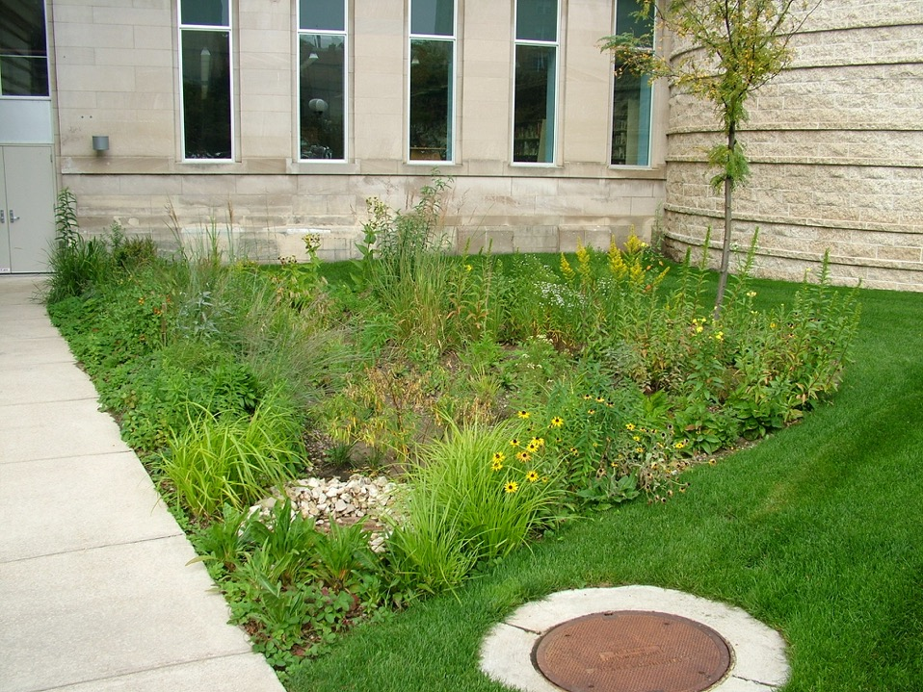

Slide 13
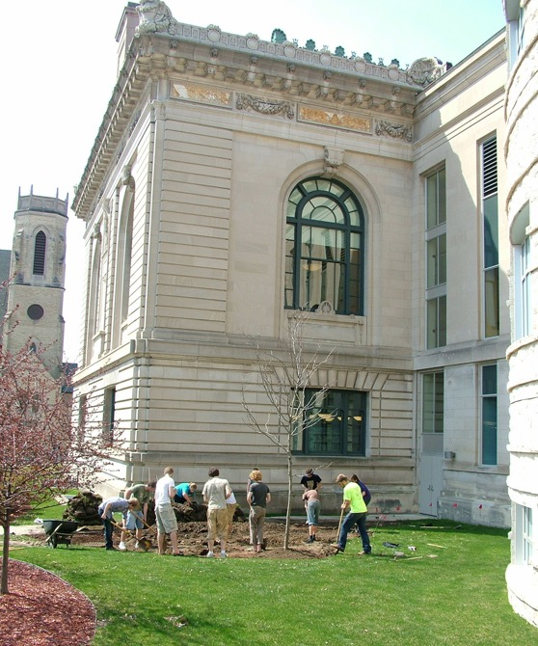
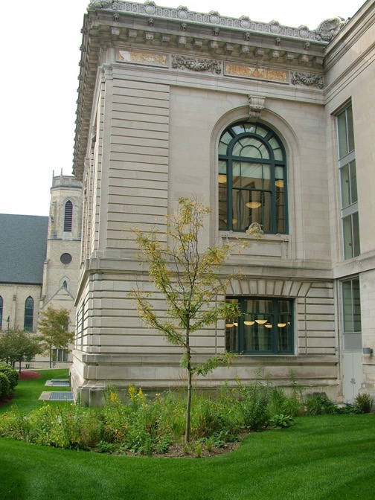

Slide 14
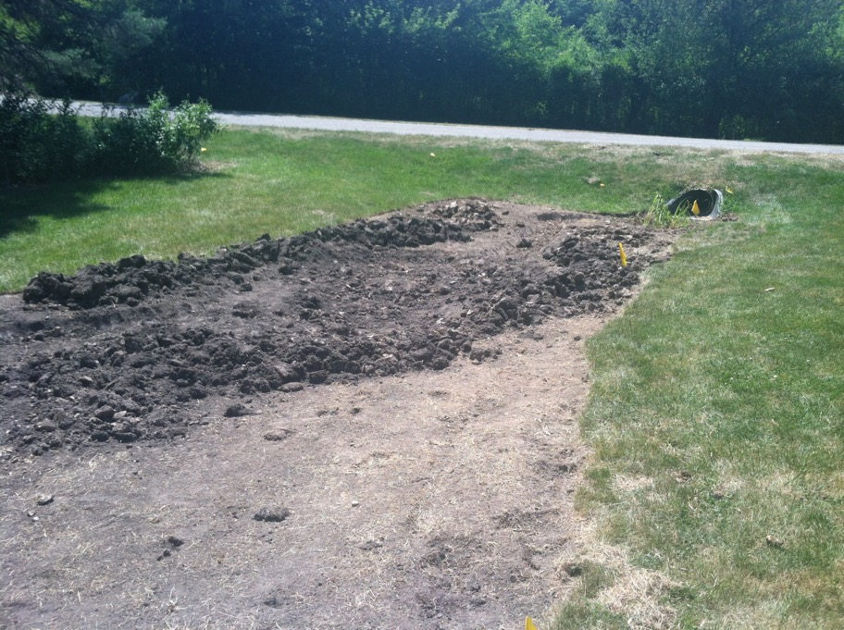
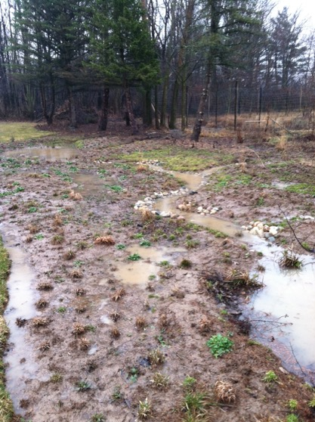
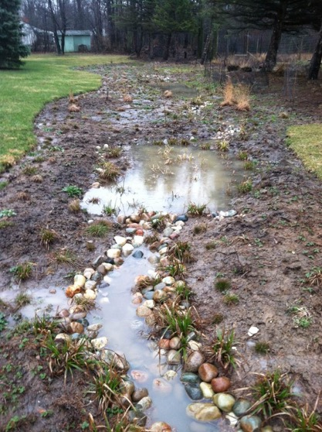
Raingardens that process temporarily wet areas

Slide 15
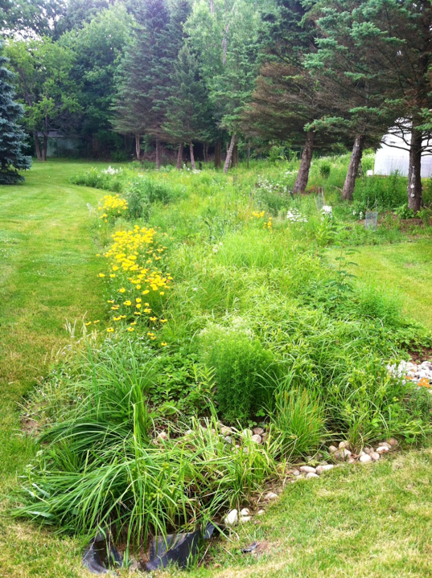

Slide 16
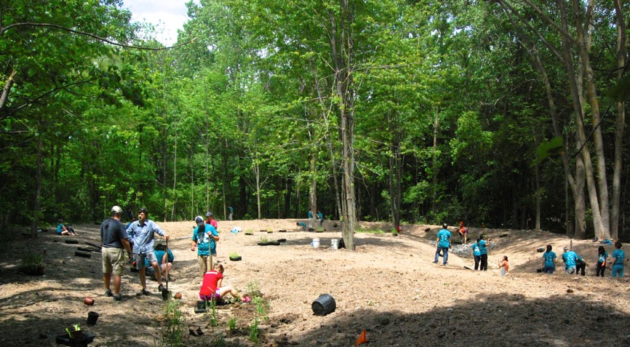
Rain Gardens on steroids - Bioswales

Slide 17
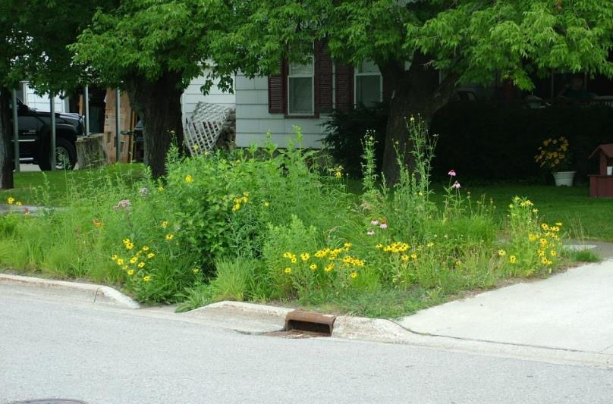
Curb cut rain gardens

Slide 18
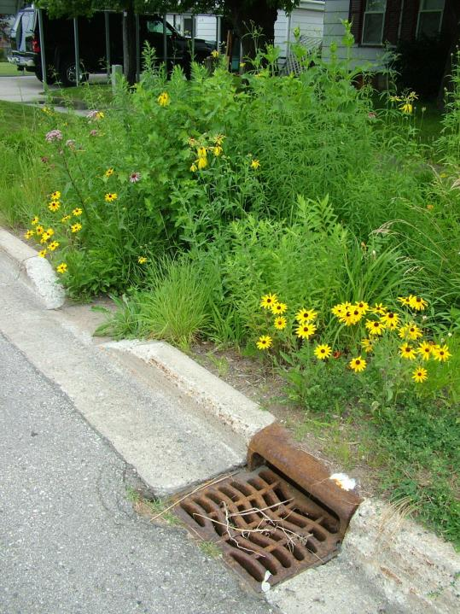

Slide 20
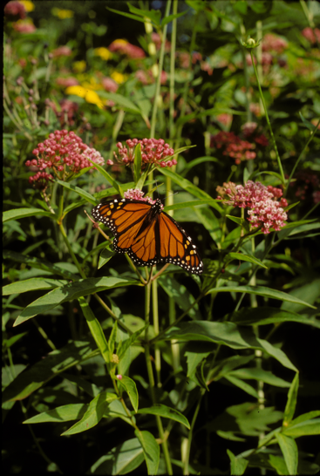
Benefits of curb-cut raingardens
Intercept stormwater before it goes into storm drain
Combine with traffic controlling bump-outs
Percolation, evapotranspiration, groundwater storage
Reduced lawn maintenance
Local biodiversity benefits (islands of biodiversity)
Neighborhood beauty

Slide 21
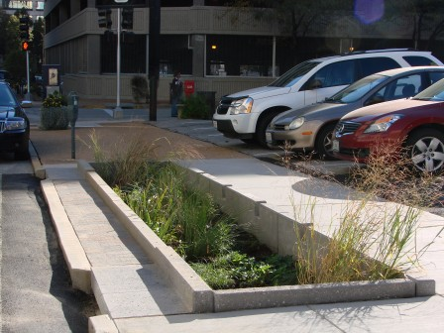
Lea
Residential Raingardens may lead to even more creative ways
to manage stormwater runoff . . .

Slide 22
Visioning a rainscaping partnership between PCS and City of GR
Permission/support for PCS to propose (and hopefully implement) project as one component of DEQ 319 grant
Technical assistance as match (engineering expertise, etc.)
Letter of commitment to accompany grant proposal (proposal due Oct. 18)

