Slide 1
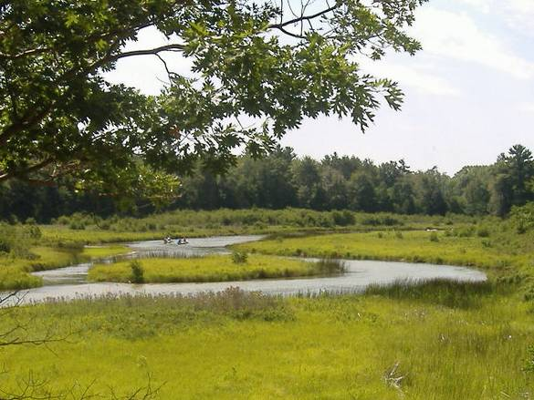
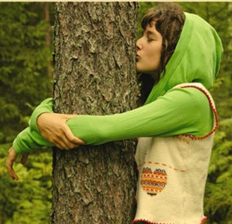
Healthy watersheds and their plants
Can people co-exist with healthy watersheds?

Slide 2
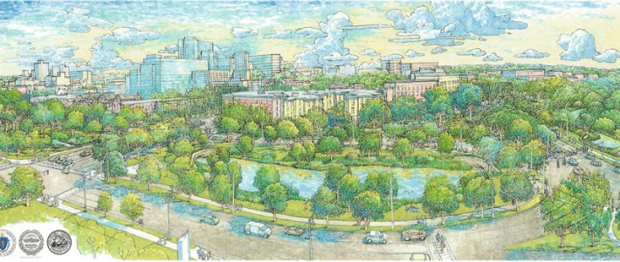
Healthy urban watersheds: a pipe dream?
Green space throughout watershed
Floodplain habitat
Healthy ecosystems accessible to community members

Slide 3
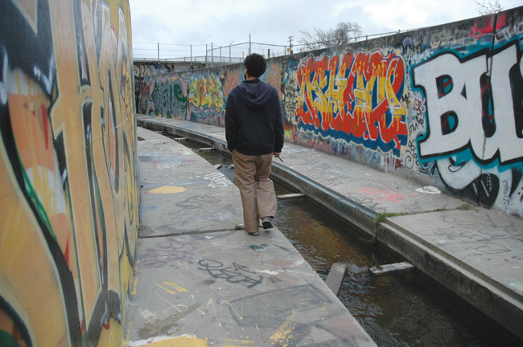
Healthy urban watersheds: a pipe dream?
“green space”
Healthy ecosystems accessible to community members
Floodplain habitat

Slide 4
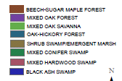

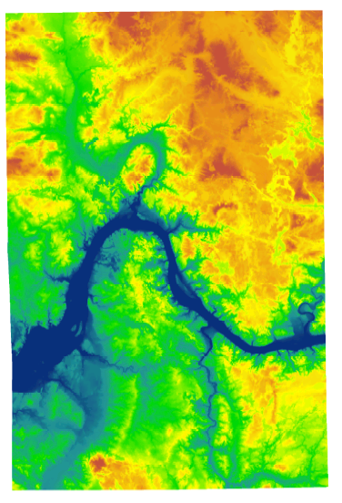
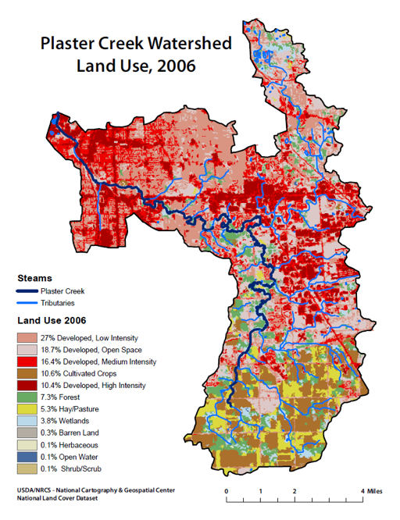
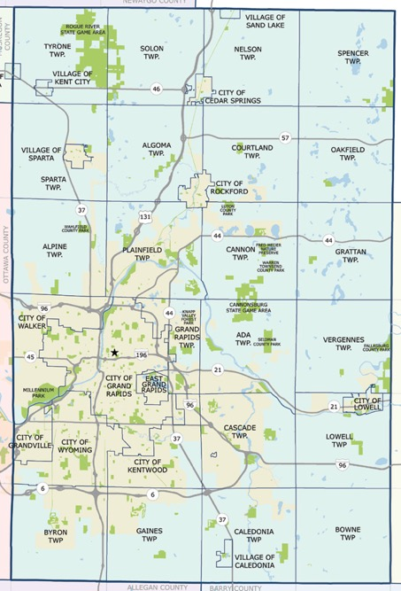
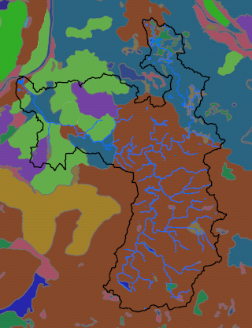
Plaster Creek

Slide 5
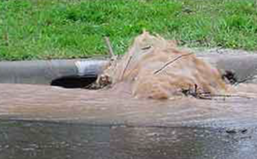
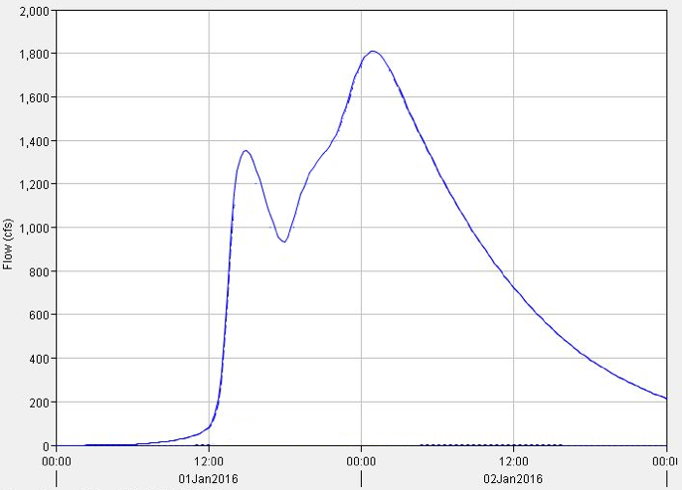
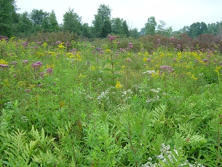
So, how much more stormwater are we dealing with?
A two inch rain today:
2800 acre-feet of stormwater
A two inch rain 1800:
500 acre-feet of “stormwater”
2,300 acre feet
Notes:
Entire watershed
Tc (existing/developed) = 2.0 / 0.5 hrs
Area = 37,120 ac
Existing = Meadow, B (CN = 58)
Developed = Impervious (5%), open space - good (95%), B (CN = 61)
Bioretention = 23,000 cf
Runoff volumes:
Developed (area under green/red curve) = 44.9 million cft
Pre-development (under blue curve) = 21.3 million cft
Difference (what we’d like to capture) = 23.6 million cft

Slide 6
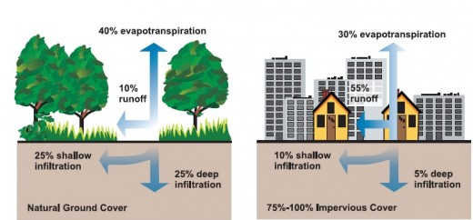

Slide 7
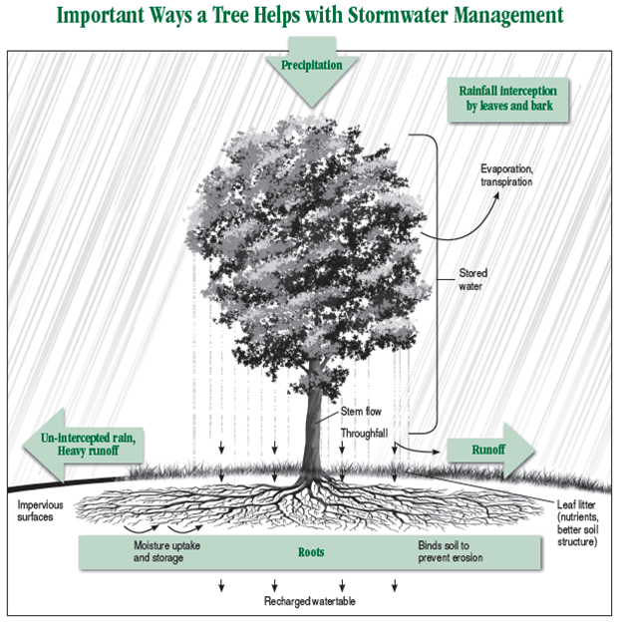

Slide 8
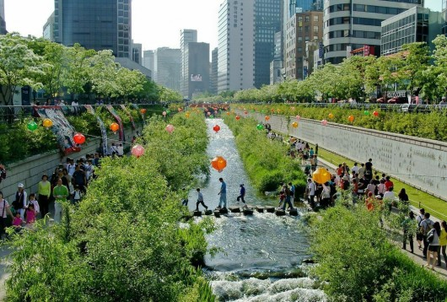

Slide 9
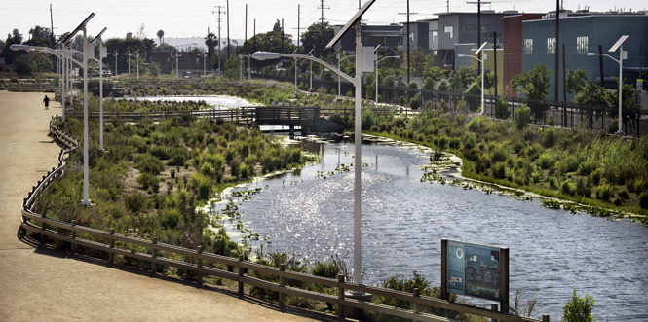
New urbanism?

Slide 10
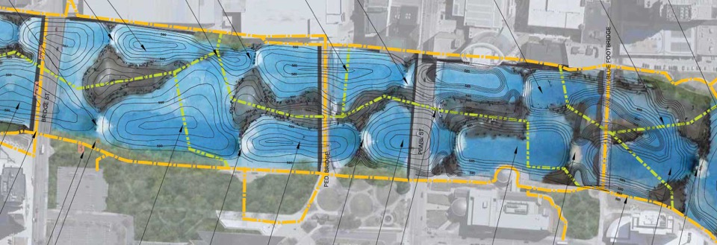
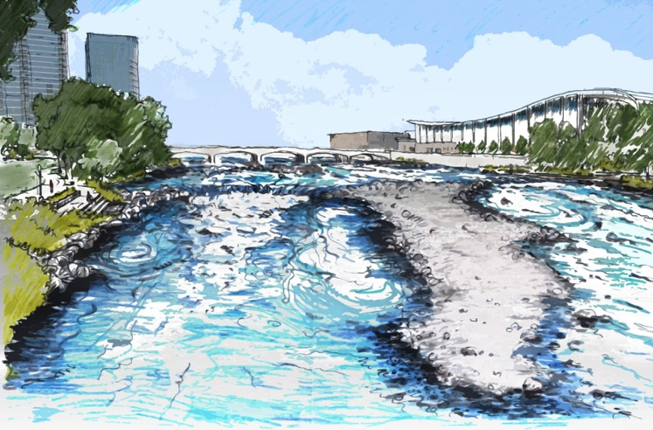

Slide 11
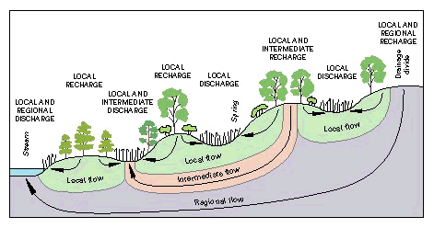
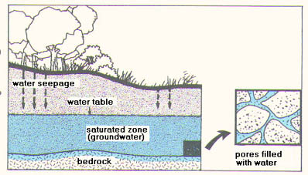
The water cycle we don’t see…

Slide 12
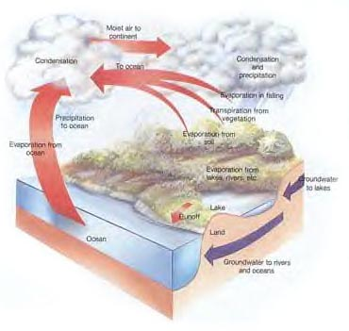

Slide 13
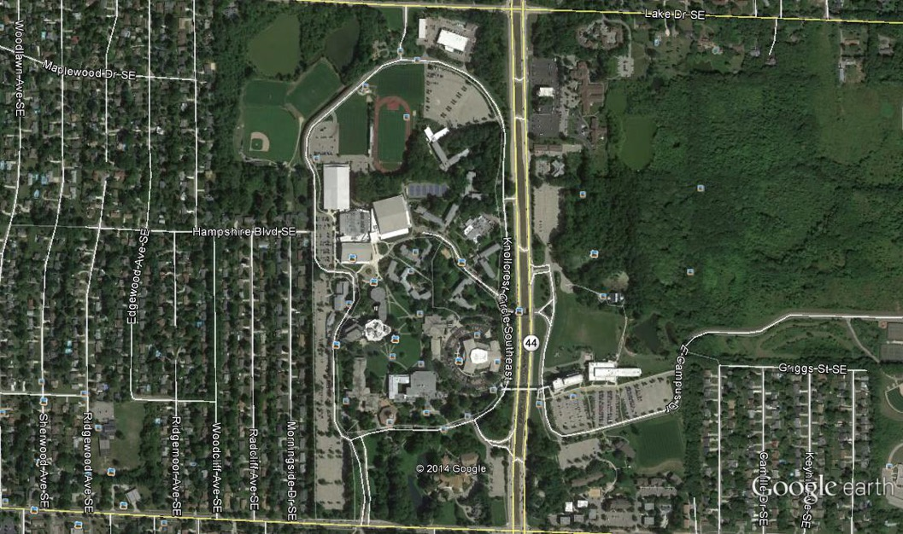
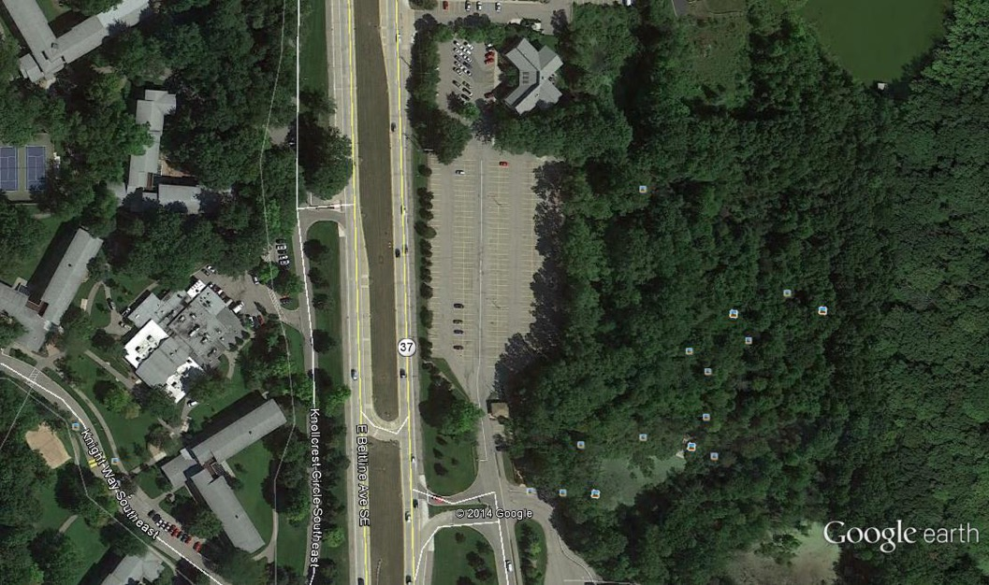
Whiskey Creek Bioswale
To Plaster Creek
Whiskey Pond

Slide 14
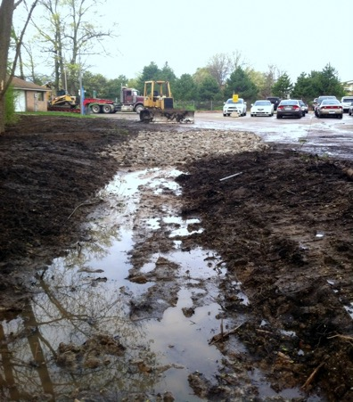
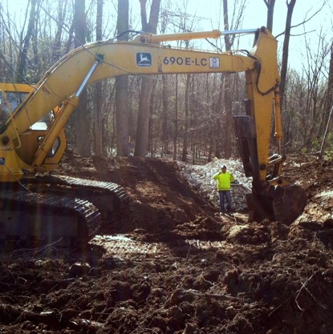
Whiskey Creek Bioswale

Slide 15
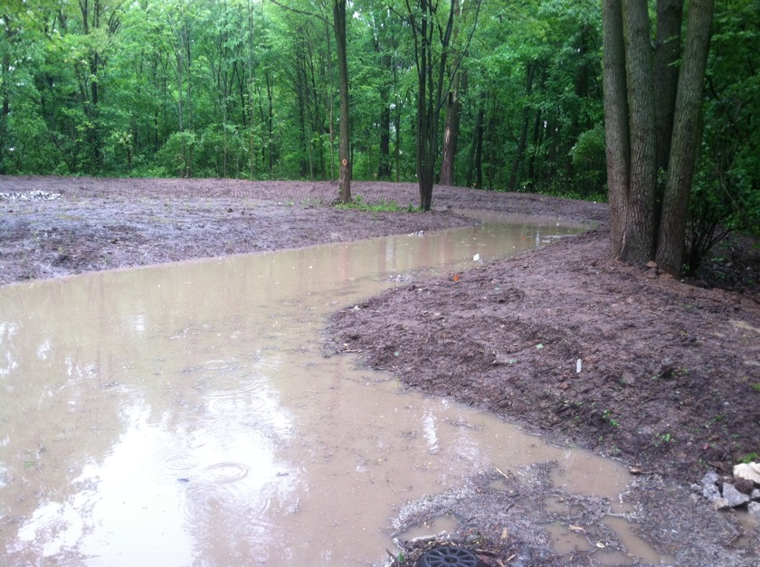

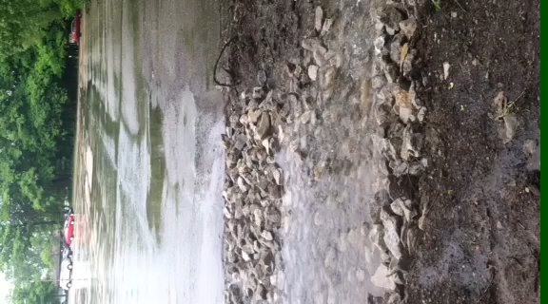
Update on Whiskey Creek Bioswale
PLAY
STOP

Slide 16
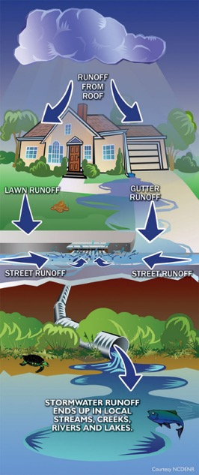
The current model:
Quick and dirty stormwater solutions…
“Get it outta here ASAP!”
“Let everyone downstream deal with it!”
“I’ll just drive to Newaygo to go fishing”
“That’s not a creek, that’s just a drain!”
“A healthy, beautiful, flourishing natural world is not something worth leaving for my kids”
A new model:
Slower, cleaner
“Keep it where it falls”
“Let’s love our downstream neighbors”
“I should be able to go fishing in my own watershed!”
“That’s not a drain, that’s a stream!”
“A healthy natural world is something I want future generations to enjoy and value.”
?

Slide 17
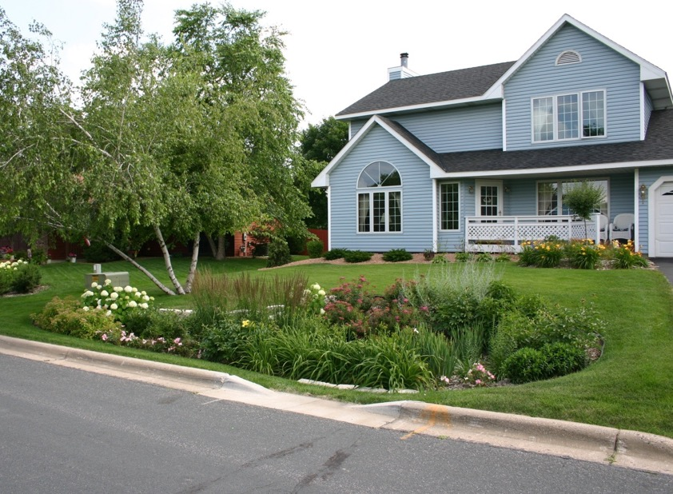
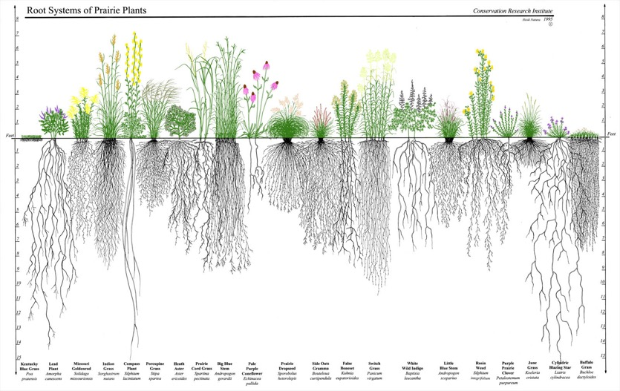
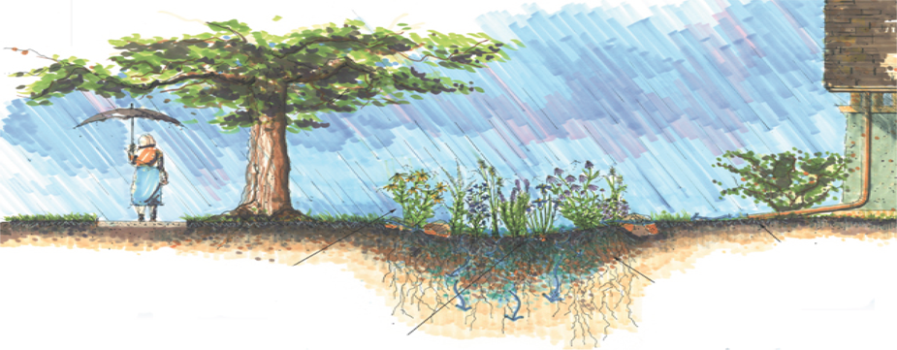
A model garden
Rain Gardens are designed to capture and clean stormwater!
Keep it in full sun! (or in well draining soils)
And use native plants!
Keep it 10’ from foundation
Avoid putting your rain garden in the “soggy bottom” areas of your yard (that spot that’s always wet)…

