Slide 1
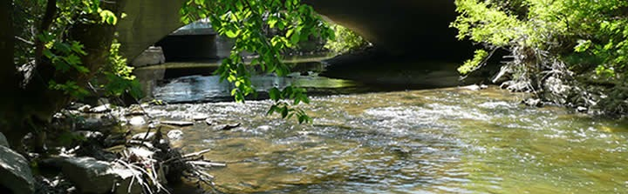
Loving Our Downstream Neighbor
Plaster Creek Stewards
Gail Heffner
Dave Warners
Notes:
(Gail) We’re grateful for this opportunity to tell you about the exciting work that is unfolding and gaining momentum. This is a project that emerged about 8 years ago as an effort to engage faculty and students in an issue of community concern. Tonight we’ll tell you about the history of this initiative, some of the current work, and why this matters.
(Dave) This is a watershed restoration initiative and it’s interdisciplinary in scope. This creek pulls together matters of social justice, environmental justice, public health, and much more. So our approach is interdisciplinary as well, in fact, the two of us are interdisciplinary as well - Gail’s doctoral work was in urban studies and community development, while mine was in botany and restoration ecology. Mention our backgrounds.
(Gail) Everyone lives in a watershed. Every school, every church, etc….exists in a watershed. Life happens in watersheds. Some cultures recognize this much better than others (i.e. New Zealand). Calvin’s property straddles the divide between 2 watersheds---to the North water flows off our campus to Reeds Lake and is part of the Coldbrook Creek watershed. To the south water flows from the Preserve through Whiskey Creek under the East Beltline and into the Sem Pond, then under Burton Street and eventually into Plaster Creek. What was startling for us to discover is that Plaster Creek is the most polluted stream in West Michigan. Plaster Creek Stewards has emerged as an initiative to address this huge problem and it really is embedded in our Reformed understanding of the Kingdom of God. Read p.32-33 of Desiring the Kingdom. Caring for God’s creation is just one of the practices of embodied faithfulness that aims our love toward the Kingdom of God.

Slide 2
Context
Pedagogy of Place: Educational approach that encourages active learning to improve the social, economic, political and ecological life of the places in which the education occurs.
Reconciliation Ecology: The science of restoring, creating and maintaining habitats, and conserving biodiversity in places where people live, work, or play. Re-inventing the human presence to better accommodate, affirm, and fit in with the other creatures with whom we share the creation.

Slide 3
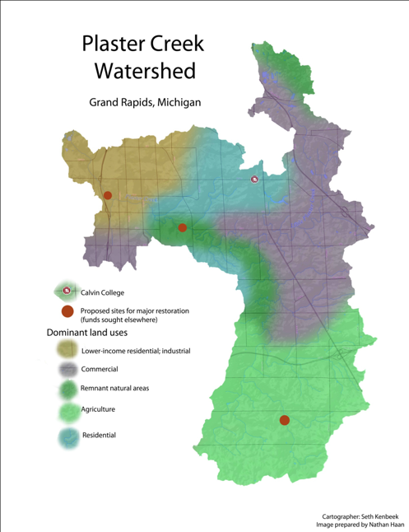
Background statistics:
Length: approx. 14 miles
Watershed area: 58 mi²
Governmental units: 9 (4
municipalities & 5 town-
ships)
>50% of Calvin fac. and staff
3200 Calvin Alumni
2400 CRC households
Notes:
Watersheds are parcels of the landscape that drain to a common point. They are naturally delineated by topography, and have potential to knit together agricultural, urban, and natural areas into one integrative whole. Every business, school, church, and individual household necessarily exists within a watershed. It follows that the quality of water that flows out of each watershed testifies to the type of activities occurring within that watershed. When community members understand the watershed concept and the particular qualities of their own watershed, such awareness provides a powerful means to connect people and institutions to the importance of taking good care of the land and water.
POINT TO: East Beltline, M-6, U.S. 131 and Calvin
Add to Basic Statistics
172 churches in the watershed (27 are CRC or Reformed)
100 schools

Slide 4
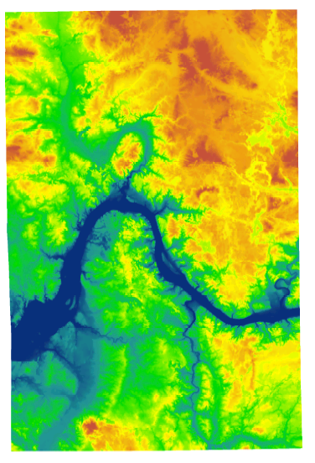
Notes:
Digital elevation map that shows the contours of Kent County . . . Rogue River here, Thornapple river here and (press button) this is the PC watershed

Slide 5
People who live at the lower ends of watersheds cannot be isolationist—or not for long. Pretty soon they will notice that water flows, and that will set them to thinking about the people upstream who either do or do not send down their silt and pollutants and garbage. Thinking about the people upstream ought to cause further thinking about the people downstream. Such pondering on the facts of gravity and the fluidity of water shows us that the golden rule speaks to a condition of absolute interdependency and obligation. People who live on rivers might rephrase the rule in this way: Do unto those downstream as you would have those upstream do unto you.
-From Watershed and Commonwealth
by Wendell Berry

Slide 6
History
Early service learning projects (2002)
Plaster Creek Working Group (2004)
Regular Meetings with Community Partners
  MDEQ Question (fall 2008)
Creation Care on the Home Front (2009)—funded by CCCS
  ‘Plaster Creek Stewards’ origin
  GR Press and $10,000 anonymous donation
  Hired part time Program Coordinator
Doing Justice To Plaster Creek Summer Workshops (2010- 2012)
Small grants to build new greenhouse (2010)
Strategic planning: focus on research, education, restoration
River Network Grant (2011)— $58,500
Clean Water Act (319) Grant (2013-2015)—$386,162
  With WMEAC, Kent Conservation District, CES, City of GR
Notes:
Calvin’s involvement in our local watershed began in 2002 with service-learning projects (through the Calvin Environmental Assessment Program) designed to develop basic botanical and vertebrate inventories of the stream corridor. These early efforts led Calvin College faculty to dialogue with community partners to consider what could be done in the watershed to address the degraded condition of Plaster Creek.
River Network—1 of 5 funded nationally; particularly interested in PCS because we are based in a college (unique model); we are engaging the local faith community; focused on restoration on-the-ground
MDEQ—particularly interested in PCS because we are educating students and the public about how to care for water/manage stormwater; because we are convening many community partners to work with us in their areas of expertise.
Dave will tell you more about what some of the problems are that we will be trying to address with this 319 grant.

Slide 7
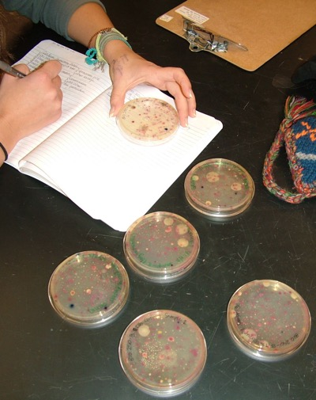
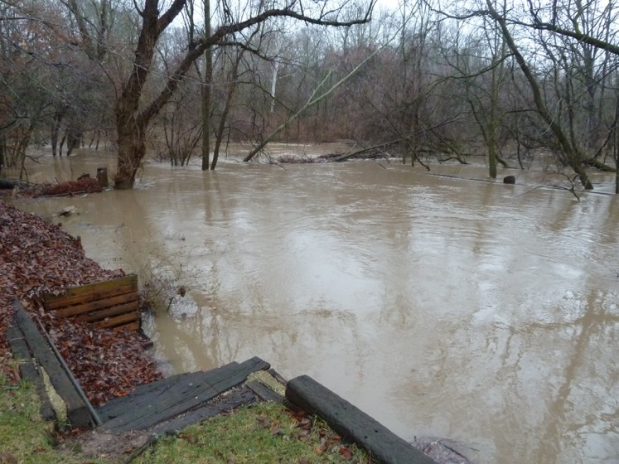
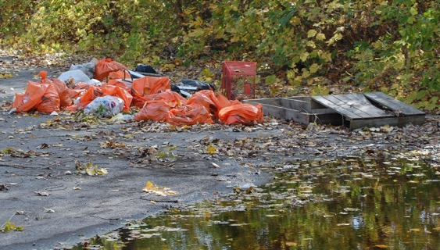
Main Problems
Flow dynamics (volume)
Sediment
Bacterial contamination
Nutrient pollution
Thermal pollution
Trash and Toxic substances

Slide 8
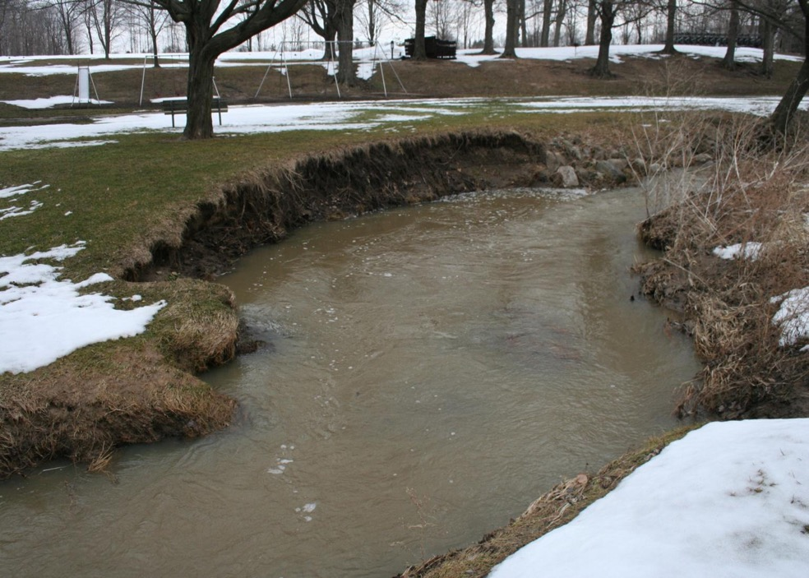

Slide 9
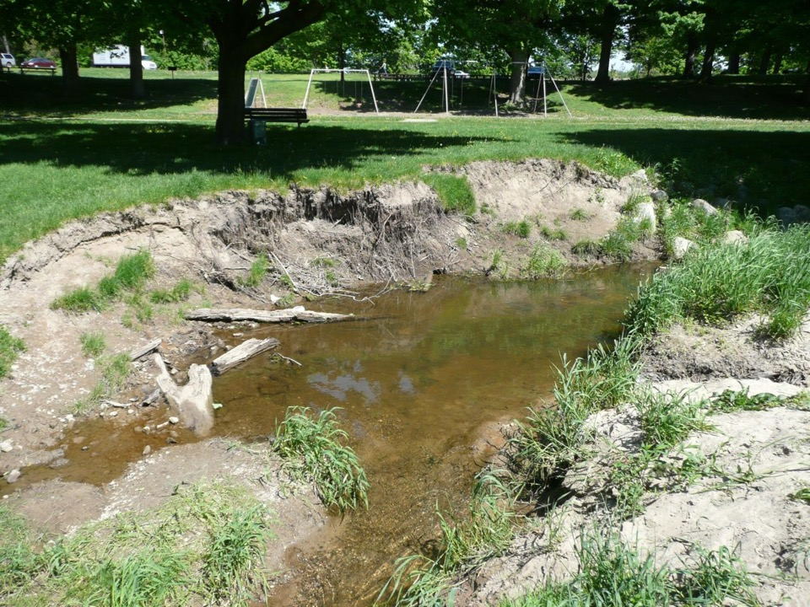

Slide 10
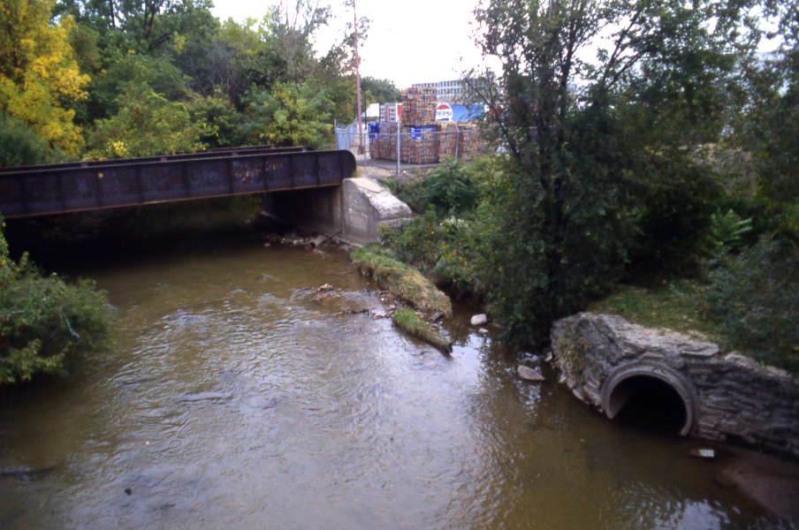
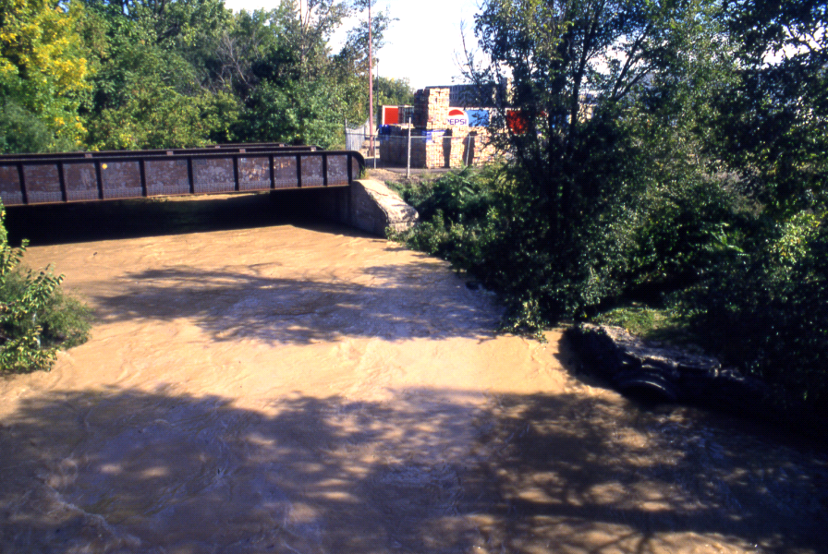

Slide 11
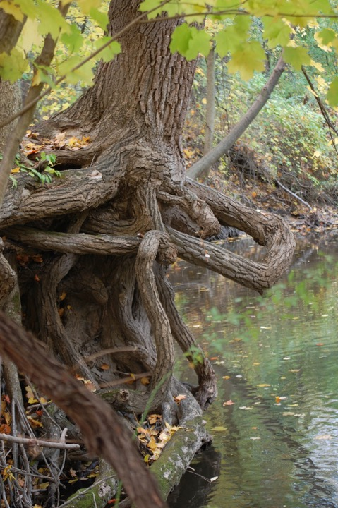
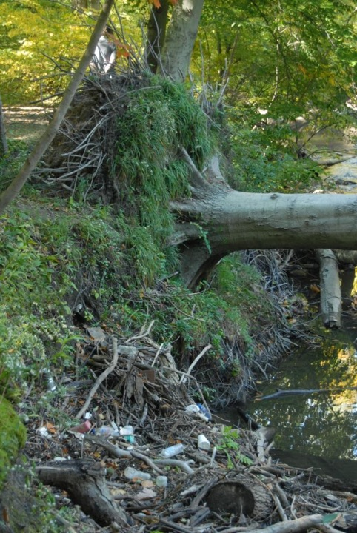

Slide 12
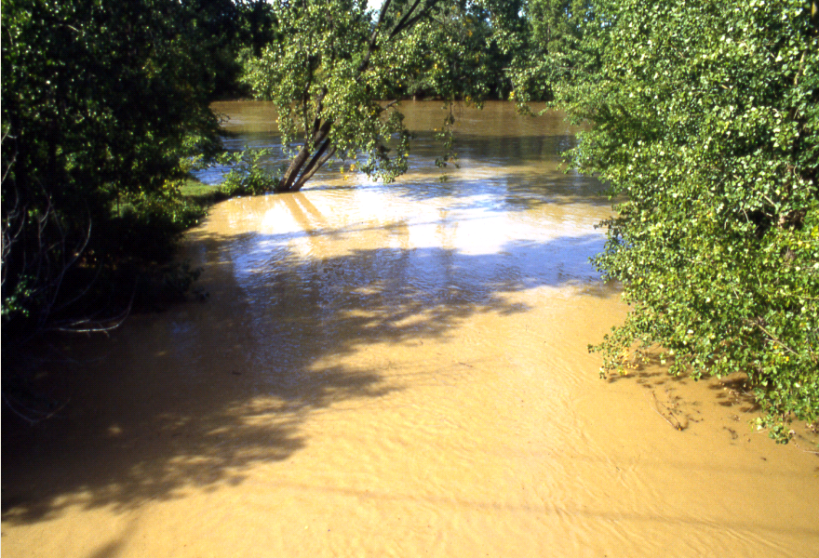

Slide 13
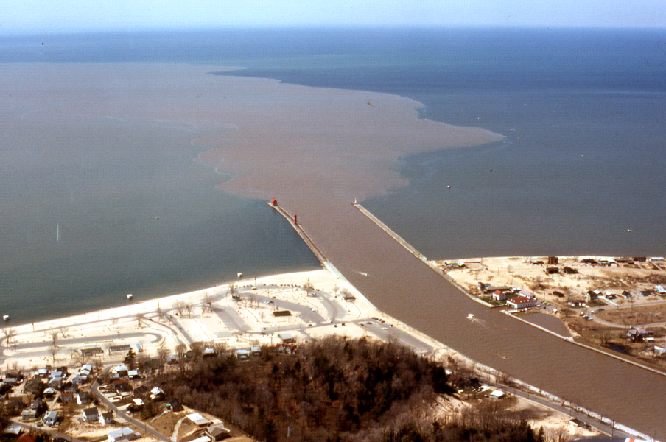

Slide 14
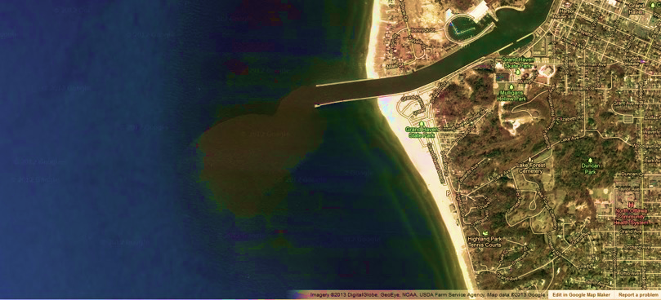

Slide 15
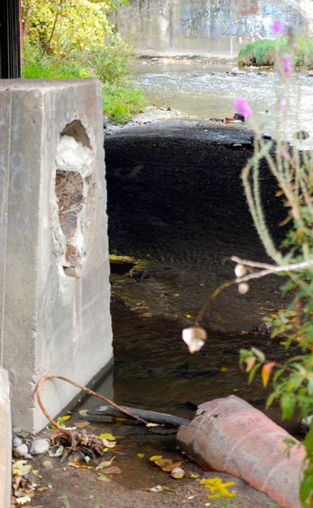
Faith Connection
Some events or experiences in life really catch our attention . . .
. . . the whole earth is filled with his glory
. . . all thy works shall praise thy name
. . . with all creation I sing praise to the
king of kings . . .
Psalm 46
Streams intended as provision, delight
Reconciliation leading to restoration
Notes:
Events/Experiences in life that really catch our attention . . . give us pause, and cause us to think about things differently mayube even challenge the way we have been thinking and living.
PC has done that to us – rain now, pass by Woodland Mall Pkg lot, singing songs in church: The whole earth is filled with his glory . . With all creation I sing, praise to the king of kings . . .All thy works shall praise thy name in earth and sky and sea . . .
Verses: Psalm 46 There is a river whose streams make glad the city of God . . . What we have here is a river whose streams make sad the city of Grand Rapids.
Streams are God’s provision for life this one isn’t. . . Streams are intended to delight . . . This one will break your heart
This is where the concept of reconciliation ecology fits well – we feel that part of our task is to bring people in the watershed to the realization that we have done wrong to this stream . . . Our relationship of abuse and neglect needs to be reconciled and out of such a reconciliation our hope is that restoration can take place.
So, then what we have here is an opportunity, as Gail mentioned earlier, to practice reconciliation, to practice creation care. . . . Practice resurrection

Slide 16
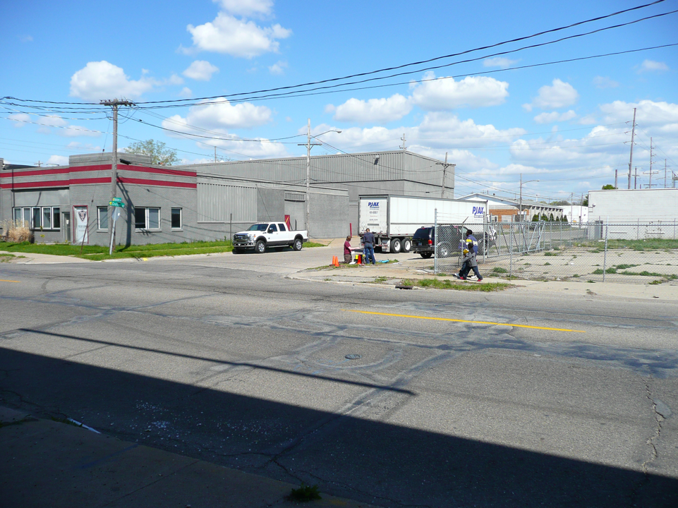
How do we begin restoring health to the watershed?

Slide 17
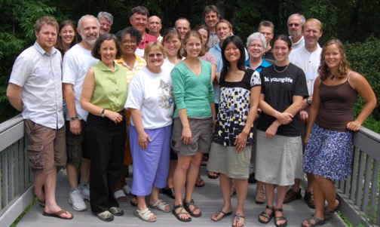
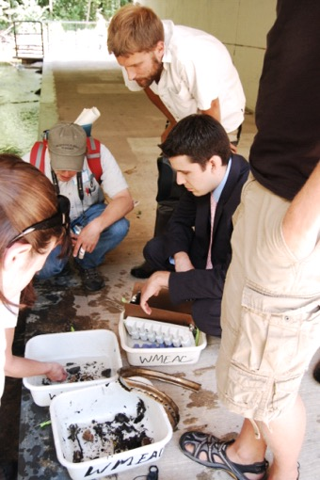
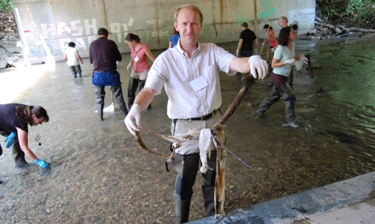
Plaster Creek Stewards
Notes:
So Plaster Creek Stewards has really emerged out of this awareness and concern
These are pictures from our first summer workshop. Among these participants are Calvin students and faculty, community partners, representatives from the denominational building, four local churches, including an assistant from Carl Levin’s office (suit) . . Some of you may recognize Pastor Mike Abma here

Slide 18
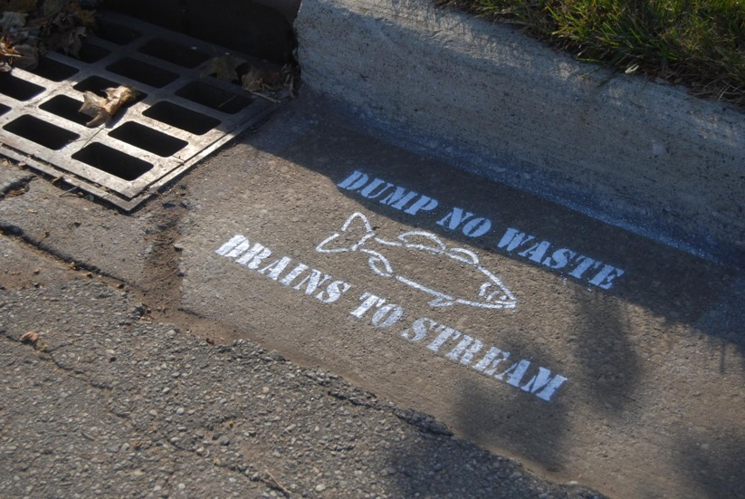
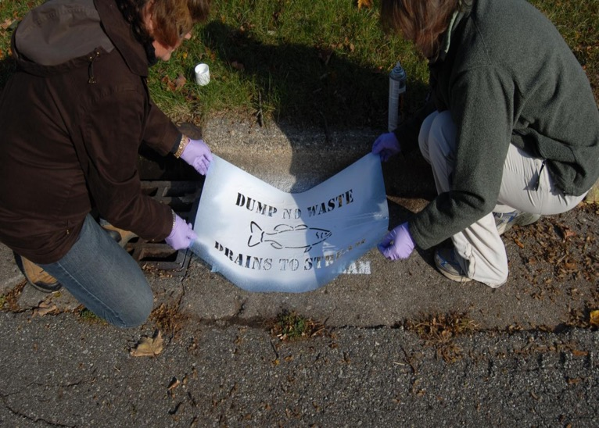
Education and Outreach builds
awareness and concern
Notes:
Our three focus areas: Education and Outreach; Research; Restoration

Slide 19
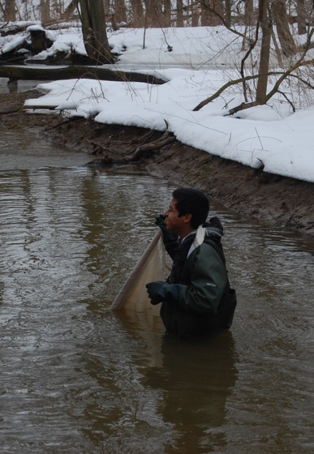
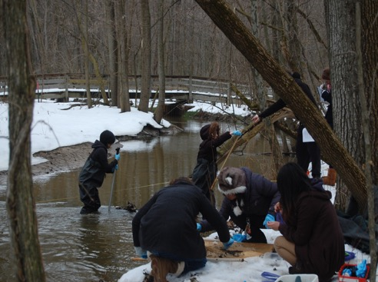
Research leads to a better understanding of how best to help

Slide 20
Social Research
Remembering stories….
Documenting oral histories becomes a way to engage people in watershed protection
Notes:
We are conducting biological research as well as social research.
As we have watched the Plaster Creek Stewards project blossom, residents began to tell stories of their memories of Plaster Creek. An English professor teaching an honors class focused the whole class on the theme of water and students visited Plaster Creek to learn something about its history and current condition. Their final assignment was an oral history project where students met with past and present residents to hear their recollections and tales of the role Plaster Creek has played and still plays in their lives and in the life of their community. Documenting these stories has helped engage students and community members to stretch their imaginations about what is possible in watershed care. We see this project as one example of a critical pedagogy of place building momentum for reconciliation ecology.

Slide 21
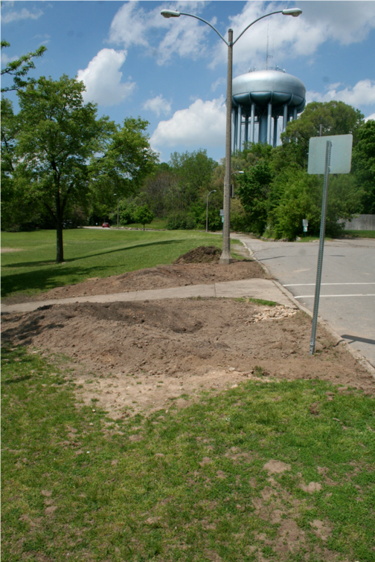
Restoration implements healthier watershed practices

Slide 22
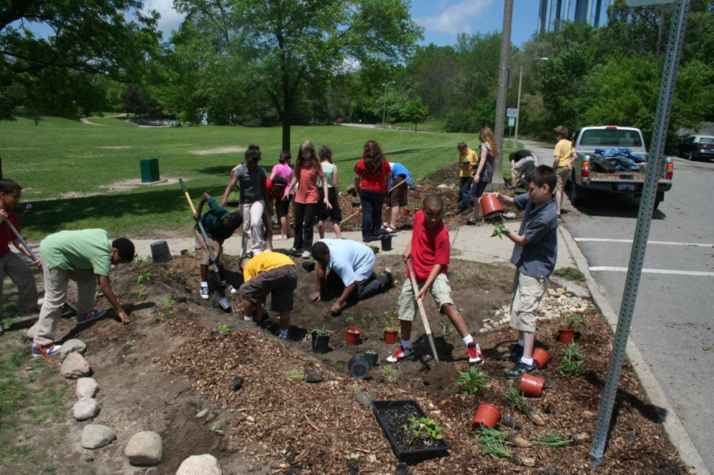

Slide 23
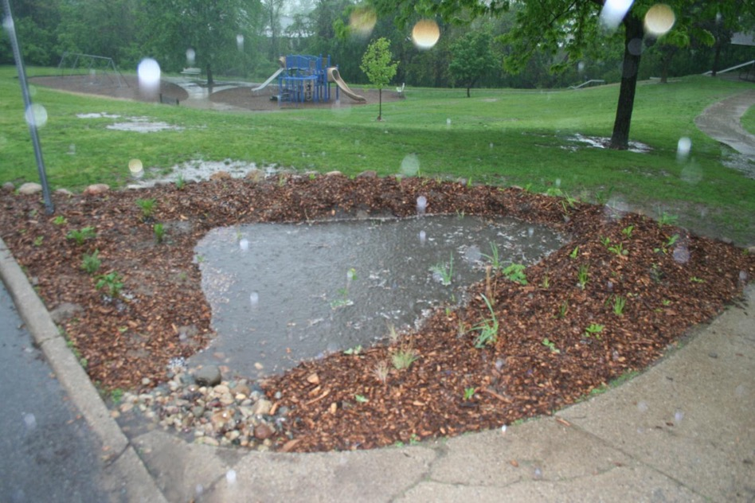

Slide 24
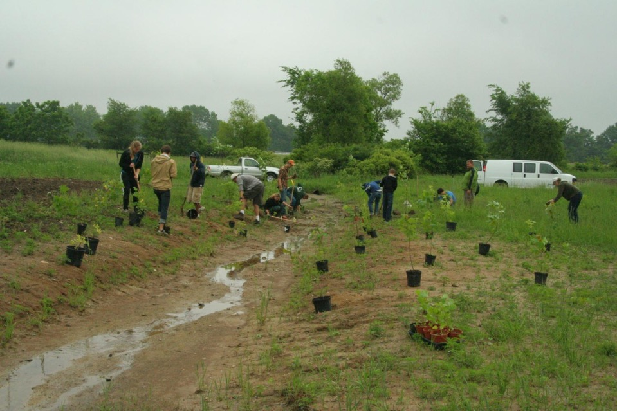
Notes:
With 319 Grant we’ll be doing some educational outreach and training, as well as constructing 4 very large bioswales full of native plants to collect stormwater runoff

Slide 25
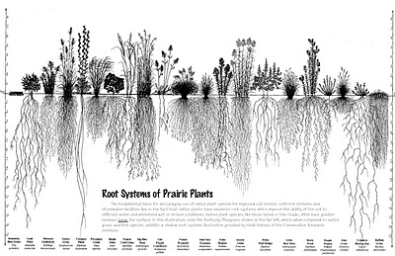
Why native plants?
Deep roots, soak up large volumes of water
Filter excess nutrients, trap excess sediment
Low maintenance - Adapted to local conditions
Essential for insects, birds, other wildlife

Slide 26
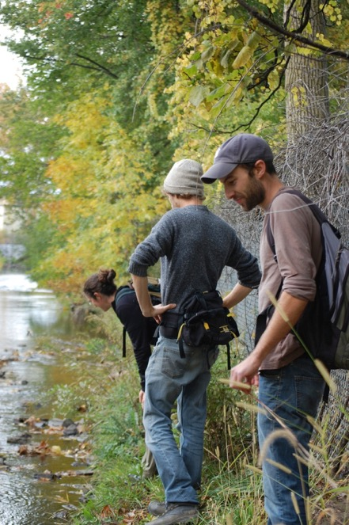
What we can all do:
Think about the water we use and what impacts it has on those downstream
Learn about your own watershed
Manage our stormwater by using rain barrels and planting rain gardens
Join the Plaster Creek Stewards mailing list to receive a newsletter twice a year and be notified of volunteer opportunities
Notes:
PAY ATTENTION!

Slide 27
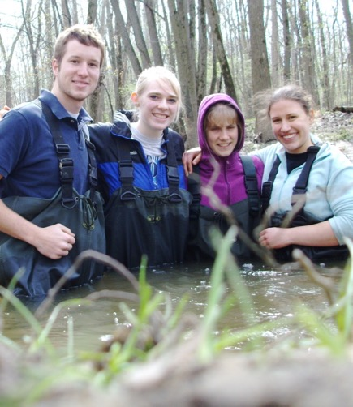
What Calvin faculty can do:
Consider ways to integrate place-based pedagogy into your teaching and research
Attend the spring and fall events (education-restoration)
Invite Plaster Creek Stewards to do adult education at your church, at your neighborhood association, etc.
Notes:
Give interdisciplinary examples---Kristin Du Mez (History), John Timmermans (English),
Thanks to many faculty who have helped us and the Provost’s Office

Slide 28
Find us on the web: ww.calvin.edu/go/plastercreekstewards
Find us on Facebook under Plaster Creek Stewards

Slide 29
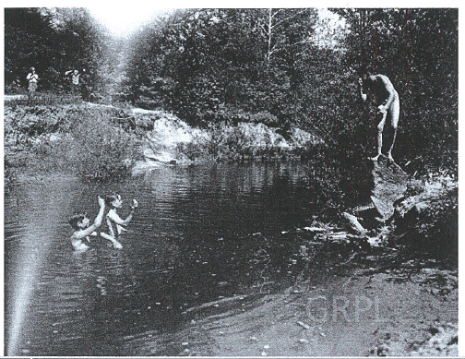
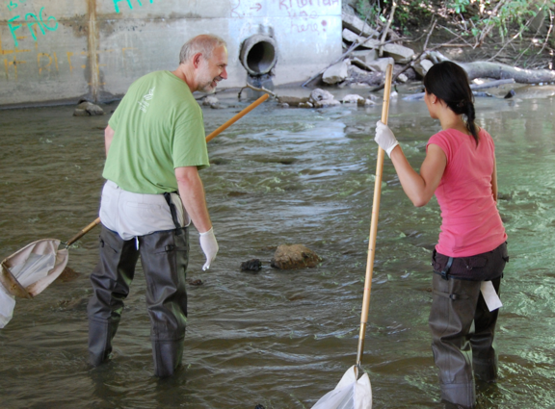
Hopeful Vision

Slide 30
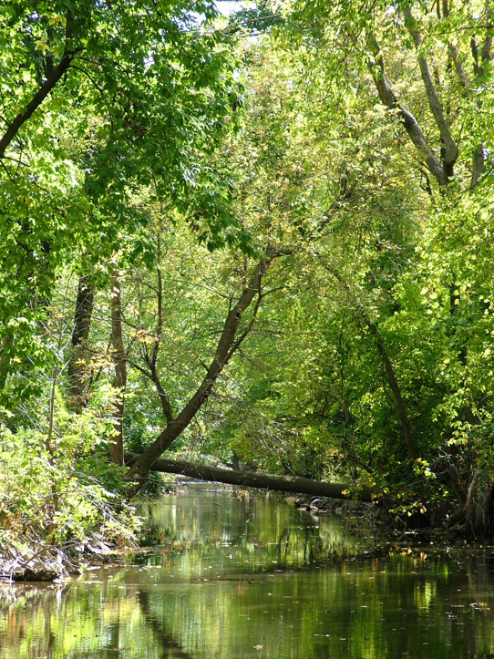
Notes:
Getting worse….Hold Steady…eventually one day we can see that it is getting better

