Slide 1
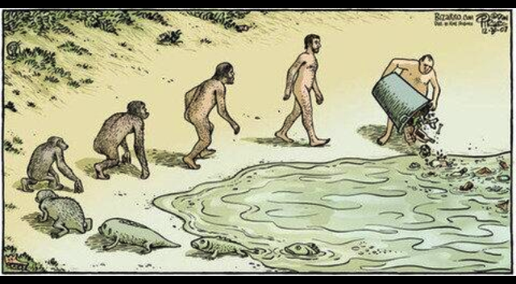
Reconciliation Ecology
A new and helpful paradigm in the evolving lexicon of creation care

Slide 2
Presentation Outline
Brief Overview of Theological Basis for Creation Care
Some Bad News . . .
Hinge point: Good Theology + Bad News = ?
Moving Forward - Reconciliation Ecology
  Secular understanding
  Faith-informed understanding
Plaster Creek Stewards as Reconciliation Ecology Case Study

Slide 3
Overview of Theological Basis
God blessed them and said, "Be fruitful and increase in number and fill the sea and let the birds increase on the earth” (Gen. 1:22)
"Let us make mankind in our image, in our likeness, so that they may rule over the fish in the sea and the birds in the sky . . .” (Gen. 1:26)
"Be fruitful and increase in number; fill the earth and subdue it. Rule over the fish in the sea and the birds in the sky and over every living creature that moves on the ground.” (Gen. 1:28)
Rule = ‘radah’ Subdue = ‘kabash’
And the LORD God took the man, and put him into the garden of Eden, to tend it, and to keep it. (Gen 2:15)
Tend, serve = ‘abad’ Keep, preserve = ‘shamar’

Slide 4
Jesus and Creation (Col. 1:15-20)
. . . in him all things were created: things in heaven and on earth, visible and invisible
. . . all things have been created through him and for him
. . . in him all things hold together
. . . God was pleased to have all his fullness dwell in him, and through him to reconcile to himself all things . . . by making peace through his blood, shed on the cross.

Slide 5
Jesus as our model (Phil 2:5-8)
Have this attitude in yourselves which was also in Christ Jesus, who, although He existed in the form of God, did not regard equality with God a thing to be grasped, but emptied Himself, taking the form of a servant, and being made in the likeness of men . . . He humbled Himself by becoming obedient to the point of death, even death on a cross!
Christians = ‘Christ’s ones’

Slide 6
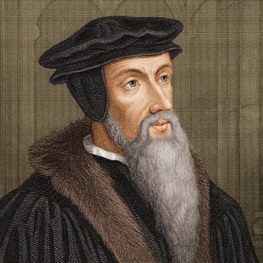
The most perfect way of seeking God . . . is for us to contemplate him in his works whereby
he renders himself near and familiar to us, and in some manner communicates himself . . .
we ought to gaze upon his works that we may be restored by his goodness.
C Institutes I.V:11 (p. 65)

Slide 7
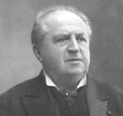
From of old the church has pointed to nature and to the Bible as the sources of knowledge of God . . . the Reformed confession truly and beautifully declares, that all creation is as a living book,
the letters of which are the creatures . . .
It has been learned by heart, and in general it is agreed,
that Divine attributes exhibit themselves in the works of
nature . . . But now that this is known, we are through with
the book of nature . . . so the book is put aside, and there
is no personal, lasting impression of the majesty of God which nature was intended to convey. No one looks for it. No account is made of it . . .
God himself is in and behind nature . . . In everything that lives in nature, rustles, throbs and stirs itself, we feel the pulsebeat of God’s own life . . . In nature also everything is for the sake of religion, to reveal to us in it the glorious presence of God, to bring us the fostering sense that in nature everywhere the living and almighty God is with us on every side, and to fill us with the sublime impression of his Power, Divinity and Majesty.
A. Kuyper, D. D., To Be Near Unto God (pp. 223-230)

Slide 8
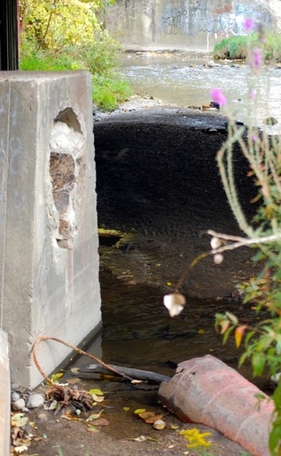
We Have Beautiful Theology . . .
We Sing Songs:
. . . the whole earth is filled with his glory
. . . all thy works shall praise thy name
. . . with all creation I sing praise to the king of kings
. . . This is my Father’s world
We Read Verses:
Psalm 24 – The earth is the Lord’s . . .
Psalm 46 – There is a river . . .
Psalm 139 – Your works are wonderful . . .
Psalm 150 – Let everything . . .
But creation’s groans keep intensifying
Notes:
Events/Experiences in life that really catch our attention . . . give us pause, and cause us to think about things differently mayube even challenge the way we have been thinking and living.
PC has done that to us – rain now, pass by Woodland Mall Pkg lot, singing songs in church: The whole earth is filled with his glory . . With all creation I sing, praise to the king of kings . . .All thy works shall praise thy name in earth and sky and sea . . .
Verses: Psalm 46 There is a river whose streams make glad the city of God . . . What we have here is a river whose streams make sad the city of Grand Rapids.
Streams are God’s provision for life this one isn’t. . . Streams are intended to delight . . . This one will break your heart
This is where the concept of reconciliation ecology fits well – we feel that part of our task is to bring people in the watershed to the realization that we have done wrong to this stream . . . Our relationship of abuse and neglect needs to be reconciled and out of such a reconciliation our hope is that restoration can take place.
So, then what we have here is an opportunity, as Gail mentioned earlier, to practice reconciliation, to practice creation care. . . . Practice resurrection

Slide 9
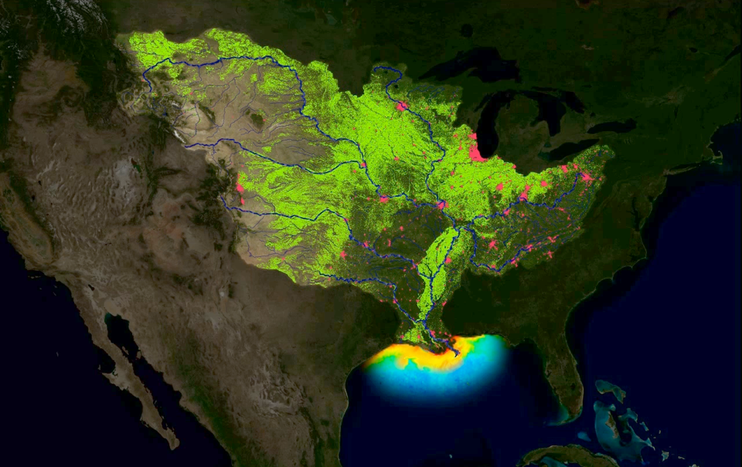
Some of the Bad News . . .

Slide 10
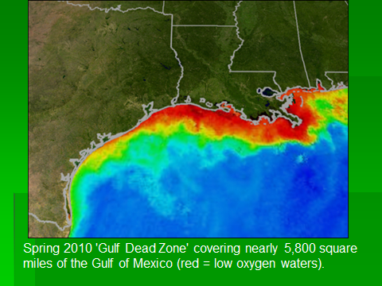
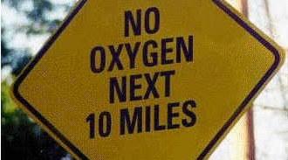

Slide 11
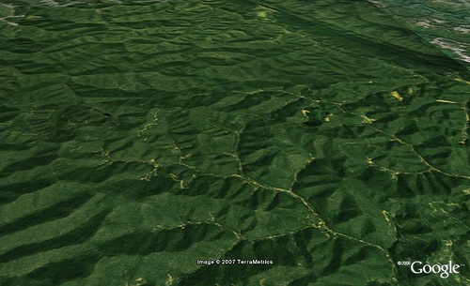
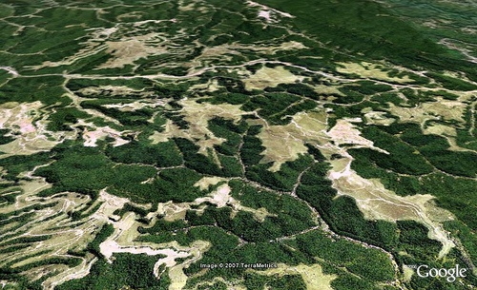
Mountaintop Removal Mining in the
McRoberts, Kentucky Area 1983 and 2004

Slide 12
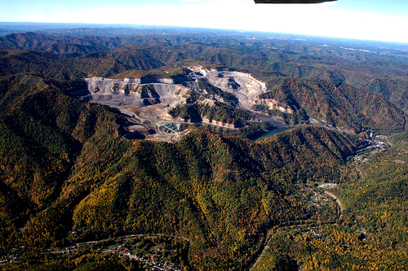

Slide 13
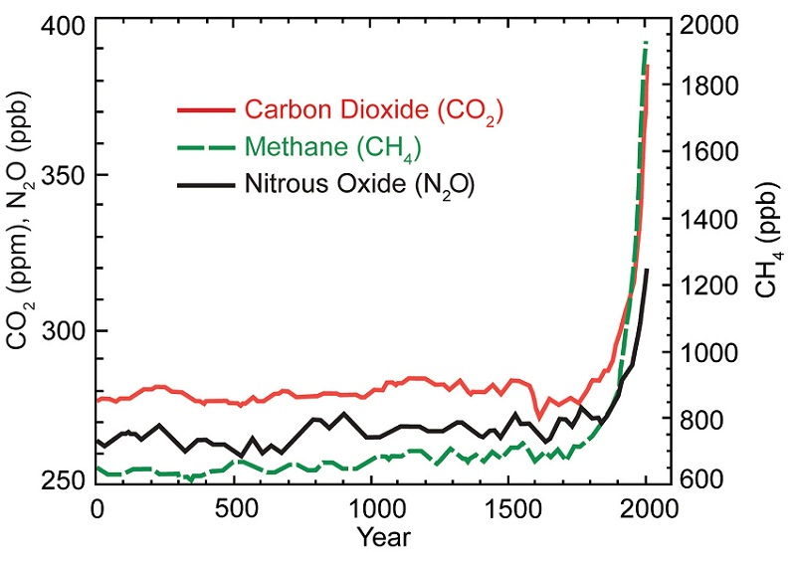
Global Climate Change

Slide 14
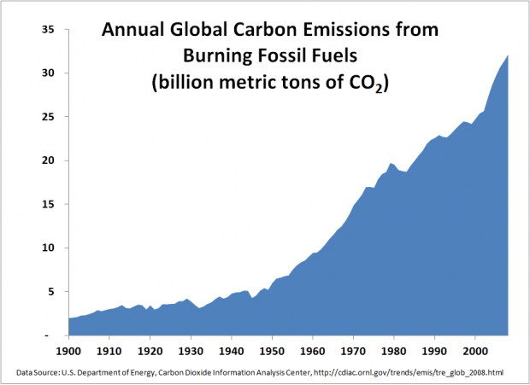

Slide 15
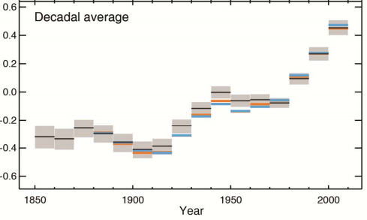
IPCC 2013 – Global temperature

Slide 16
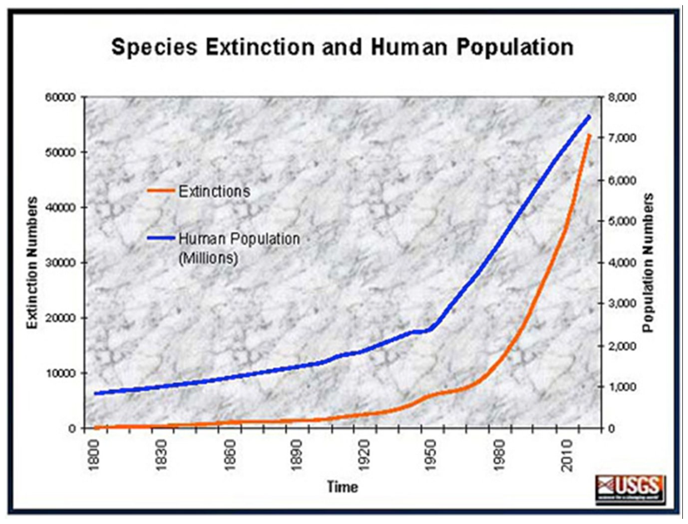

Slide 17
"If there is danger in the human trajectory, it is not so much in the survival of our own species as in the fulfillment of the ultimate irony of organic evolution: that in the instant of achieving self-understanding through the mind of man, life has doomed its most beautiful creations."
E. O. Wilson

Slide 18
Elizabeth Kolbert, The Sixth Extinction
While you and I might not be thrilled to admit it, the extinction of the human race would be the very best possible outcome for the rest of the community of life on our fragile world.
And that could happen. But not before we kill off much of our fellow beings. We don't have to, of course. We still have time. We can still awaken to our true responsibility to serve the Earth and not exploit it to death. We are just an infant species. We are not yet mature but this is our chance to grow. We could face our predatory truth together and begin to take great care. We could. It is one of the choices before us.
But regardless, the age of consequences is upon us. The wild ride has begun. I just wish we could open our eyes. And hearts. And minds. And see, feel and know what we are doing and how it is affecting everything around us.
Our time here is so brief. It would be a shame if our only legacy were ignorance, arrogance and death. We have so much more to offer. What are we waiting for?

Slide 19
Where are we?
Environmental challenges we face today have not inspired a response worthy of their significance.
  (despite adequate and beautiful theology)
We need to better understand/appreciate that we exist in an essential relationship with creation.
Emerging concept of Reconciliation Ecology can help, and it holds particular promise for communities of faith.

Slide 20
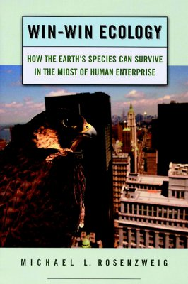
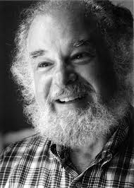
“Need to reconcile human uses of the planet with those of other species”
5% land surface = protected
95% = human dominated
What is Reconciliation Ecology?

Slide 21
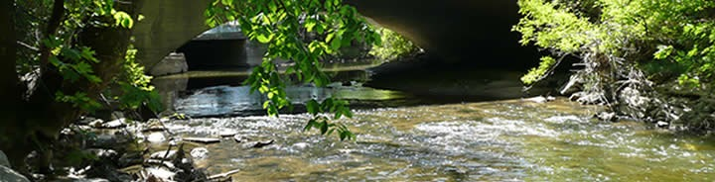
Progression of Ecological Paradigms
Preservation: Setting aside natural areas
Conservation Biology: Managing the preserved areas
Restoration Ecology: Improving degraded areas
Reconciliation Ecology: Sharing our habitats deliberately with other species. Re-inventing the human presence to better accommodate, affirm, and fit into the landscape of biodiversity which surrounds us. The science of restoring, creating and maintaining habitats, and conserving biodiversity in the places where people live, work, or play (Rosenzweig 2003)

Slide 22
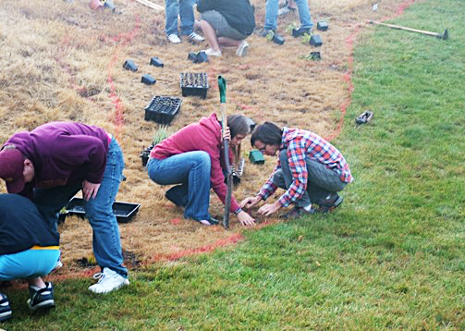
Further Thoughts on Reconciliation Ecology
Reconciliation =
- bringing back together (again);
- getting two things to correspond
(again)
Opposite =
Irreconcilable

Slide 23
God
Non-human Creation
Humans
NhC
NhC
Humans
Humans

Slide 24
God
Non-human Creation
Humans
NhC
NhC
Humans
Humans

Slide 25
God
Reconciliation
Non-human Creation
Humans
NhC
NhC
Humans
Humans

Slide 26
Reconciliation between God and humanity
Ezekiel 45:17 The prince shall be required to furnish the people with sacrifices for public worship—sin offerings, burnt offerings, meal offerings, drink offerings, and thank offerings—to make reconciliation for the people of Israel.
Romans 5:11 . . . we also rejoice in God through our Lord Jesus Christ, through whom we have now received this reconciliation.
II Corinthians 5:18 And all these things are from God who reconciled us to himself through Christ . . .

Slide 27
God
Reconciliation
Non-human Creation
Humans
NhC
NhC
Humans
Humans

Slide 28
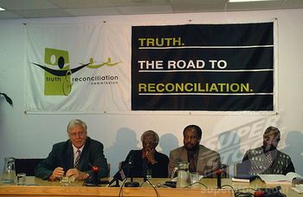
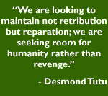
Reconciliation among people - South Africa’s Truth and Reconciliation Commission (TRC)

Slide 29
Reconciliation among people
In one case, a police officer who masterminded the butchering of a number of families in an attack on a rural village faced his victims: "I can never undo what I have done," he said. "I have no right to ask your forgiveness, but I ask that you will allow me to spend my life helping you to rebuild your village and put your lives together." Out of the horrors of the past, the TRC makes space for grace, and the potential for newness in South Africa shines through.
“. . . there is no peace without confronting the hurts of history.” - Bishop Desmond Tutu

Slide 30
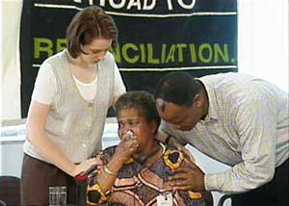
Reconciliation – Basic Steps
1. Recognition of wrong that was done
2. Admission of complicity (regret, lament)
3. Commit to no further harm, work to alleviate past harm
4. Grace extended by those wronged, accepted by perpetrators
5. Agreement to move forward
in a new relationship.

Slide 31
God
Reconciliation
Non-human Creation
Humans
NhC
NhC
Humans
Humans

Slide 32
Colossians 1:20
. . . God was pleased to have all his fullness dwell in him, and through him to reconcile to himself all things . . . by making peace through his blood, shed on the cross.
II Corinthians 5:18
And all these things are from God who reconciled us to himself through Christ, and who has given us the ministry of reconciliation.

Slide 33

protect the future of a planet in peril?
ShareThis Copy and Paste
ShareThis Copy and Paste
MORAL GROUND: Ethical Action for a Planet in Peril
edited by Kathleen Dean Moore and Michael P. Nelson (Trinity University Press)
All we have to do to wreck the planet is just keep doing what we are doing now.
Why should we act rightly and change our destructive ways?

Slide 34
Michael P. Nelson
We often hear that people only change their ideas, and therefore their behavior, in the face of crisis. But we forget that a crisis can be a moral crisis as well, a sense of revulsion for a life that we are living, a commitment to live differently and to be a different kind of person. We need The Great “yuck!” Yuck, what we are doing is repulsive. Yuck, this is not the way a responsible person lives. The Great “yuck!” can be followed by The Great “no!” No, I will not live this way. No, I will not be this kind of a person, this kind of an agent in the world. Finally, The Great “no!” will give way to The Great “yes!” Yes, I will live a life of respect, of humility, empathy, care, and attentiveness. Yes, I will choose to live with dignity and grace, no matter what.

Slide 35

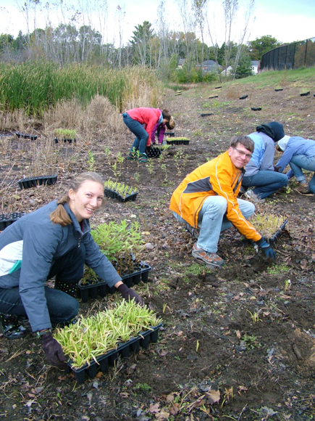
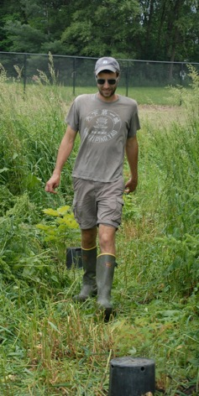
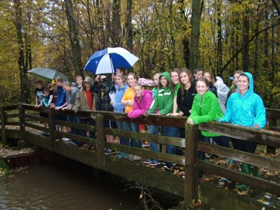
Plaster Creek Stewards as an Example of Reconciliation Ecology

Slide 36
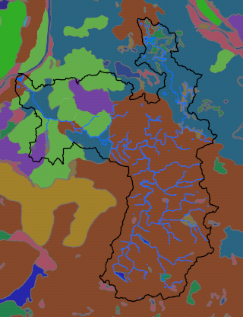
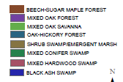
Plaster Creek Watershed Land cover ca. 1800

Slide 37
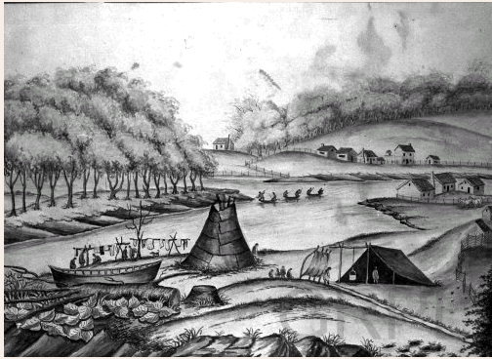
History of Plaster Creek
16,000 ya Glacier recedes
2,000 ya Native Americans
(Hopewell)
1500 Odaawaa Indians
1615 Samuel de Champlain
“Kee-No-Shay Creek”
Early 1800s – Chief Blackbird
1826 - Grand Rapids founded
by missionaries
1841 – First plaster mill
1900 – Last lumbering completed
1940s – Silver Creek culverted
2008 – Plaster Creek Watershed Management Plan
2009 – Plaster Creek Stewards formed
2011 - Green Grand Rapids Master Plan

Slide 38
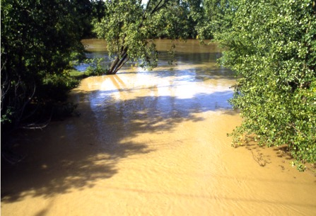
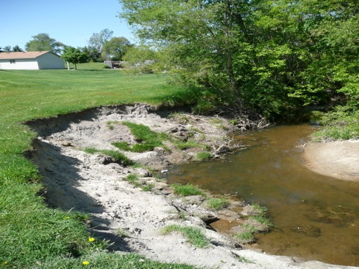
Plaster Creek

Slide 39
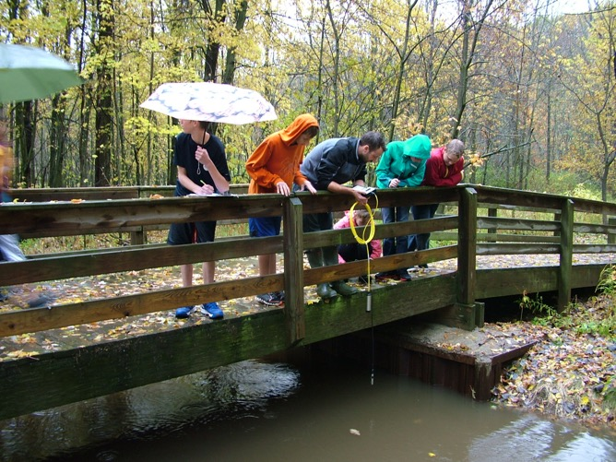
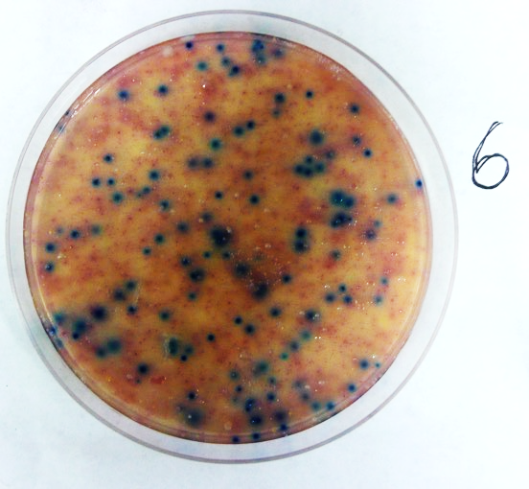
WQS for safe full body contact: <130 E. coli per 100ml as a 30-day mean, with no more than 300 in any single reading.
>5200
E. coli colonies per 100ml !!

Slide 40
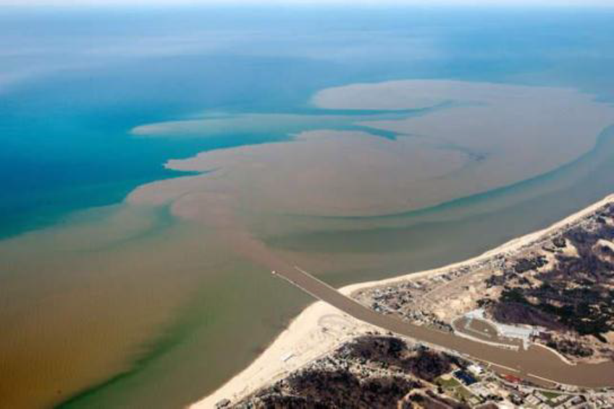
Lake Michigan at
Grand Haven
April 28, 2013

Slide 41
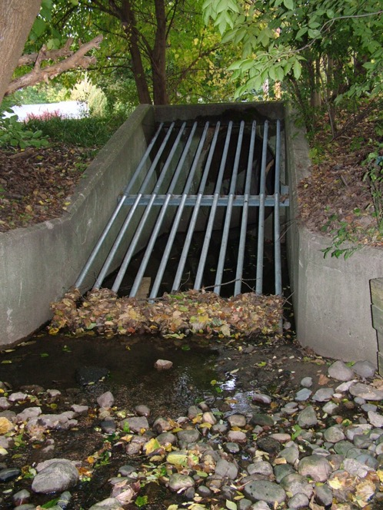
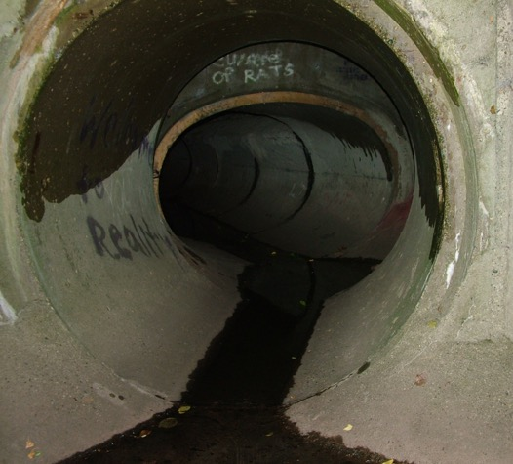
Silver Creek

Slide 42
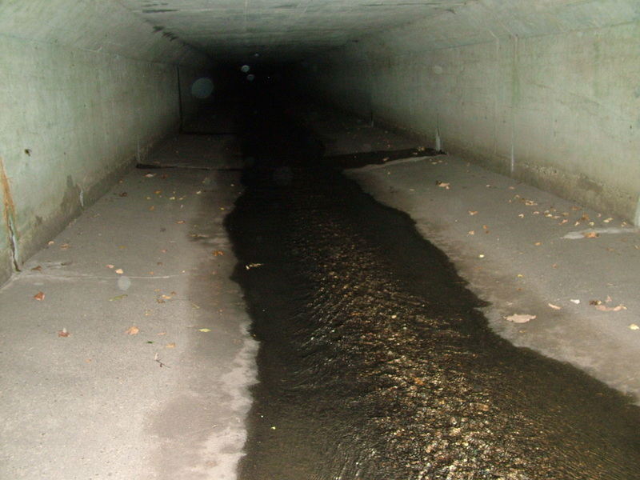

Slide 43
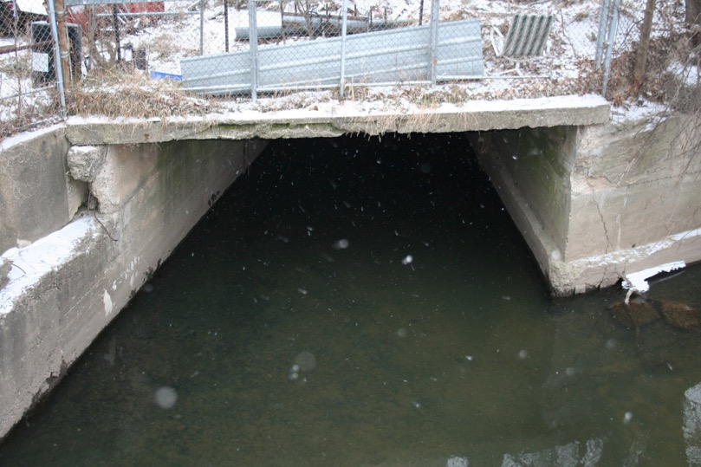

Slide 44
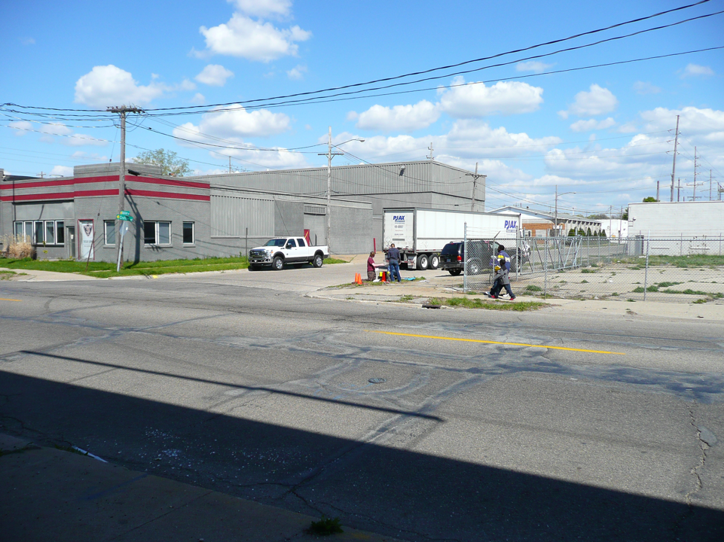
Silver Creek
April, 2012

Slide 45
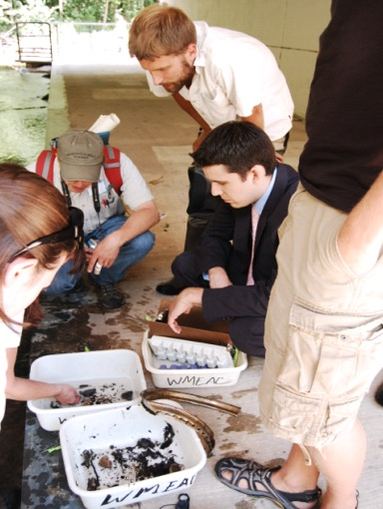
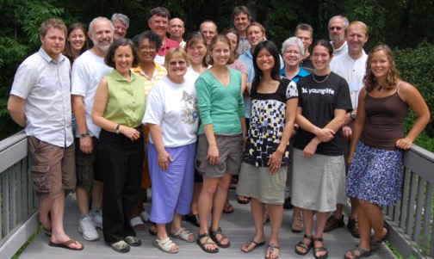
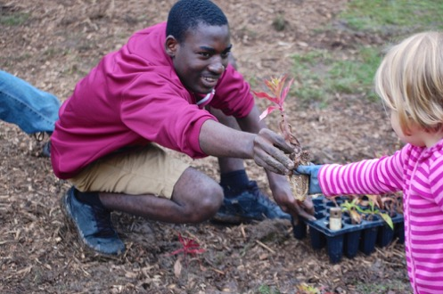
Plaster Creek Stewards
A collaboration of Calvin College faculty, staff, and students working together with local schools, churches, and community partners to restore health and beauty to the Plaster Creek Watershed.

Slide 46
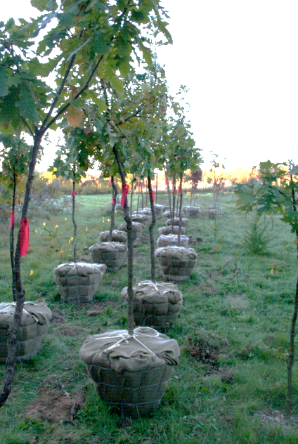
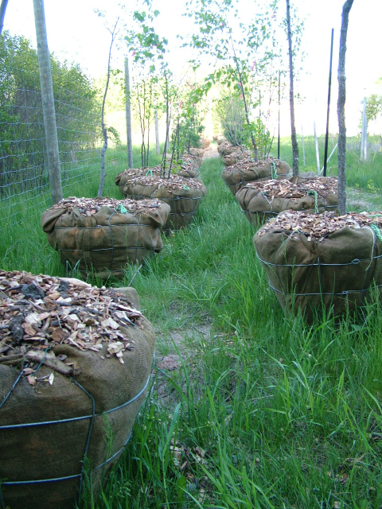

Slide 47
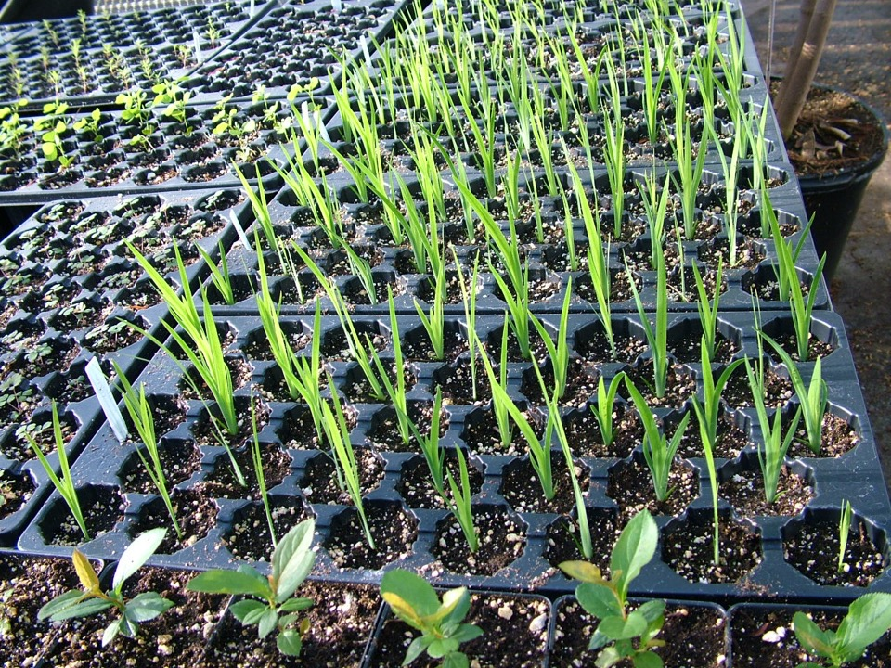

Slide 48
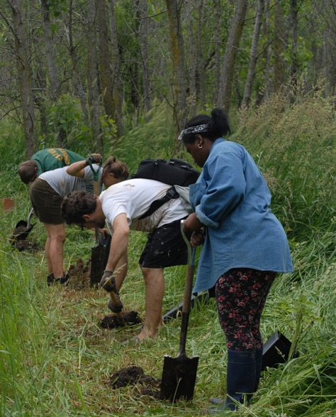
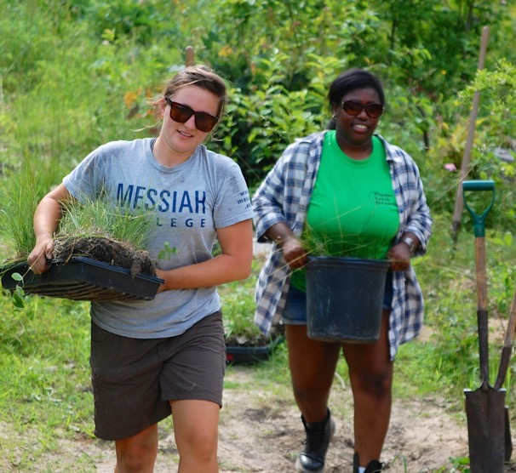

Slide 49
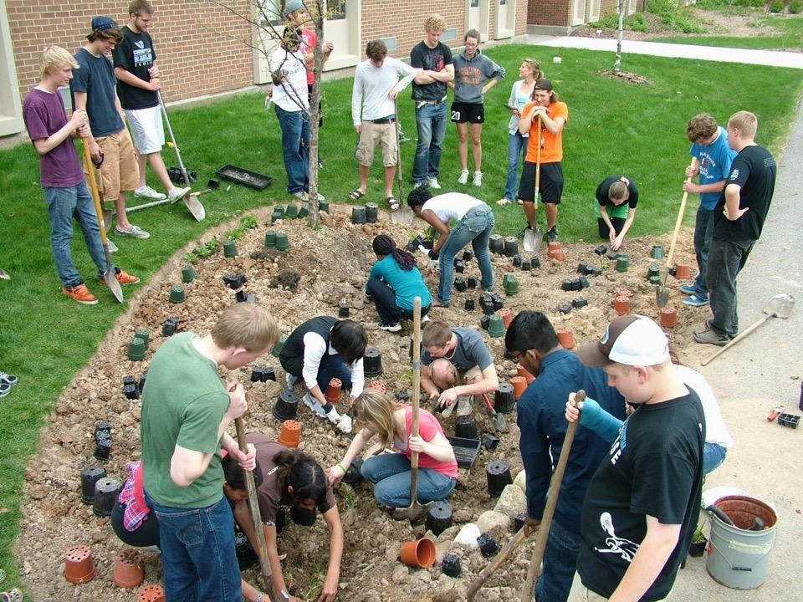

Slide 50
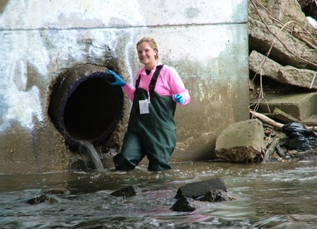
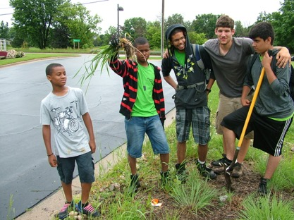
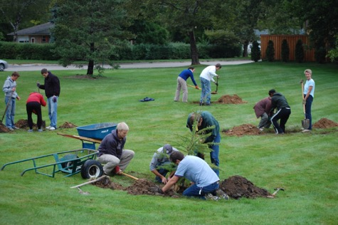
Reconciliation -
Ecological version
1. Recognition of wrong that was done
2. Admission of complicity (regret, lament)
3. Commit to no further harm, work to alleviate past harm
4. Grace extended by those wronged, accepted by perpetrators
5. Agreement to move forward
in a new relationship.

Slide 51
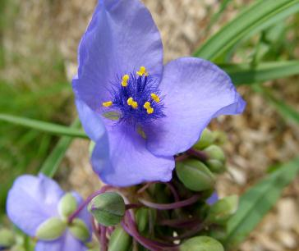




Slide 52





One place
One plant
One half hour:
Solidago rigida (Stiff goldenrod)

Slide 53

Ecologically Reconciled Future:
Fewer toxins
Cleaner air
Healthier people
Less volatile weather
Social equity
More birds, butterflies
Mountains with tops
Swimmable, playable waters
Fish we can eat
More beauty, less ugliness (less yuck)

Slide 54
Concluding Thoughts
Living sustainably and becoming responsible stewards is a significant challenge and a necessary goal (a sustainable future will be much better than an unsustainable one)
Introducing reconciliation ecology into the Creation Care dialogue is a helpful progression (focus on relationships and the changes that we need to make)
II Corinthians 5:18 And all these things are from God who reconciled us to himself through Christ, and who has given us the ministry of reconciliation.

Slide 55


Slide 57
Calvin College Carbon Budget 2007

Slide 58
Calvin College Carbon Budget 2007
Carbon Sequestration (MTCE/yr)
Carbon Emissions
(MTCE/yr)
Total Sequestration: 51 MTCE
Total Emissions: 66,400 MTCE

Slide 59
American College and University Presidents’ Climate Commitment
Adrian College
Albion College
Aquinas College
Butler University
Carleton College
Case Western Reserve University
College of Menominee Nation
Goshen College
Grand Rapids Community College
Grand Valley State University
Grinnell College
Gustavus Adolphus College
Hillsborough Community College
Houghton College
Kalamazoo College
Lake Superior College
Luther College
Macalester College
Messiah College
Middlebury College
Northland College
Oberlin College
Point Loma Nazarene University
Swarthmore College
Texas Christian University
Trinity College
Washtenaw Community College
Western Michigan University
Whitworth University
Wittenberg University

Slide 60

Closing Story: ,
San Gerardo de Dota, Costa Rica

Slide 61

Don Efrain Chacon

Slide 62


Slide 63


Cloud Forest

Slide 64



Slide 65


Slide 66


Slide 67


Slide 68

Unsustainable Practices
Clear cutting the forest
Dairy cows raised on steep slopes
Sustainable Alternatives
Mixed Orchards
Fish Farming
Ecotourism

Slide 69


Slide 70


Slide 71


Slide 72


Slide 73


Slide 74

Hotel Savegre de Montana

Slide 75


Slide 76


Slide 77



Slide 78


Slide 79
A global analysis of the impacts of urbanization on bird and plant diversity reveals key anthropogenic drivers
Myla F. J. Aronson1⇑, Frank A. La Sorte2, Charles H. Nilon3, Madhusudan Katti4, Mark A. Goddard5, Christopher A. Lepczyk6, Paige S. Warren7, Nicholas S. G. Williams8,9, Sarel Cilliers10, Bruce Clarkson11, Cynnamon Dobbs12, Rebecca Dolan13, Marcus Hedblom14, Stefan Klotz15, Jip Louwe Kooijmans16, Ingolf Kühn15, Ian MacGregor-Fors17, Mark McDonnell9, Ulla Mörtberg18, Petr Pyšek19,20,21, Stefan Siebert10, Jessica Sushinsky22, Peter Werner23 and Marten Winter24
+
Abstract
Urbanization contributes to the loss of the world's biodiversity and the homogenization of its biota. However, comparative studies of urban biodiversity leading to robust generalities of the status and drivers of biodiversity in cities at the global scale are lacking. Here, we compiled the largest global dataset to date of two diverse taxa in cities: birds (54 cities) and plants (110 cities). We found that the majority of urban bird and plant species are native in the world's cities. Few plants and birds are cosmopolitan, the most common being Columba livia and Poa annua. The density of bird and plant species (the number of species per km²) has declined substantially: only 8% of native bird and 25% of native plant species are currently present compared with estimates of non-urban density of species. The current density of species in cities and the loss in density of species was best explained by anthropogenic features (landcover, city age) rather than by non-anthropogenic factors (geography, climate, topography). As urbanization continues to expand, efforts directed towards the conservation of intact vegetation within urban landscapes could support higher concentrations of both bird and plant species. Despite declines in the density of species, cities still retain endemic native species, thus providing opportunities for regional and global biodiversity conservation, restoration and education.
anthropogenic activities global biodiversity native species density of species urbanization
Received December 20, 2013.
Accepted January 17, 2014.
© 2014 The Author(s) Published by the Royal Society. All rights reserved.

Slide 80
“Despite declines in the density of species, cities still retain endemic native species, thus providing opportunities for regional and global biodiversity conservation, restoration and education.”

