Slide 1
Rainscaping for watershed restoration
Neil Gilbert
Andrea lubberts
Michael ryskamp

Slide 2
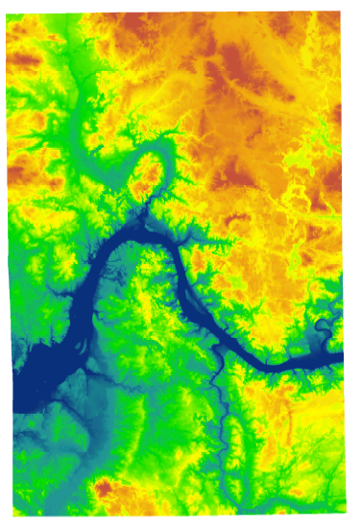
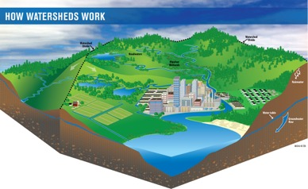
Quizbowl
What is a watershed?
Plaster Creek runs directly into Lake Michigan (T/F?).
An area of land that “drains” to a common point.
All of the “stream’s land.”

Slide 3
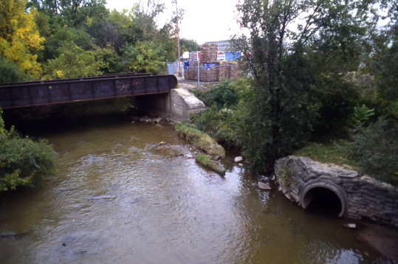
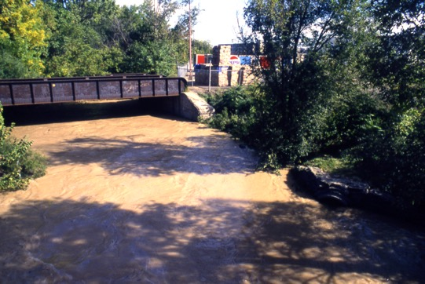
Quizbowl
Why does Plaster Creek turn brown after it rains? Why does the Rogue River turn less brown than Plaster Creek after a rain storm?

Slide 4
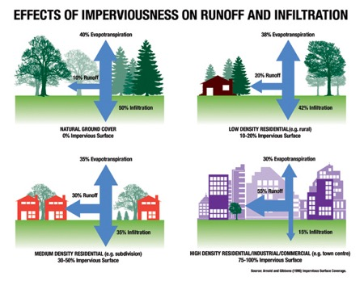

Slide 5
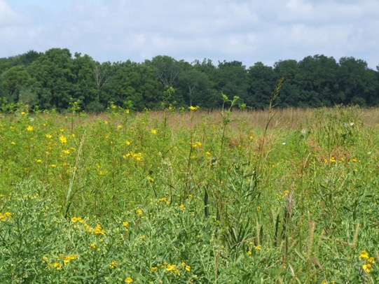
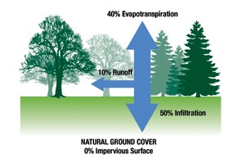

Slide 6
About 50% of the watershed

Slide 7
Quizbowl
If you took a sample of water from Plaster Creek, what would you find in it (besides water)?
What makes the water in Plaster Creek unsafe for human contact?
About how much sediment flows through Plaster Creek each year?

Slide 8
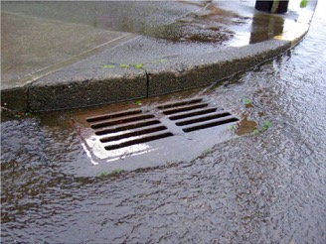
Quizbowl
How do urban landscapes alter the natural water cycle?
Where does the water go after it enters a storm drain?

Slide 9
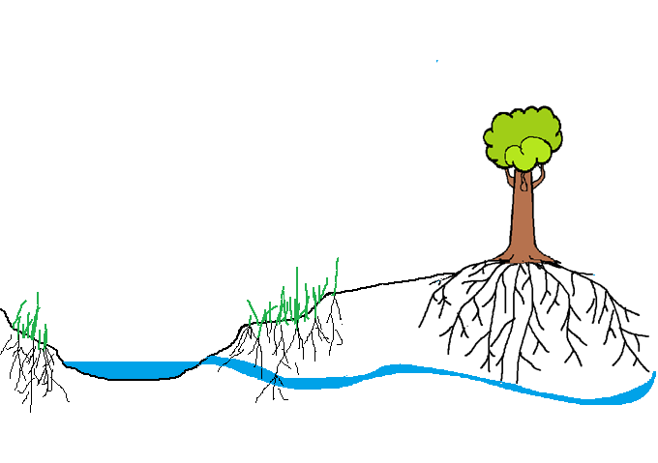
Two different stormwater stories….
Stream channel
Groundwater

Slide 10
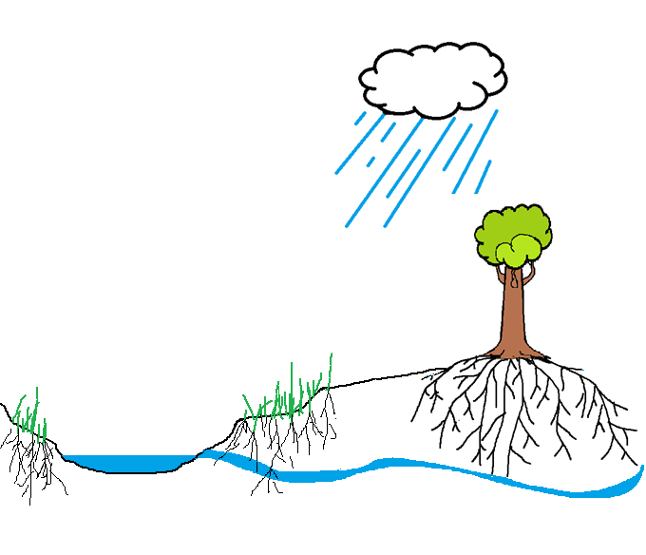
What happens when it rains?
The slow and steady story
Interception
Evaporation
Stream channel
Groundwater

Slide 11
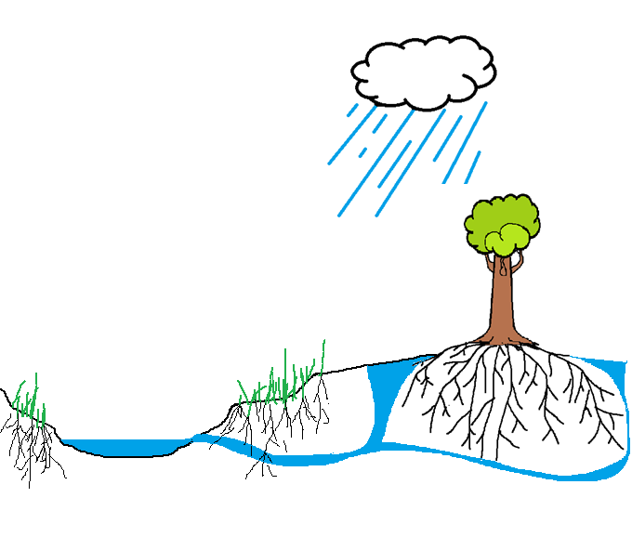
What happens when it rains?
The slow and steady story
Interception
Evaporation
Infiltration
Transpiration (plants)
Groundwater storage
Groundwater discharge
(Surface Runoff)
Stream channel
Groundwater

Slide 12
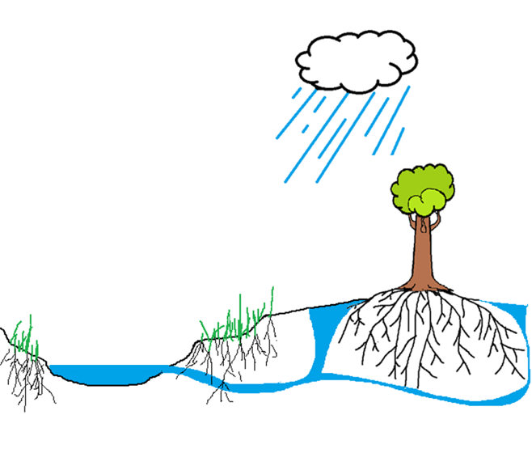
What happens when it rains?
The slow and steady story
Interception
Evaporation
Infiltration
Transpiration (plants)
Groundwater storage
Groundwater discharge
(Surface Runoff)
Stream channel
Groundwater

Slide 13
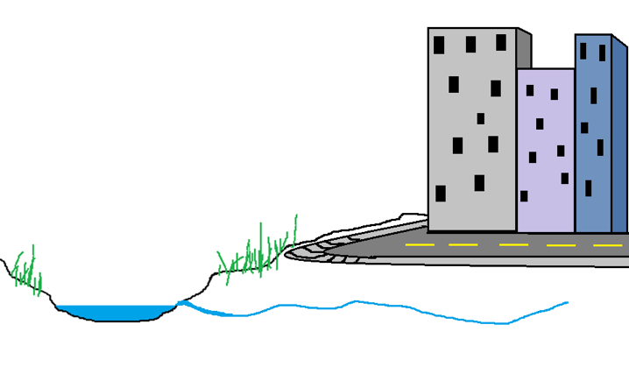
What happens when it rains?
The quick and dirty story…
Stream channel
Groundwater

Slide 14
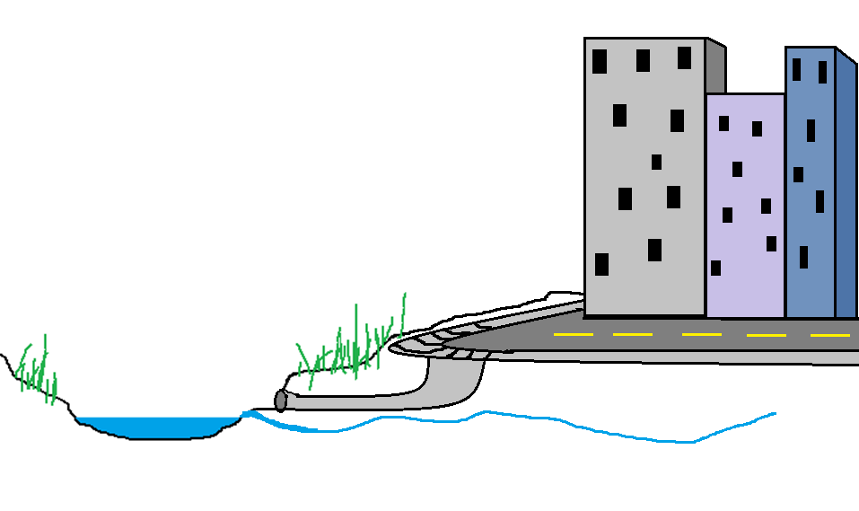
What happens when it rains?
The quick and dirty story…
Stream channel
Groundwater

Slide 15
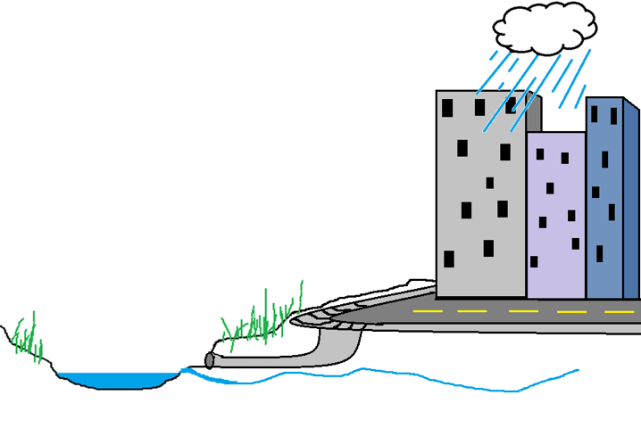
What happens when it rains?
The quick and dirty story…
Stream channel
Groundwater

Slide 16
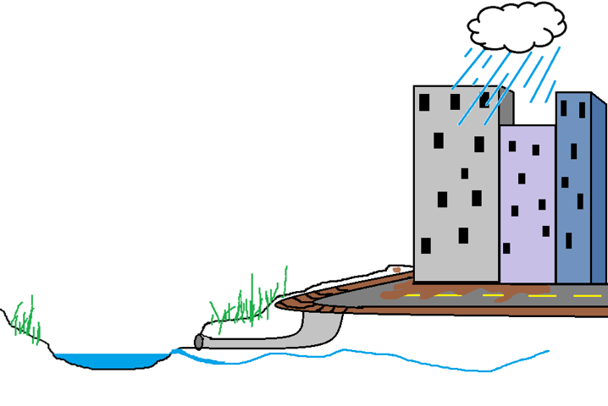
`
What happens when it rains?
The quick and dirty story…
Stream channel
Groundwater

Slide 17
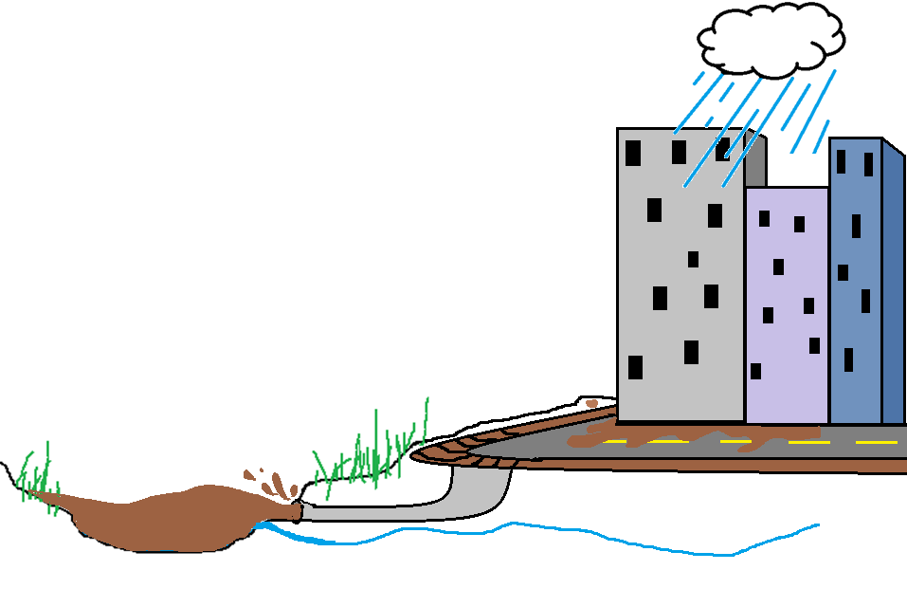
What happens when it rains?
The quick and dirty story…
Stream channel
Groundwater

Slide 18
Quizbowl
Give three examples of Green Infrastructure (GI). Do you know of any Green Infrastructures in Grand Rapids?
What proportion of urban streams in the US are degraded?
How are these two questions related?

Slide 19
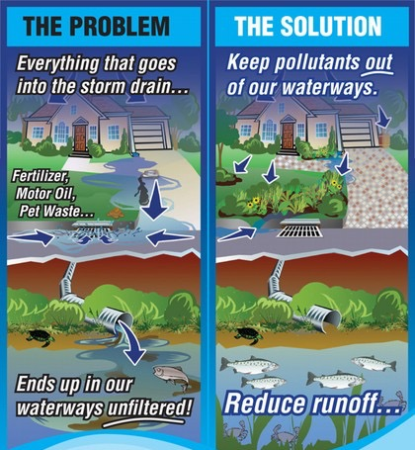
How is Green infrastructure a paradigm shift?

Slide 20
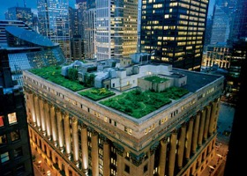
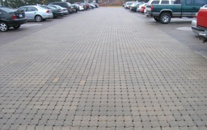
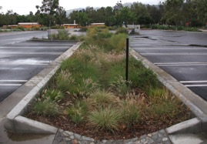
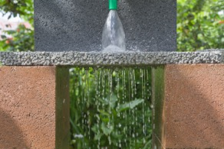

Slide 21
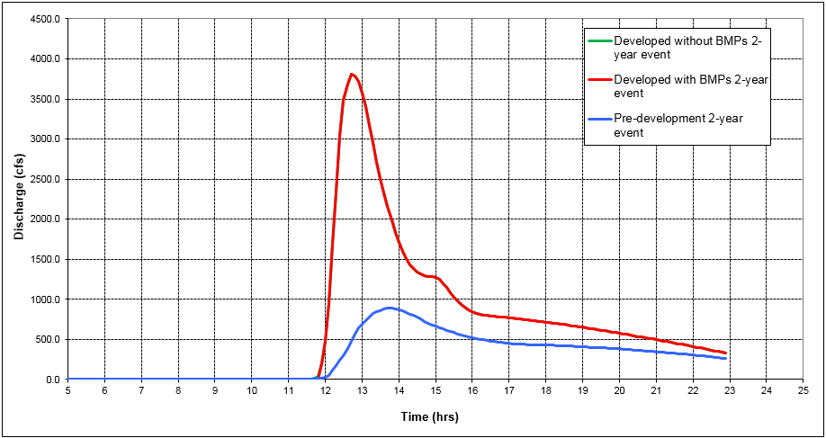
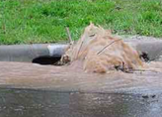
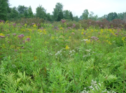
Green vs Gray
Notes:
Entire watershed
Tc (existing/developed) = 2.0 / 0.5 hrs
Area = 37,120 ac
Existing = Meadow, B (CN = 58)
Developed = Impervious (5%), open space - good (95%), B (CN = 61)
Bioretention = 23,000 cf
Runoff volumes:
Developed (area under green/red curve) = 44.9 million cft
Pre-development (under blue curve) = 21.3 million cft
Difference (what we’d like to capture) = 23.6 million cft

Slide 22
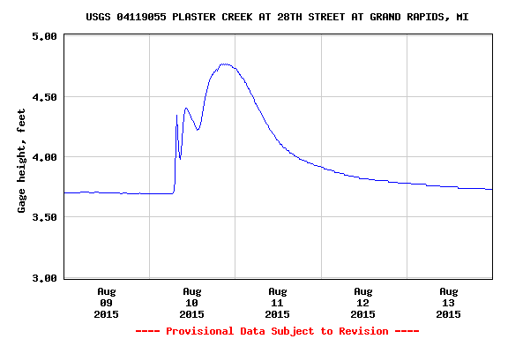

Slide 23
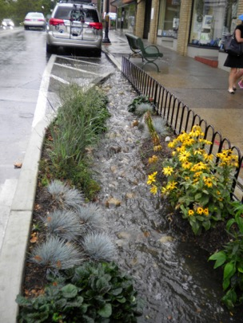
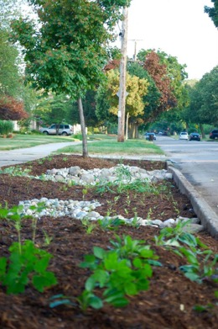

Slide 24
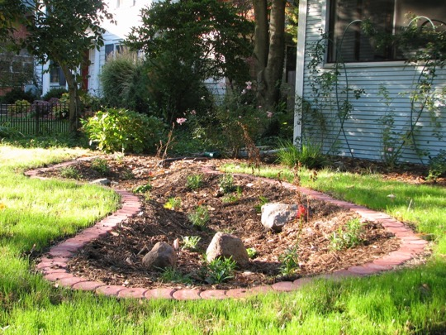

Slide 25
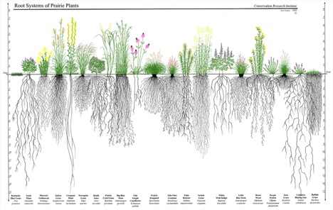
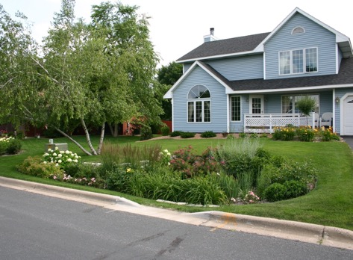
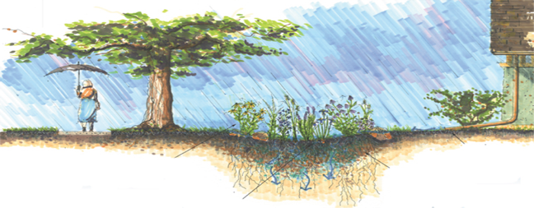
A model rain garden
Rain Gardens are designed to capture and clean stormwater!
And use native plants!
Keep it in full sun! (or in well draining soils)
Keep it 10’ from foundation
Avoid putting your rain garden in the “soggy bottom” areas of your yard (that spot that’s always wet)…

