Slide 1
Loving Your Downstream Neighbor: Environmental Justice and
Plaster Creek
Gail Gunst Heffner
David P. Warners
Notes:
The familiar passage in Micah 6:8 reminds us of what the Lord requires of us---to do justice, to love mercy and to walk humbly with our God.
But putting flesh on these words, acting on them, embodying them is no simple task.
Sometimes our acts of injustice are invisible to us and we are not aware and conscious of how we are living in ways that cause harm to others. (Read excerpt from Educating for Eco-Justice and Community (Bowers), p.16
We are never neutral---everything we do is either part of the problem or part of the solution to the big daunting issues we face.
In this presentation, we will try to show how important it is for us to begin to pay attention to the impact our lives are having on people, on the earth, in our own communities. And we will give you some ideas about action we can take to be part of the solution, not the problem.
Introduce Plaster Creek watershed----define watershed

Slide 2
People who live at the lower ends of watersheds cannot be isolationist—or not for long. Pretty soon they will notice that water flows, and that will set them to thinking about the people upstream who either do or do not send down their silt and pollutants and garbage. Thinking about the people upstream ought to cause further thinking about the people downstream. Such pondering on the facts of gravity and the fluidity of water shows us that the golden rule speaks to a condition of absolute interdependency and obligation. People who live on rivers might rephrase the rule in this way: Do unto those downstream as you would have those upstream do unto you.
From Watershed and Commonwealth by Wendell Berry
Notes:
Stories--- African American grandfather and grandson fishing downstream in Plaster Creek and Dave witnessed an Asian immigrant fishing.

Slide 3
Environmental justice is an integral part of social justice
We are called to have right relationships—
with God
with our self
with each other
with the whole creation
Notes:
There is a body of literature on environmental justice (in fact, there are 17 principles of environmental justice that have been developed by the People of Color Environmental Leadership Summit.)
God desires us to have right relationships---with God, with each other, with our selves and with the whole creation. Right now there is brokenness in our relationship with God, with ourselves, with one another, and with the whole creation.
Part of the reason there is so much brokenness in our relationship with the creation is because of how we view it. Many people view our relationship with the creation as a battle between humans and the earth. They see us as separate and that we need to conquer it for our own purposes---we need to “master “ it. This view has led to so much exploitation of the earth. We would argue that a more appropriate reading of the Bible is that humans are part of the creation, not separate from it. Insofar as we treat it with care and respect, it will flourish and prosper. Insofar as we treat it as merely resources to be extracted for our own pleasure, it becomes damaged and injured/impaired.
Any attempt to address environmental problems must also address issues of social justice . Pollution, poverty, water rights, racism, human-induced climate change and hunger—all are wedded together. Disregard for the health of the planet always goes hand in hand with oppression and violence against the most vulnerable.

Slide 4
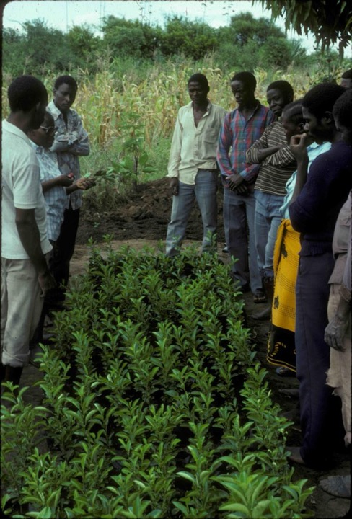
Ezekiel 34:25-28
“I will make a covenant of peace with them . . . I will send down showers in season; there will be showers of blessing. The trees of the field will yield their fruit and the ground will yield its crops; the people will be secure in their land . . . They will live in safety, and no one will make them afraid.”
‘Peace’ = Shalom = ‘absence of fear’
‘Peace’ = Shalom = ‘fittingness’
Notes:
Shalom is ‘the fullest manifestation of life as God intends it.’ David Wise (TEATC)
Shalom is “an order, a harmony in creation in which every creature existed in peace and harmony with the rest of creation; Shalom is a gracious gift from God.” - Mariano Avila
“Shalom is both God’s cause in the world and our human calling.” – Nicholas Wolterstorff (Until Justice and Peace Embrace)
Shalom is “God’s dream and promise for the fulfillment of his creation; the knitting together of all the brokenness in the cosmos, in the relations between man and man, a man and himself, man and nature, within nature, and between man-nature and God.” - David Wise (TEATC)
Stewardship is one of the means by which God uses human beings to bring about his shalom in creation.
Shalom is the end goal of stewardship . . . When we steward well, shalom results.

Slide 5
Whose preferences count
Who pays the price for development enjoyed by others?’
Who are the captives and to what are they captive?
Notes:
We need to begin to pay attention to who benefits and who pays for the way the land, air, and water is being used. “Suppose a person has been deprived of some good to which she has a right. ..Being deprived of that to which she has right constitutes an alteration in her moral condition. She is then wronged. When Union Carbide’s chemical plant in Bhopal, India, spewed poisonous fumes into the air , it deprived the residents of the valley of a good to which they had a right, namely, the good of having non-noxious air to breathe; thereby the residents were wronged.” (p.25 Wolterstorff , Justice)
Environmental hazards, exposures, and risks are not uniformly distributed across populations and multiple biological and social factors (including age, poverty, and minority status, intersect to create unique exposures that place some individuals and communities at disproportionately high risk of environmental disease. (*Burger, Joanna, et al)
For our conversation today, the captives we are considering are those that live downstream. They are the recipients of all the pollution, sedimentation, bacteria, etc that come from those living and working upstream. Their health and welfare is affected by the decisions and choices we make.
So we are encouraging you to begin thinking about upstream and downstream.

Slide 6
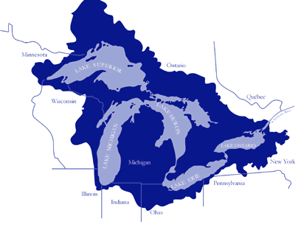
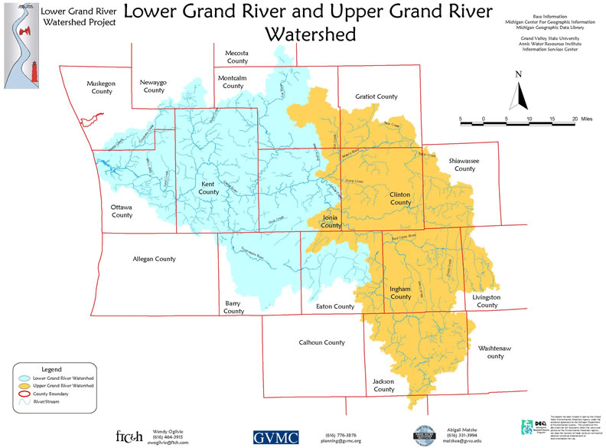

Slide 7
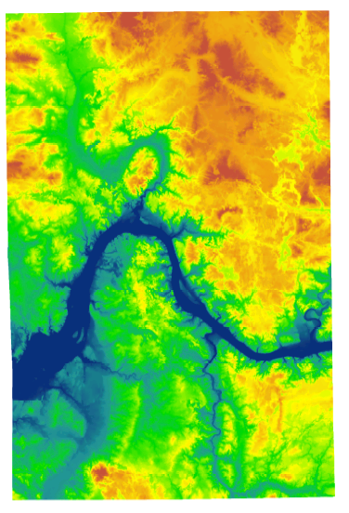

Slide 8

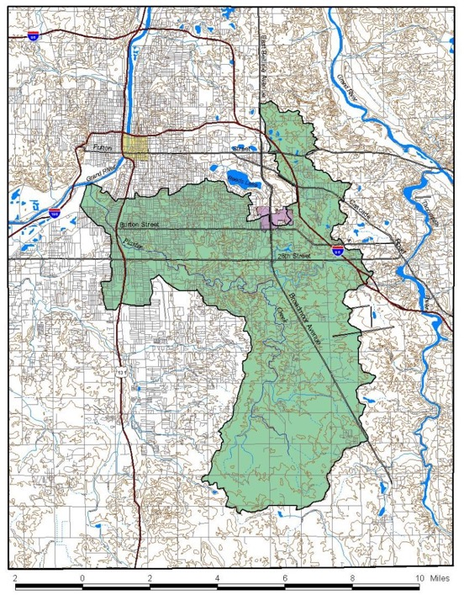
-58 square miles
-Grand River: 5,572
-creek is 14 miles long
-Grand River: 260
Grand Rapids
East Grand Rapids
Grand Rapids Township
Wyoming
Kentwood
Gaines Township
Ada Township
Caledonia Township
Cascade Township
http://www.calvin.edu/~oas2/pcs/

Slide 9
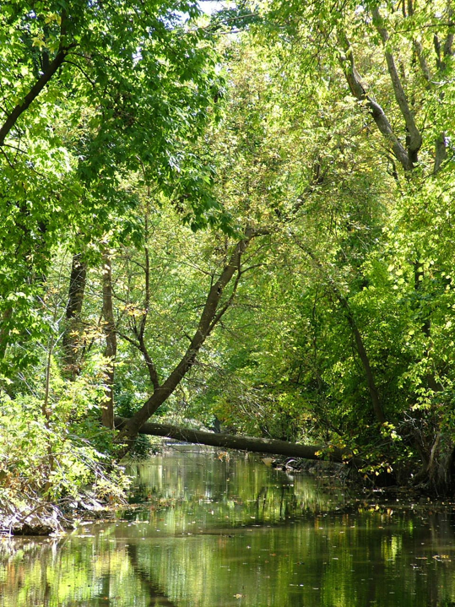
“There is a river whose streams make glad the city of God . . .”
- Psalm 46:4
Psalm 46:4

Slide 10
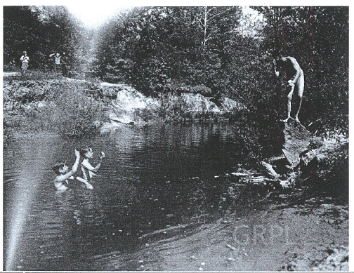

Slide 11
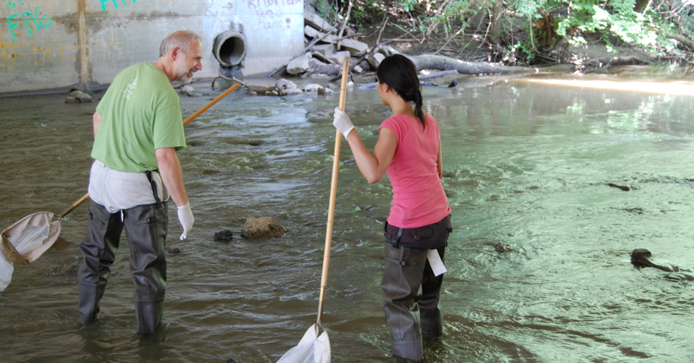

Slide 12
Designated uses
Use | Status
Indigenous aquatic life/wildlife habitat | Impaired
Warm water fishery | Impaired
Partial body contact recreation | Threatened
Total body contact recreation | Impaired
Agriculture (irrigation) | met
Main Problems
Main Problems
Flow dynamics (volume)
Sediment
E. coli contamination (and other potential pathogens)
Nutrient pollution
Thermal pollution
Toxic substances

Slide 13
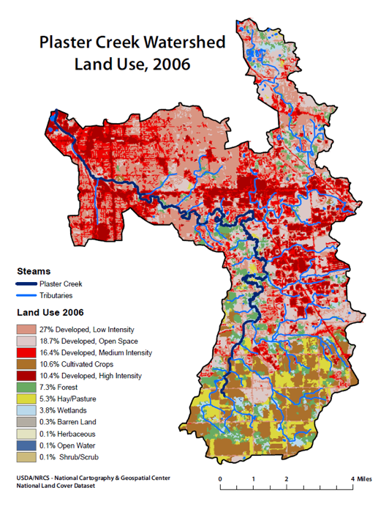

Slide 14
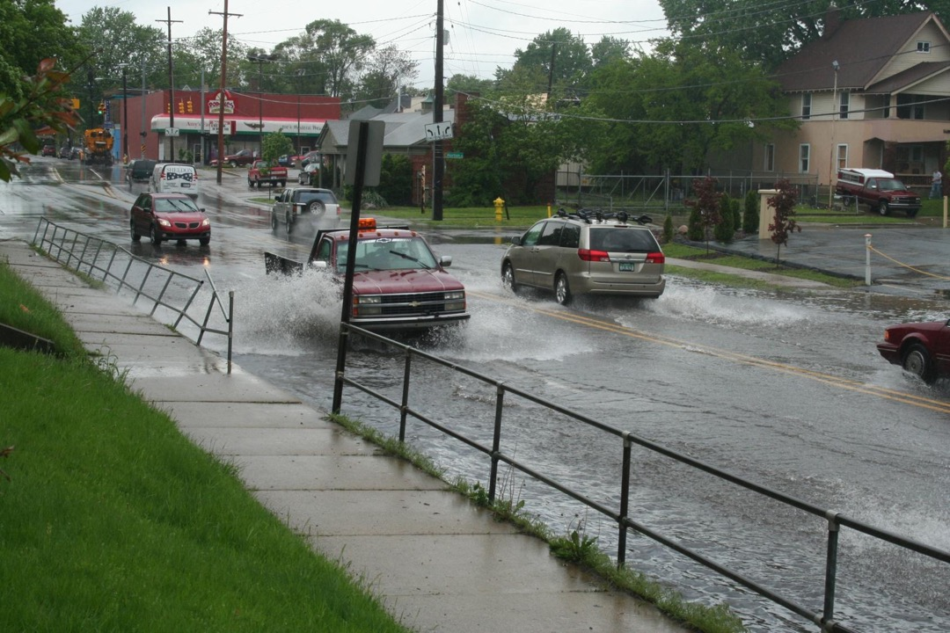

Slide 15
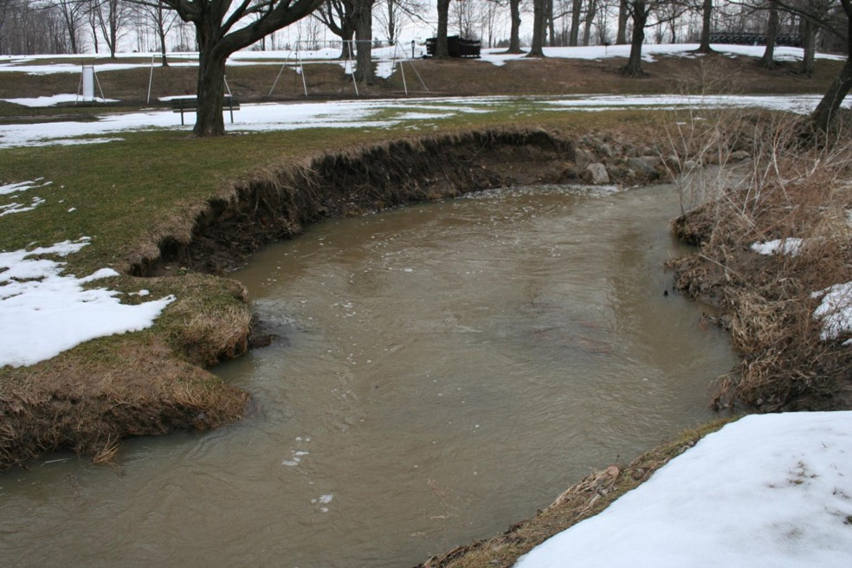

Slide 16
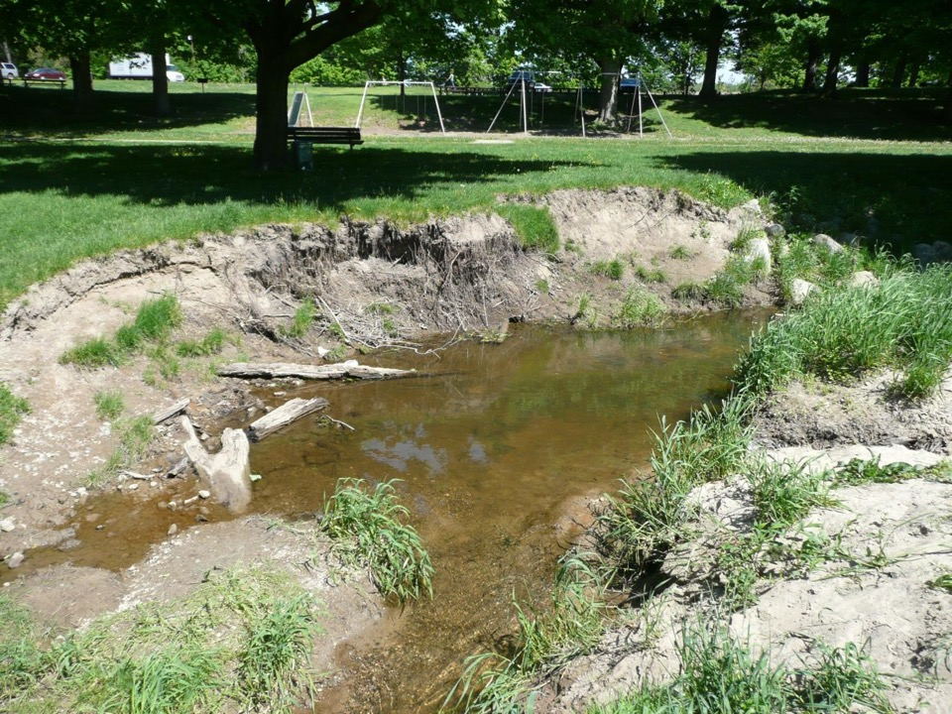

Slide 17
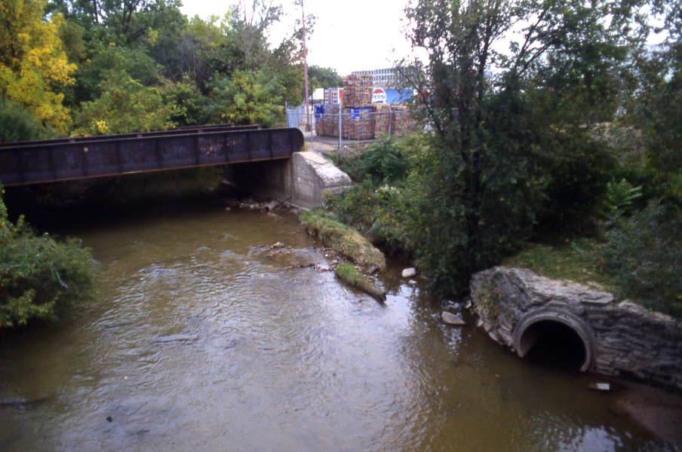
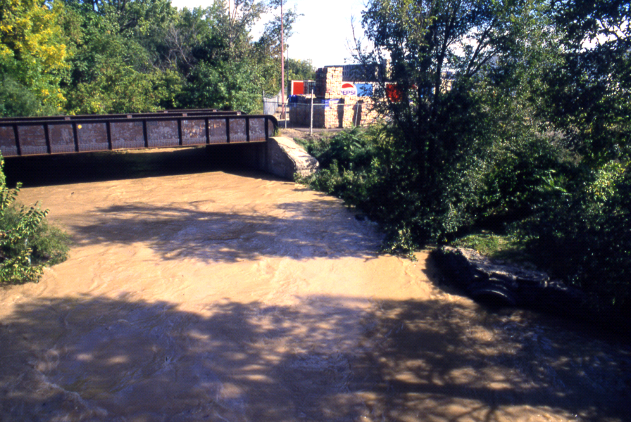

Slide 18
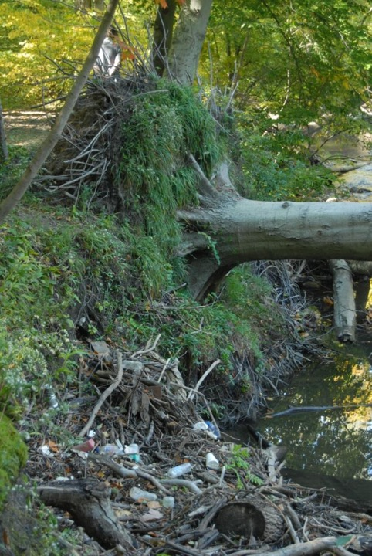

Slide 19
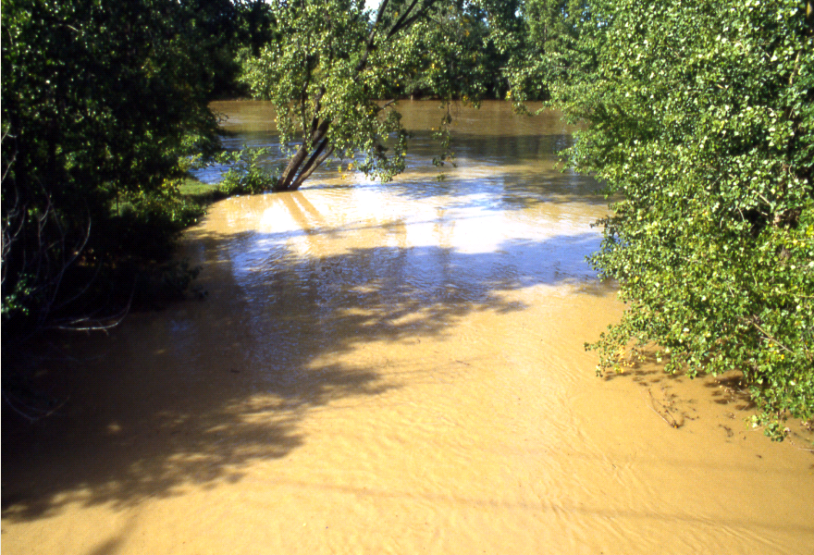

Slide 20
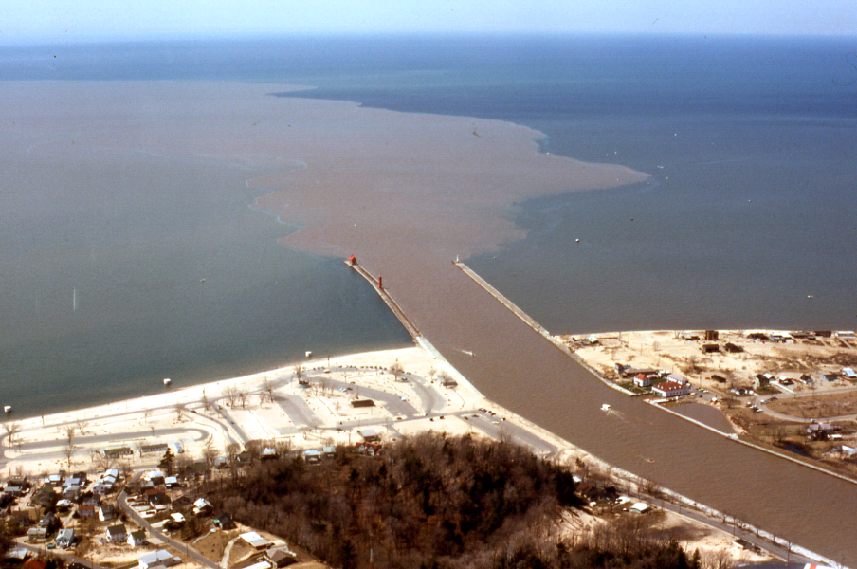

Slide 21
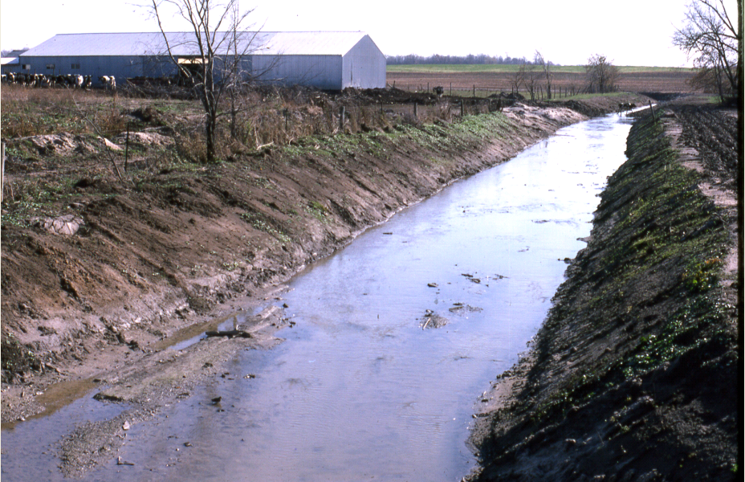
E. coli
Sources
  Cattle access to the creek
  Agricultural runoff (tile drains?)
  Pet waste
  Faulty septic tanks
  (and sewer lines)
  Wildlife
Notes:
Explain TMDL

Slide 22
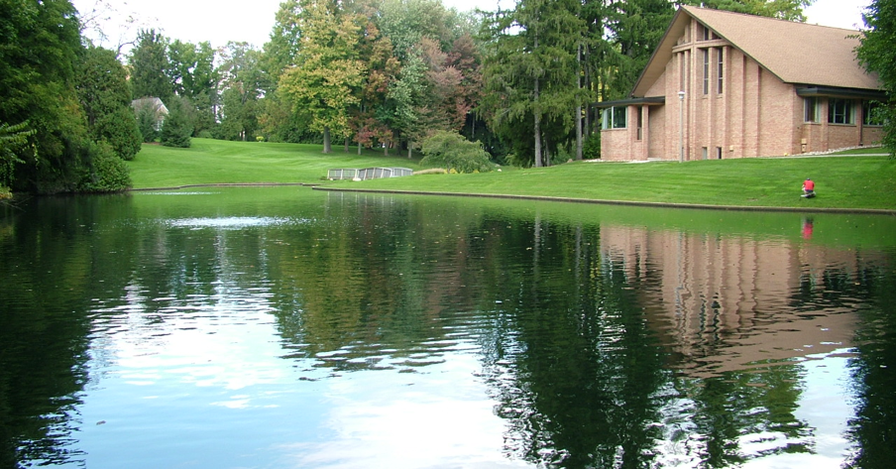
Nutrient pollution
Comes from:
  Fertilizers
  Animal manure
  Sediment
  Sewers and septic systems

Slide 23
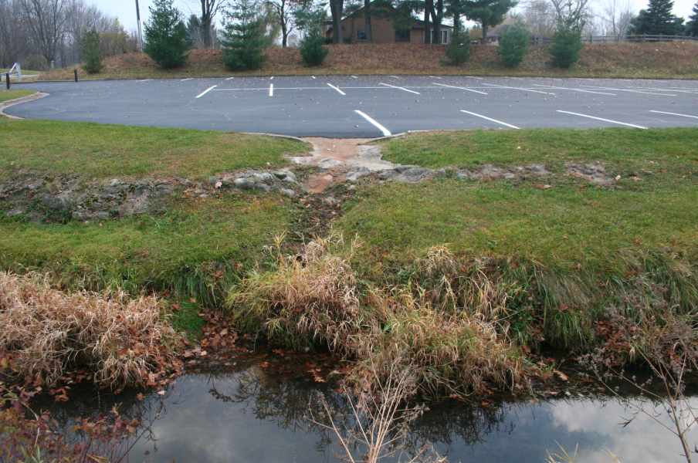
Thermal Pollution
Notes:
Include figures with temperature over time for a healthy watershed and a nasty one

Slide 24
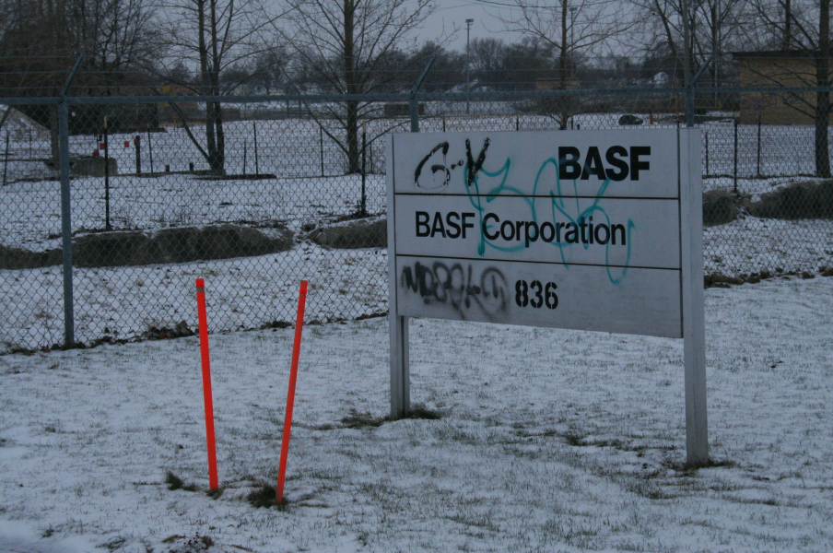
Toxic substances
Point source and non-point source

Slide 25
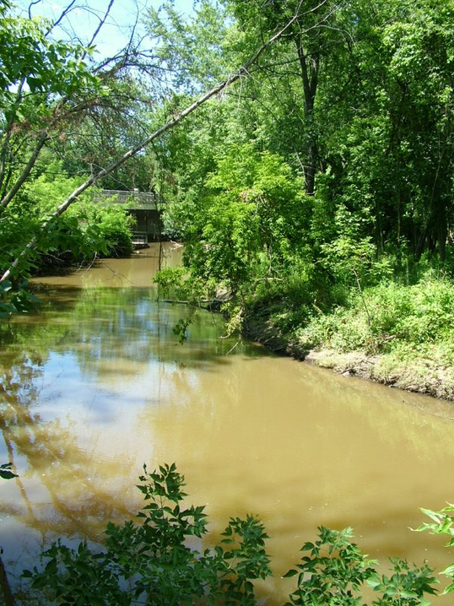
Sediment
Caused by:
  Urban runoff
  Agricultural runoff
  Construction
  Stream bank erosion

Slide 26
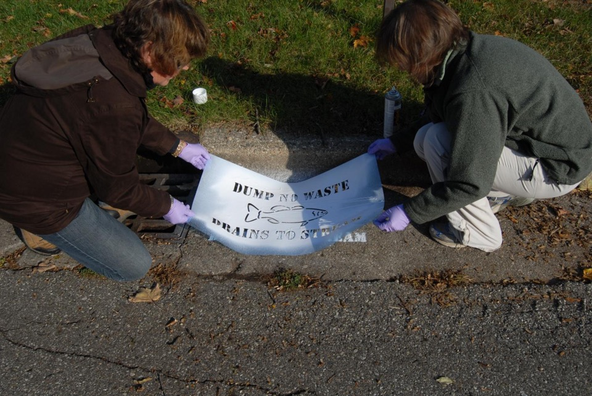
How do we address the injustices?
Notes:
We need to start paying attention to water---It is fundamental to all life. Everyone deserves clean water.
Healthy streams and rivers are part of what makes for a healthy community. There’s a big emphasis across the country (and world) on “place-making.” Healthy creeks, streams, and rivers are part of what makes a place.
Where does our water go? In our homes, our churches, our places where we work, shop, and live.
We need to recognize the brokenness around us and take action to bring healing. Everyday we have opportunities to embody faithfulness. Caring about our water is one way to do this.
We need to consider who is upstream and who is downstream from us? Our downstream neighbors should not be our captives. How do we live in such a way as to “free the captives”?

Slide 27
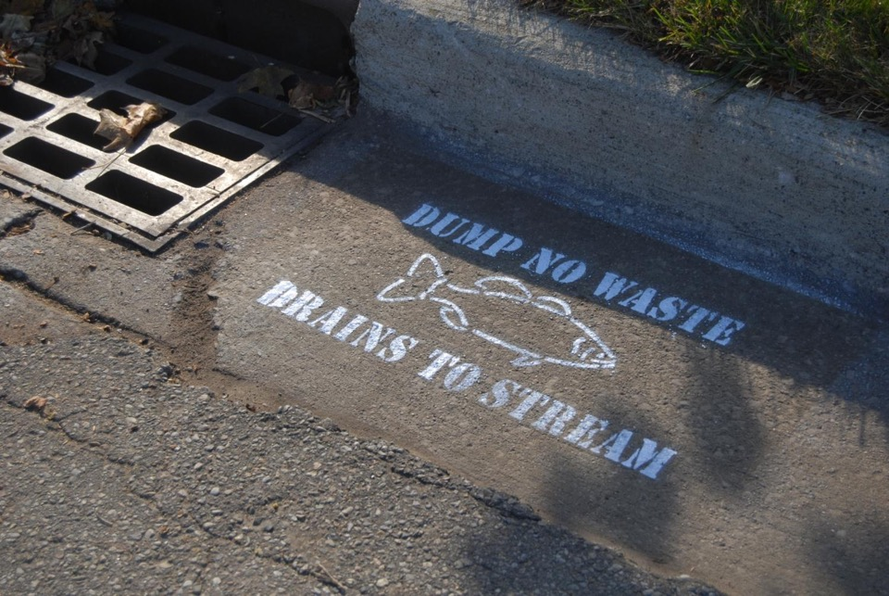
Notes:
We need to recognize the brokenness around us and take action to bring healing. Everyday we have opportunities to embody faithfulness. Caring about our water is one way to do this.
We need to consider who is upstream and who is downstream from us? Our downstream neighbors should not be our captives. How do we live in such a way as to “free the captives”?
You could join the Plaster Creek Stewards initiative

Slide 28
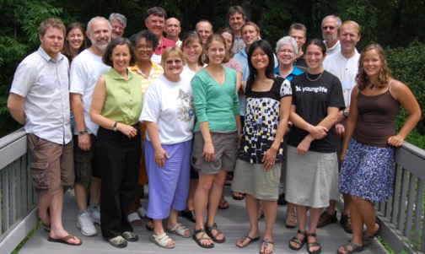
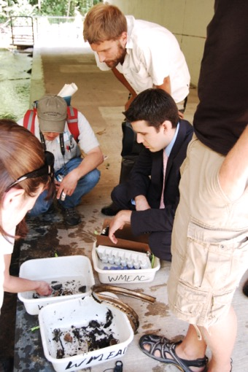
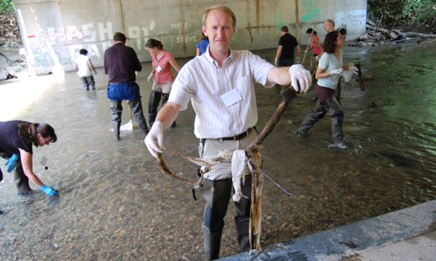
Plaster Creek Stewards
A collaboration of Calvin College faculty and staff, churches, and community partners working to restore health and beauty to the Plaster Creek Watershed.
Notes:
Explain the mission of Plaster Creek Stewards—research, education/ outreach, restoration
Invite them to:
April 28 spring event
May 3 CEAP Poster Session
Summer workshop –June 5-7
Upstream-downstream partnerships
Oral history project

Slide 29
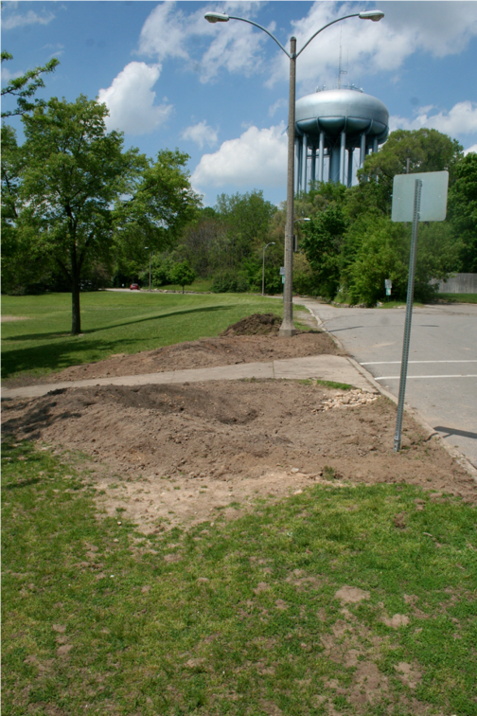
Rain gardens
Notes:
Dave

Slide 30
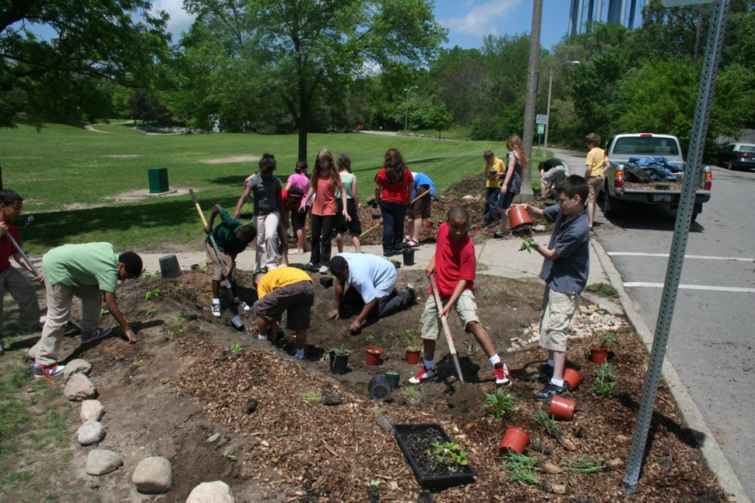

Slide 31
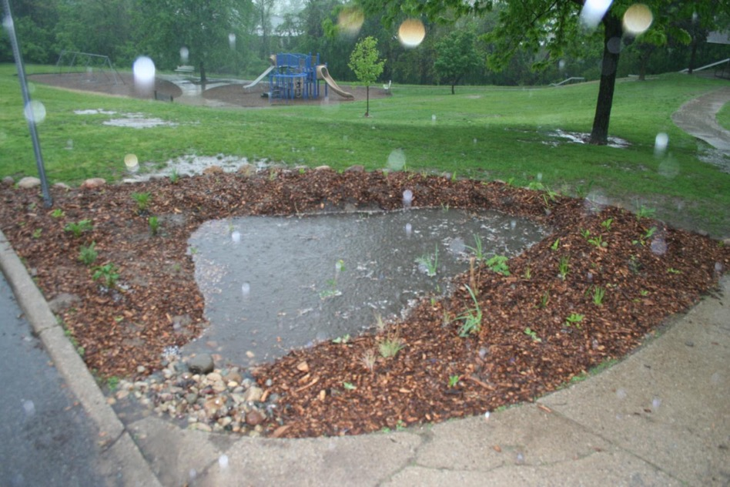

Slide 32
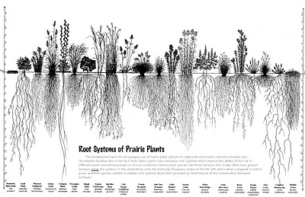
Why native plants?
Multi-functional tools for stormwater management
Deep roots, mostly perennial
Low maintenance
Adapted to local soils and climate
Essential for insects, birds, other wildlife

Slide 33
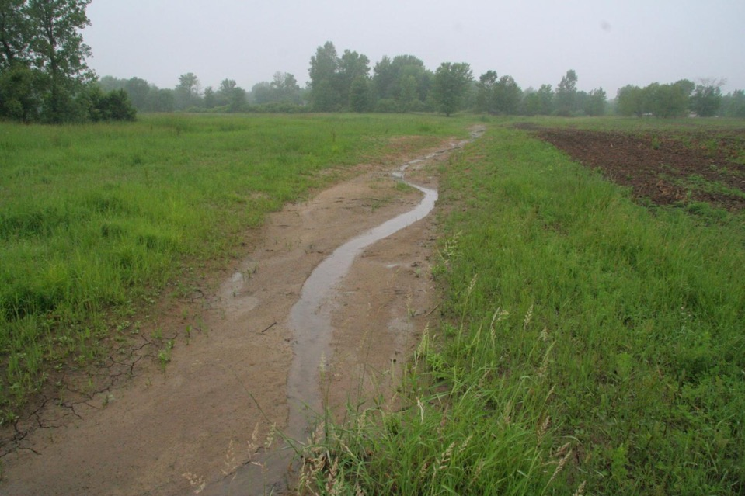

Slide 34
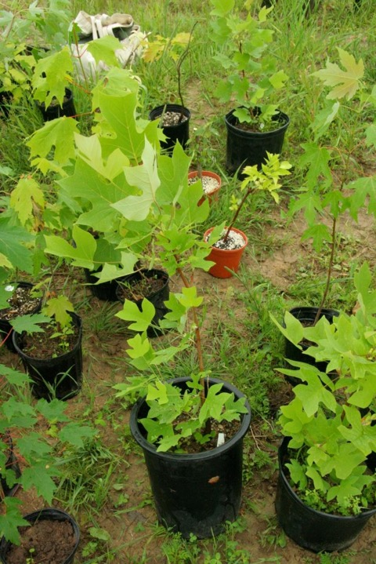

Slide 35
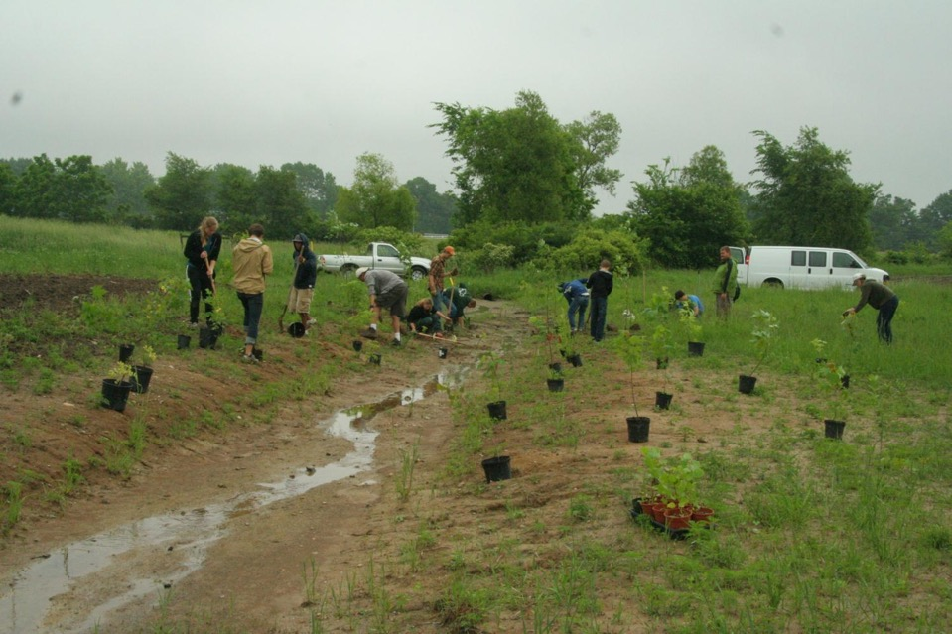

Slide 36
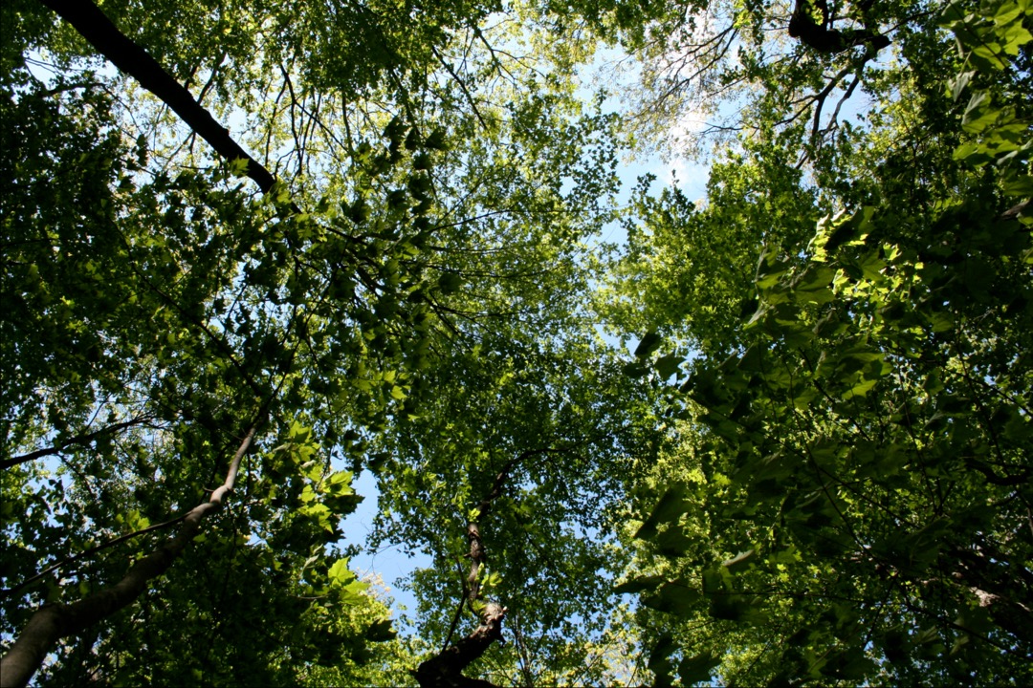

Slide 37
Final Thought
“Then the angel showed me the river of the water of life. It was as clear as crystal. It flowed from the throne of God and of the Lamb. It flowed down the middle of the city's main street. On each side of the river stood the tree of life, bearing 12 crops of fruit. Its fruit was ripe every month. The leaves of the tree bring healing to the nations.”
- Revelation 22:1,2
The day is coming when . . . .
Notes:
HOLD STEADY!

Slide 38
God
Rest of
Creation
Humans
Humans
Humans

