Slide 1
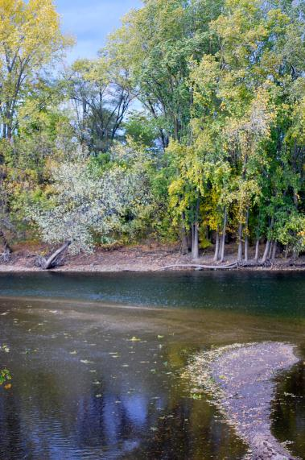
Learning in Place: Education, Research, and Action in the Plaster Creek Watershed
Gail Gunst Heffner
David Warners
Michael Ryskamp
Andrea Lubberts

Slide 2
Context
Pedagogy of Place: Educational approach that encourages active learning to improve the social, economic, political and ecological life of the places in which the education occurs.
Reconciliation Ecology: The science of restoring, creating and maintaining habitats, and conserving biodiversity in places where people live, work, or play. Re-inventing the human presence to better accommodate, affirm, and fit in with the other creatures with whom we share the creation.

Slide 4
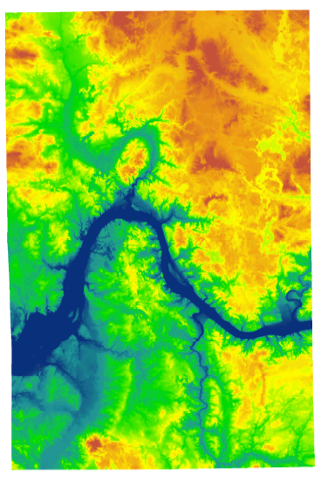
Notes:
Digital elevation map that shows the contours of Kent County . . . Rogue River here, Thornapple river here and (press button) this is the PC watershed

Slide 5
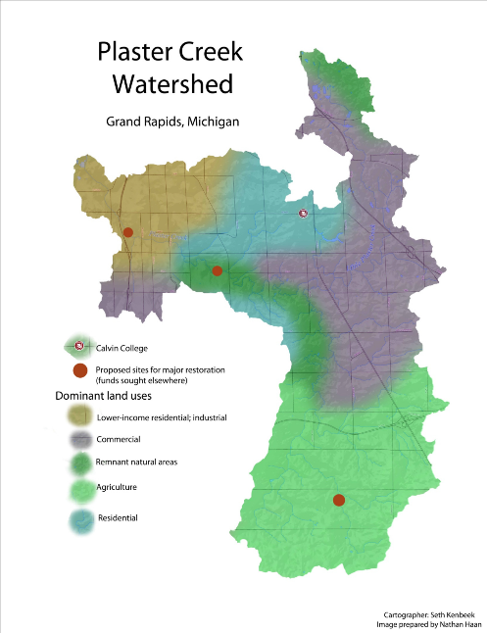
Background statistics:
Length: approx. 14 miles
Watershed area: 58 mi²
Governmental units: 9 (4
municipalities & 5 town-
ships)
>50% of Calvin fac. and staff
3200 Calvin Alumni
More than 100 schools
More than 170 churches
Notes:
Watersheds are parcels of the landscape that drain to a common point. They are naturally delineated by topography, and have potential to knit together agricultural, urban, and natural areas into one integrative whole. Every business, school, church, and individual household necessarily exists within a watershed. It follows that the quality of water that flows out of each watershed testifies to the type of activities occurring within that watershed. When community members understand the watershed concept and the particular qualities of their own watershed, such awareness provides a powerful means to connect people and institutions to the importance of taking good care of the land and water.
POINT TO: East Beltline, M-6, U.S. 131 and Calvin
Add to Basic Statistics
172 churches in the watershed (27 are CRC or Reformed)
100 schools

Slide 6
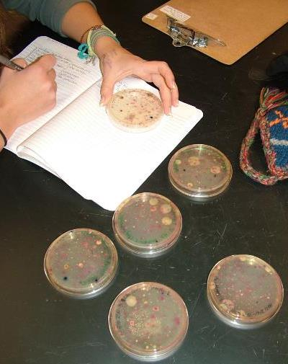
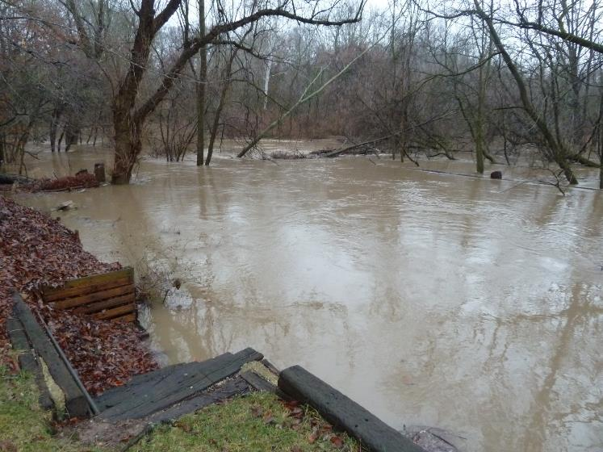
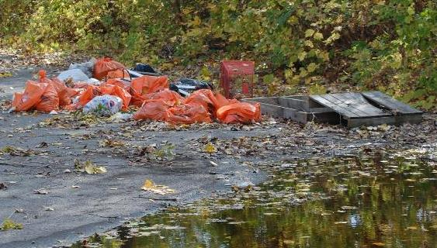
Main NPS Problems:
Flow dynamics (volume)
Sediment
Bacterial contamination
Nutrient pollution
Thermal pollution
Trash and Toxic substances

Slide 7
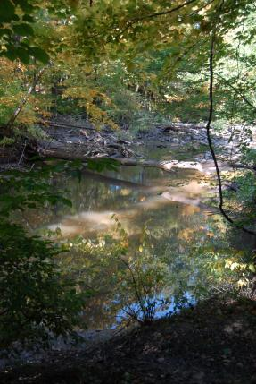
Think upstream-downstream
People who live at the lower ends of watersheds cannot be isolationist—or not for long. Pretty soon they will notice that water flows, and that will set them to thinking about the people upstream who either do or do not send down their silt and pollutants and garbage. Thinking about the people upstream ought to cause further thinking about the people downstream. Such pondering on the facts of gravity and the fluidity of water shows us that the golden rule speaks to a condition of absolute interdependency and obligation. People who live on rivers might rephrase the rule in this way: Do unto those downstream as you would have those upstream do unto you.
-From Watershed and Commonwealth
by Wendell Berry

Slide 8
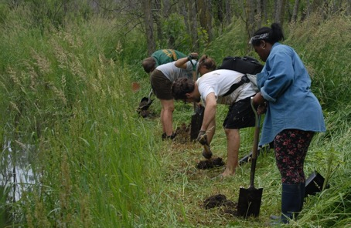
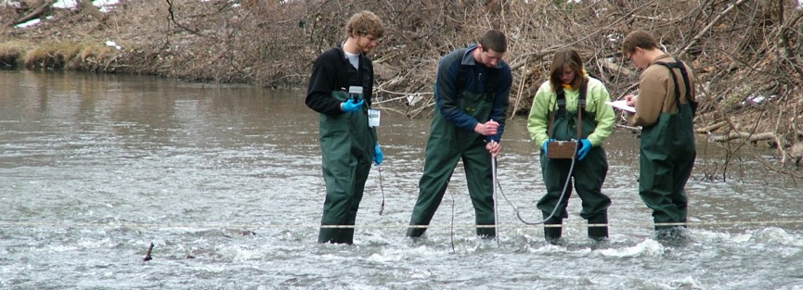
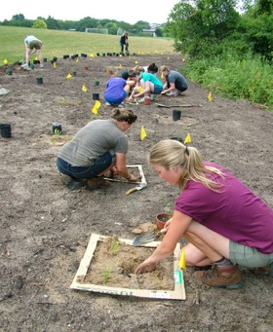
Drain or Floodplain?
Characterizing Healthy Habitat and Measuring Human Impact on Local Waterways Groundswell LGREI and Plaster Creek Stewards

Slide 9
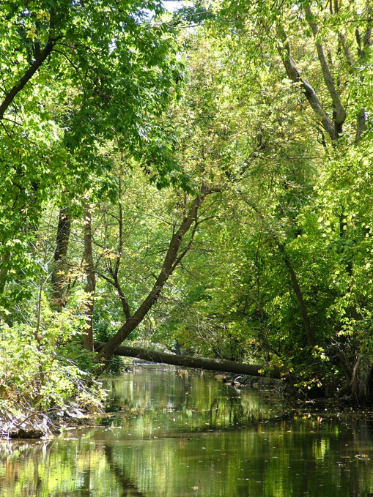
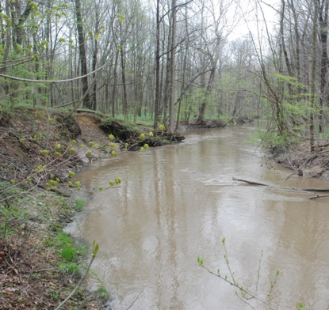

Slide 10
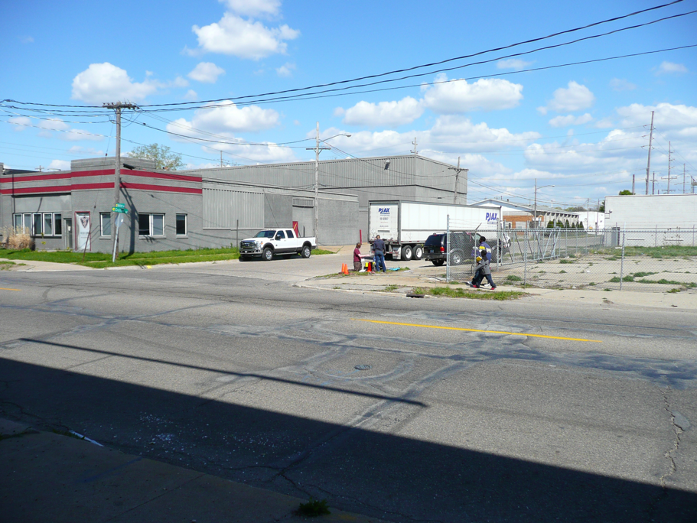

Slide 11
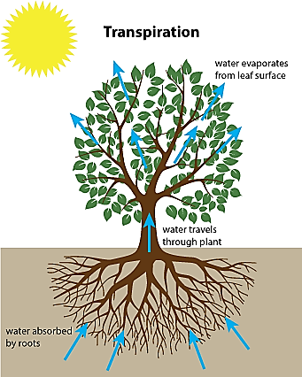
Natural Rainwater Processing
Interception
Evaporation
Infiltration
Transpiration
Groundwater storage
Groundwater discharge
(Surface Runoff)

Slide 12
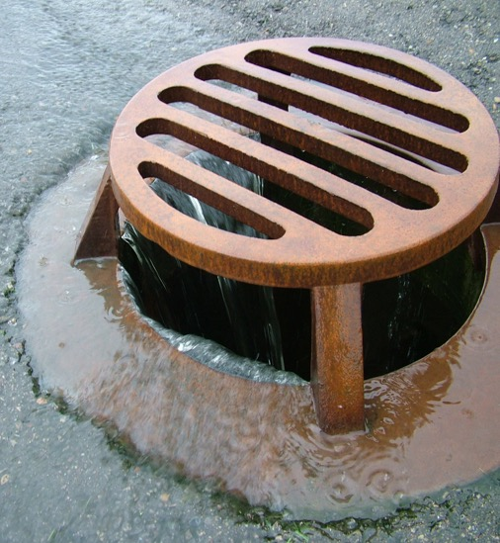
Urban Rainwater Processing
Interception
Evaporation
Infiltration
Transpiration
Groundwater storage
Groundwater discharge
Surface Runoff!

Slide 13
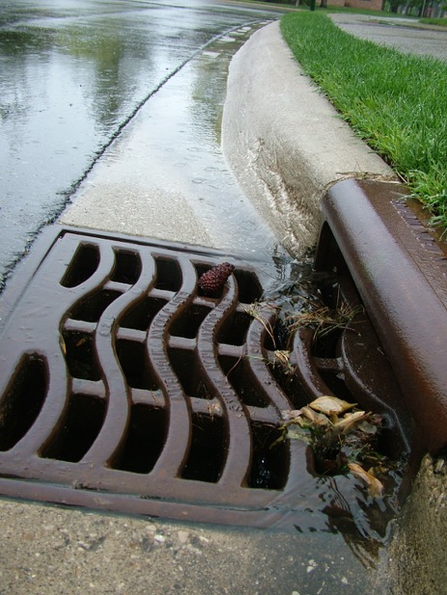
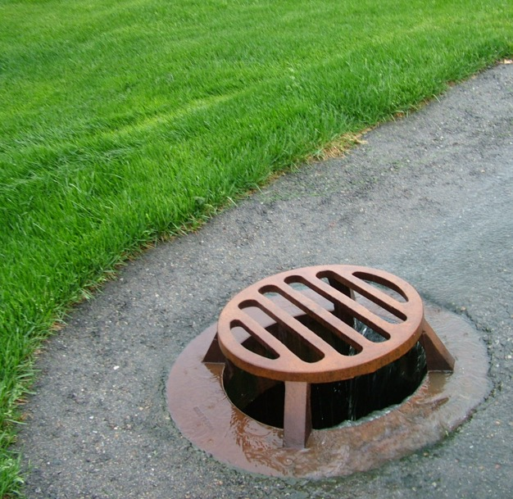
Stormwater is the main trigger

Slide 15
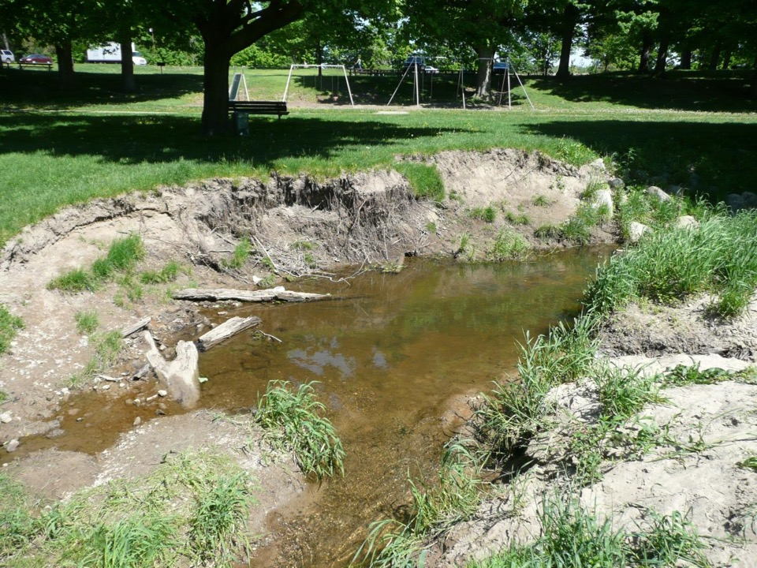

Slide 16
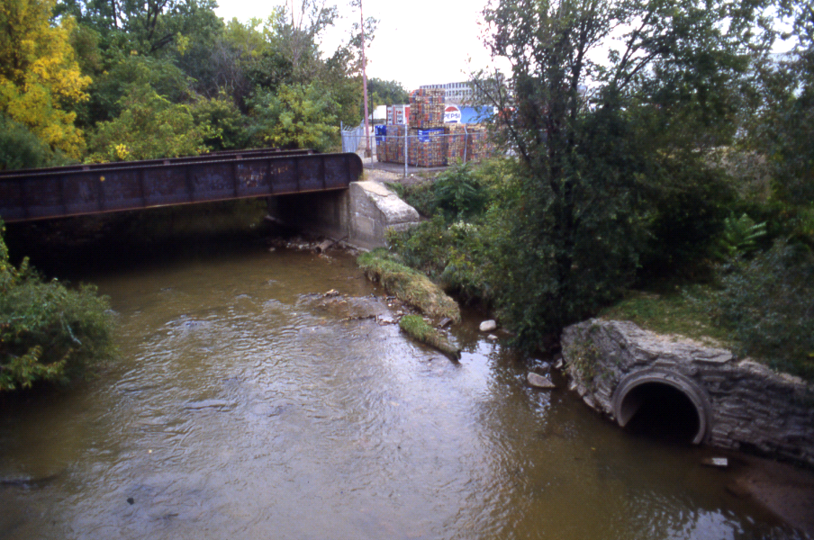
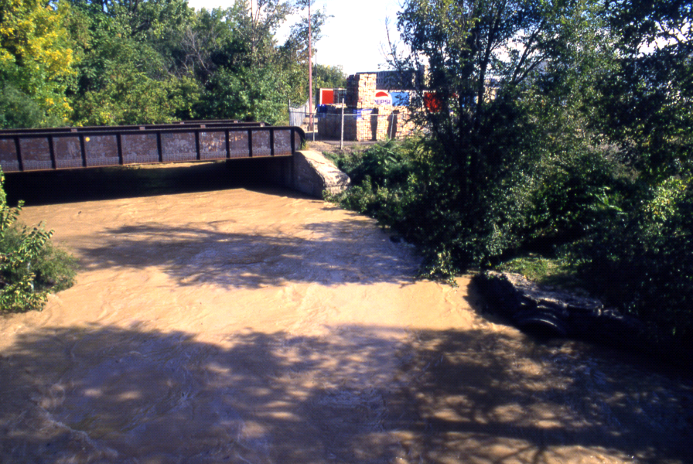

Slide 17
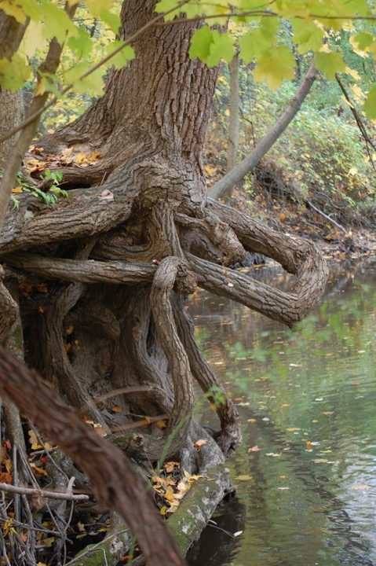
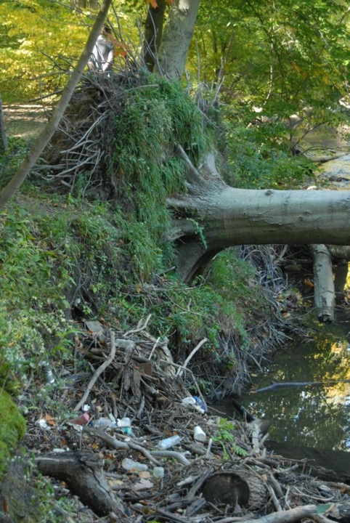

Slide 18
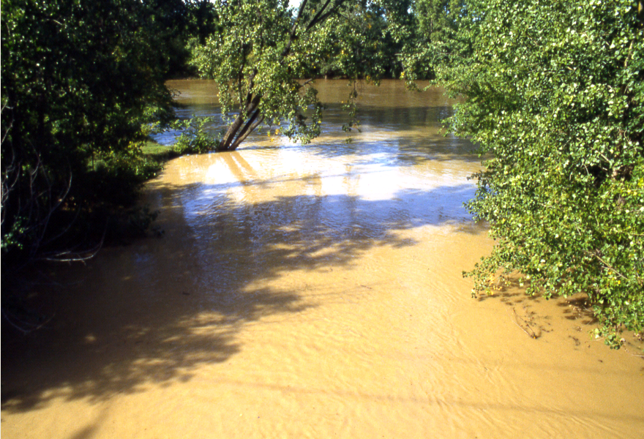

Slide 19
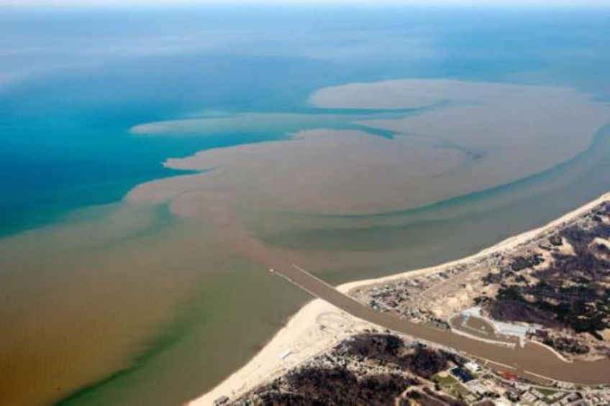
April, 2013

Slide 20
OHWM = Ordinary High Water Mark

Slide 21
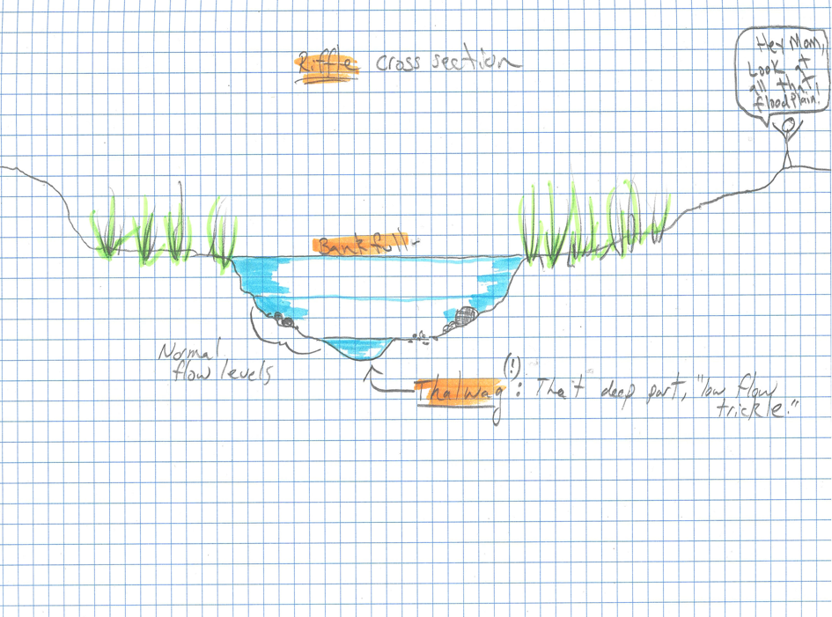

Slide 22
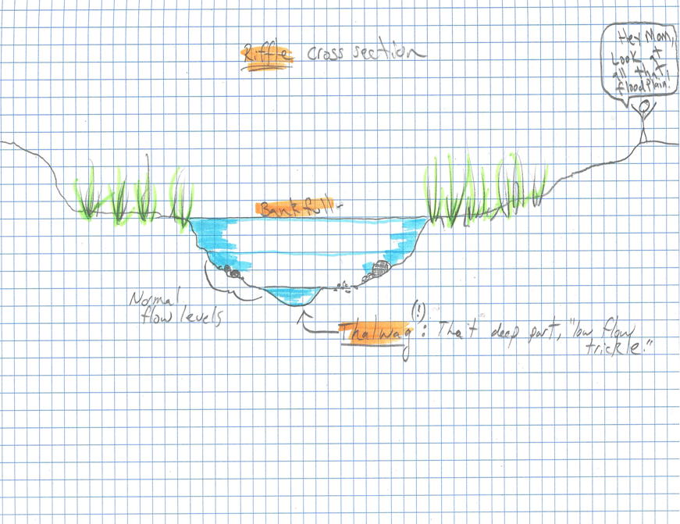
1. Pound in stake
3. Tie tape to a tree or stake it in at the other side,
2. Tie tape across, try to keep it level. Choose a point well above the waterline to capture flood plain profile.
4. Use stadia rod to measuere distance from tape to ground (y-axis). Use tape to measure distance from stake (x-axis).
Some important points:
1. Tape/stake to ground (if tape isn’t at ground level)

Slide 23
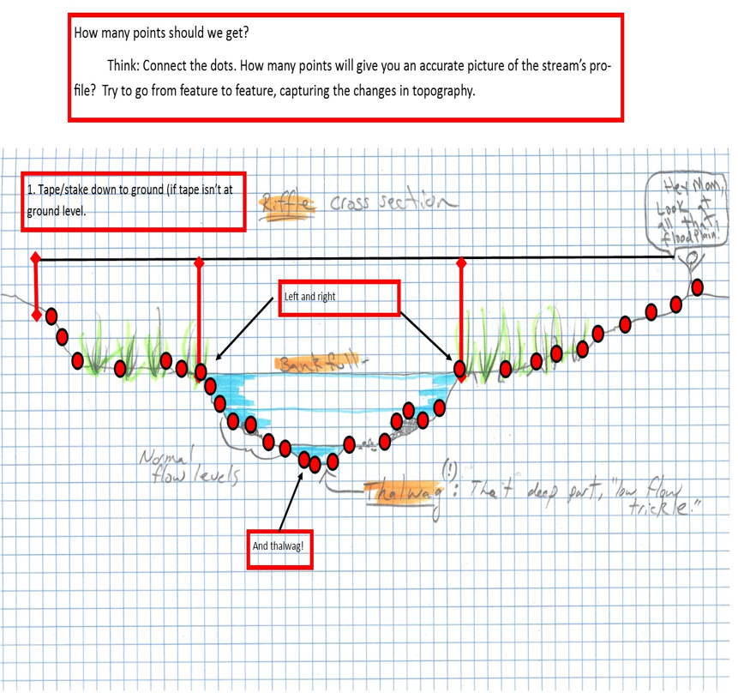

Slide 25
Description | Width (x-axis) | Height – Tape (cm) (y-axis) | Height –water (depth) (cm)
Bench Mark | 0 | 0
Dirt to tape | 0 | 3
 | 5 | 10
 | 8 | 11
 | … | …
Left edge of water | 154 | 212 | 0
In stream | 159 |  | 5
 | 165 |  | 12
 | … | …
Right edge of water | 325 | 213 | 0
Out of stream | 330 | 202

