Slide 1
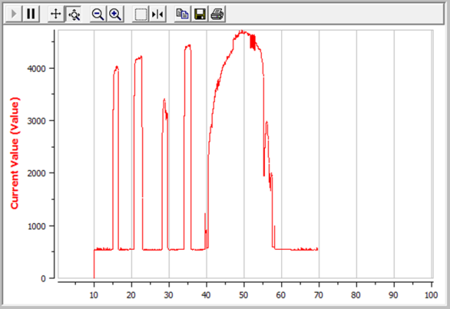
Jacob Lair, Electrical & Computer Concentration
About the Company
Hydro-Gear is a world leader in the design and manufacture of precision drive solutions for the industrial, commercial, and consumer markets.
Internship Project Overview
Project Achievements
Writing low-level software code for a CAN peripheral microchip that will be used for Hydro-Gear’s current Bluetooth Module project
SPI messages verified with oscilloscope decoding
Successful transmission of Tx and Rx CAN messages
Auto Detect Clock Rate Function
Optimized logic using high optimization and status registers
Incorporated a capacitive touch sensor along with visual graph
Debugged circuit design with shorting issue
Experience Gained
Better Understanding of Serial Communication (CAN, SPI)
Higher Proficiency Writing High Level and Low Level Embedded Software
Configuration of Clock Rates for communication
Writing, Drawing, and Presenting Information in a technical manner (documentation, schematic drawings, presentations)
Reading, Understanding, and Acting upon Documentation
Working in an Engineering Work Environment

