Slide 1

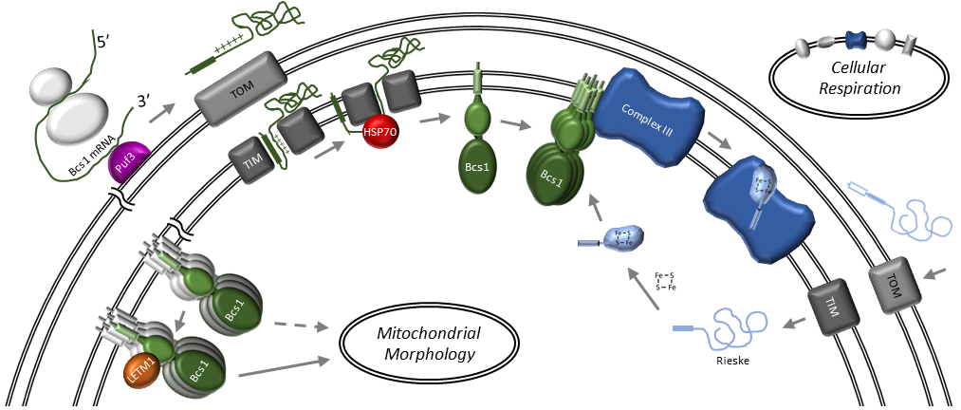
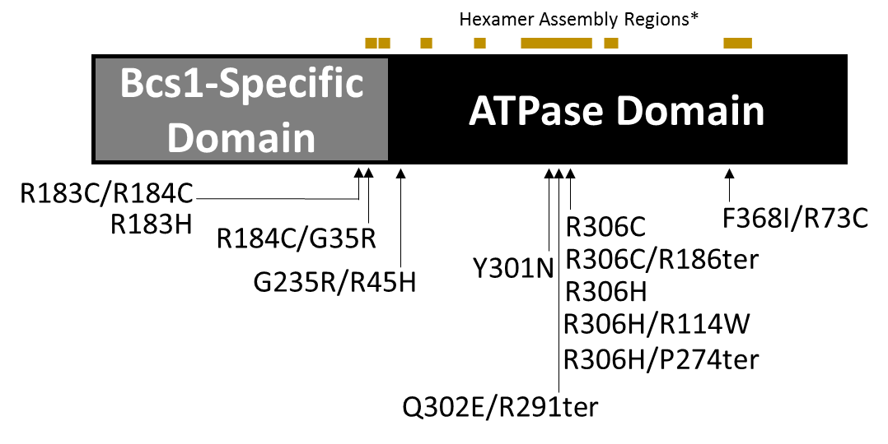
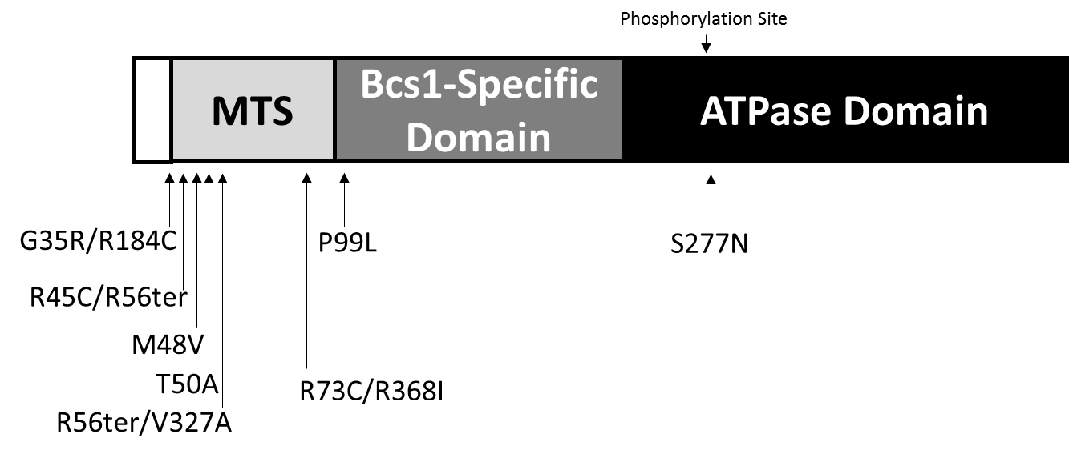
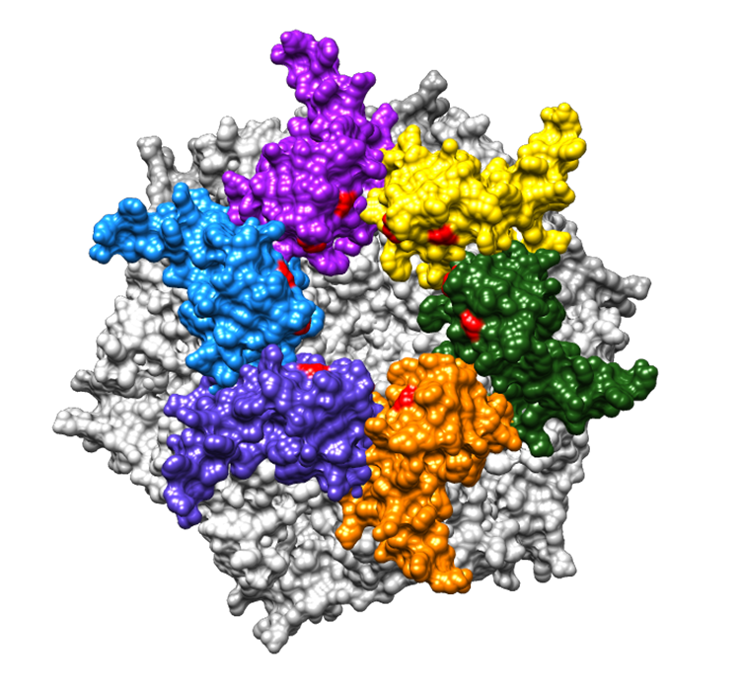
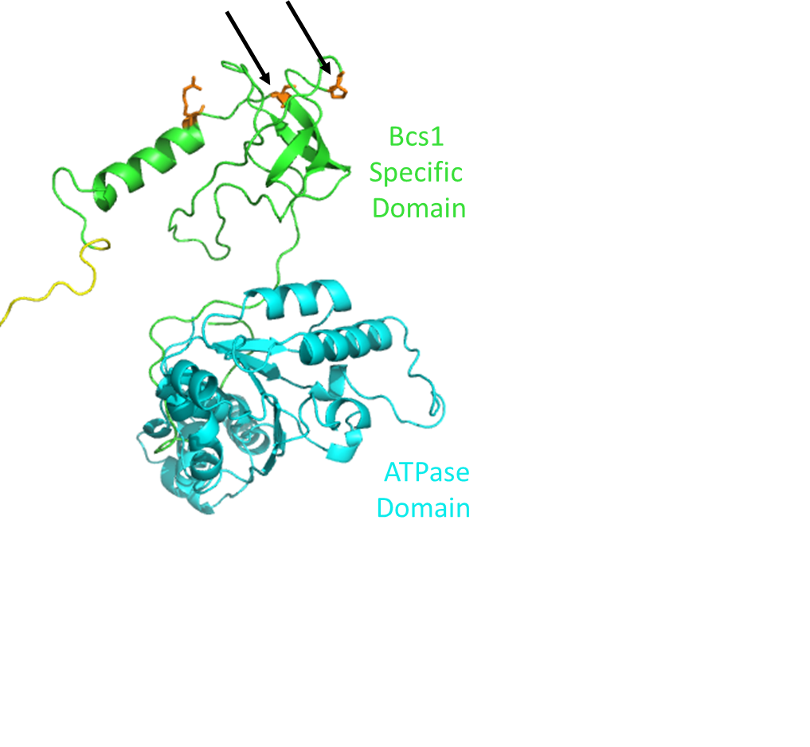
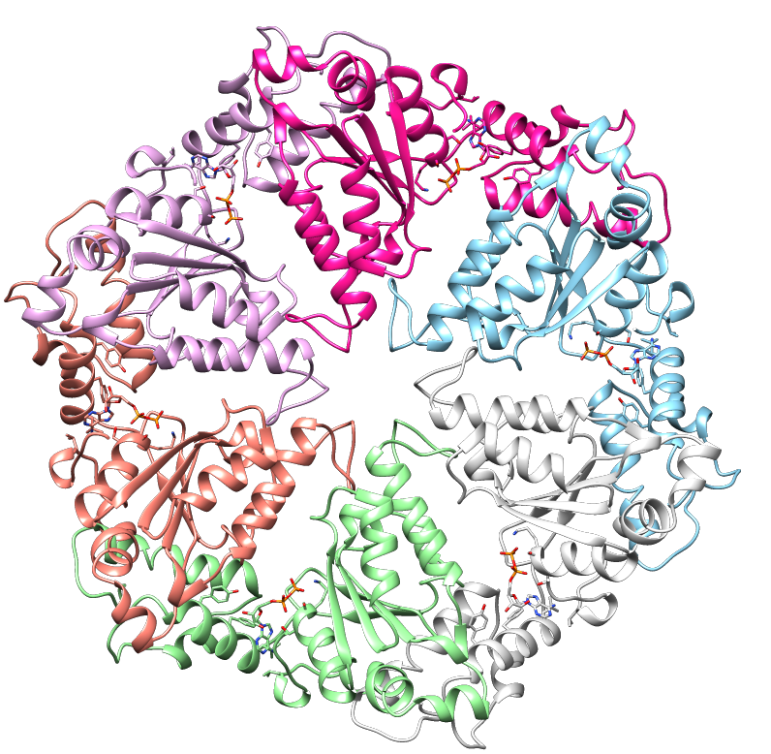
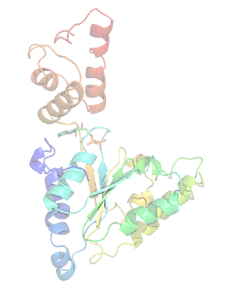
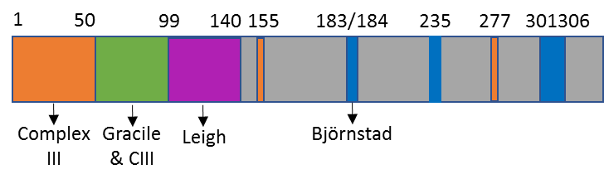
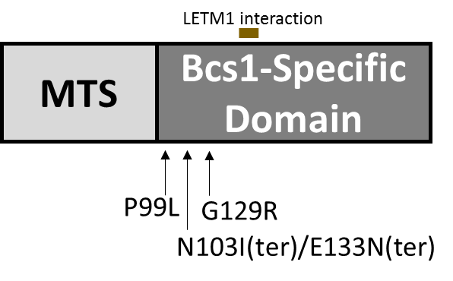
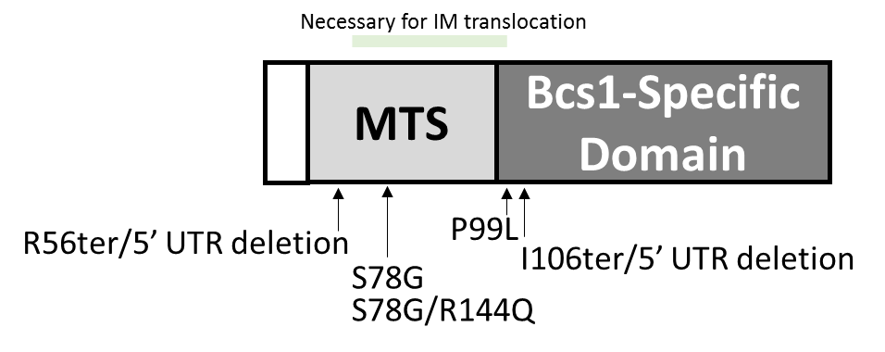
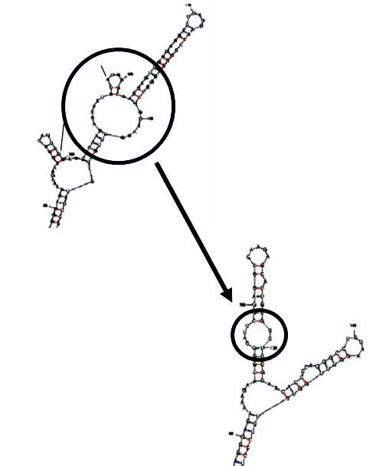
Elucidating Genotype-Phenotype Connections in BCS1L Mutations
Kalina Reese, Dr. Rachael Baker, Dr. Amy Wilstermann, Calvin College, Grand Rapids, MI
Role of BCS1L in the Mitochondria
Björnstad Syndrome
Complex III Deficiency
      Observed with homozygous mutations in hexamer assembly contact regions
      Heterozygous patients with both a Björnstad mutation and an early termination also exhibit a Björnstad phenotype because only full length BCS1 can assemble.
The severity of the disease depends
on the particular amino acid
change (Y301N is more
severe than R183H) and whether
the possibility for disulfide bond
formation is introduced (R183H
vs. R183C/R184C).
      Observed with mutations primarily in or near the Mitochondrial Targeting Sequence
Below: IntFOLD model of BCS1 with key mutations highlighted
Review and document mutations and respective phenotypes from all published cases
Optimize comprehensive disease descriptions
Develop BCS1L structural models
Identify links between particular mutations and phenotypic outcomes
        Structural modeling suggests key CIII mutations may occur in regions important for the translocate of Rieske by BCS1L.
        Patients with a mutation on
        a phosphorylation
        site (S277N) show CIII
        deficiency, suggesting this
        site is key for CIII assembly.
      Above: Hexameric assembly model of ATPase domain
      (grey) and BCS1 specific domain with same mutations highlighted in red.
*Assembly Regions Not To Scale
      Chimera model of a hexameric assembly of the BCS1L ATPase domain
Leigh Syndrome
GRACILE Syndrome
      Observed primarily in the BCS1 – Specific Domain
      Observed primarily
      in the Mitochondrial Targeting Sequence
      Point or termination mutations near the LETM1 interaction site (important for mitochondrial morphology) present a Leigh phenotype.
Documented Leigh mutations exhibit
fragmented and punctate mitochondria,
supporting a role of BCS1 in
mitochondrial morphology.
The characteristic muscular lesions
may be linked to a BCS1L role in
mitochondrial morphology.
                Disruptions in or near the MTS exhibit a
                CIII deficiency/GRACILE phenotype, likely caused by lack of BCS1L in the mitochondria.
                Deletions in the 5’ UTR inhibit BCS1L translation, also leading to GRACILE.
Iron overload (characteristic of GRACILE) may be due to disruption of the Rieske interaction.
      Deletions in the 5’ untranslated region lead to changes in mRNA structure, causing a decrease in translation efficiency.
Gil-Borlado et al. (2009), “Pathogenic Mutations in the 5′ Untranslated Region of BCS1L mRNA in Mitochondrial Complex III Deficiency.”
Moran et al. (2010) “Cellular Pathophysiological Consequences of BCS1L Mutations in Mitochondrial Complex III Enzyme Deficiency.”
Conclusions & Future Directions
Acknowledgements
Reassigning the case diagnoses using optimized disease descriptions was essential for identifying patterns in the relationship between genotype and phenotype.
Future questions and experiments based on our analysis:
Björnstad: Create R183C and R183H mutations to determine the possible role of disulfide bond formation in disease severity.
GRACILE Syndrome: Measure iron overload resulting from GRACILE-associated mutations.
Complex III Deficiency: Use reactive oxygen species assays along with native gels to determine the severity of Complex III assembly disruption for a particular mutation.
Leigh Syndrome: Construct mutations in the Leigh region and use confocal microscopy to analyze the impact on mitochondrial morphology.
Dr. Rachel Baker and Dr. Amy Wilstermann for guidance and mentorship
Sarah David for accompanying me in lab
Departments of Chemistry/Biochemistry and Biology at Calvin College for materials and support
Jansma Family Research Scholarship for funding my summer research
CCCS for funding Rare Disease Research

