Slide 1
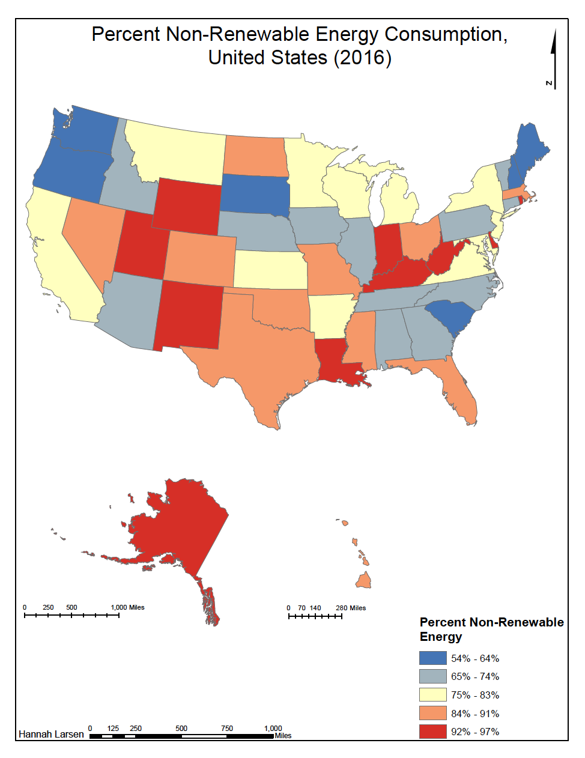
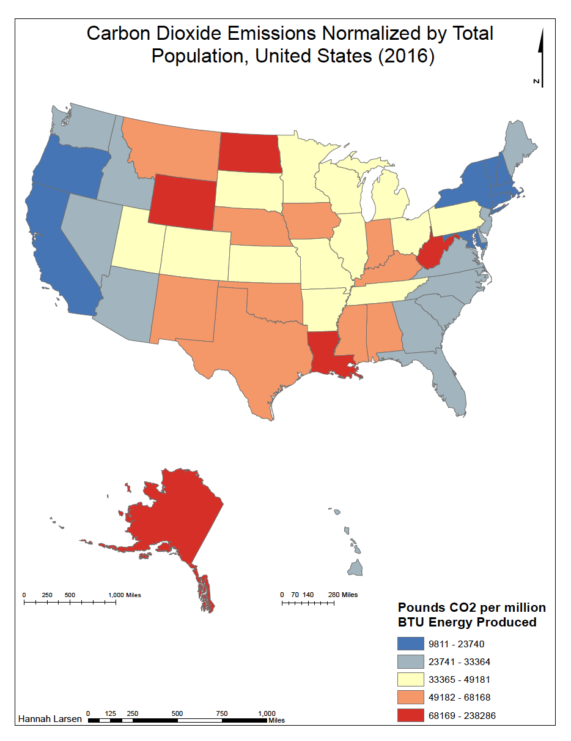
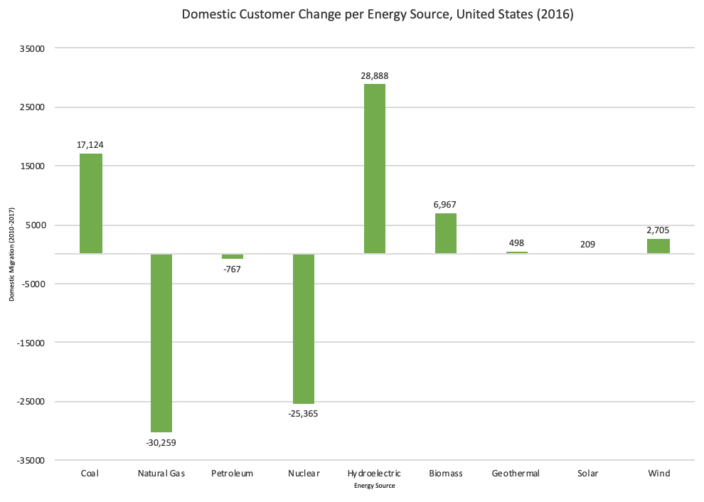
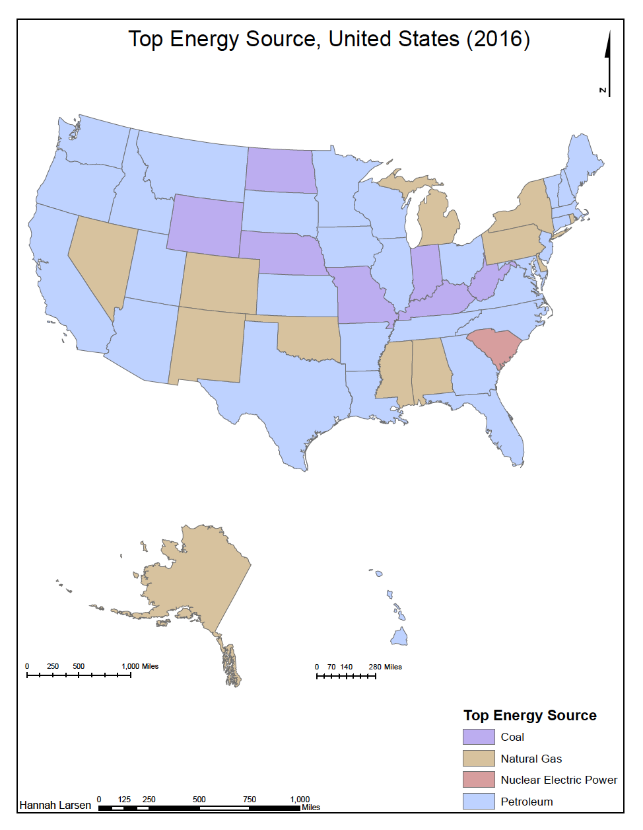
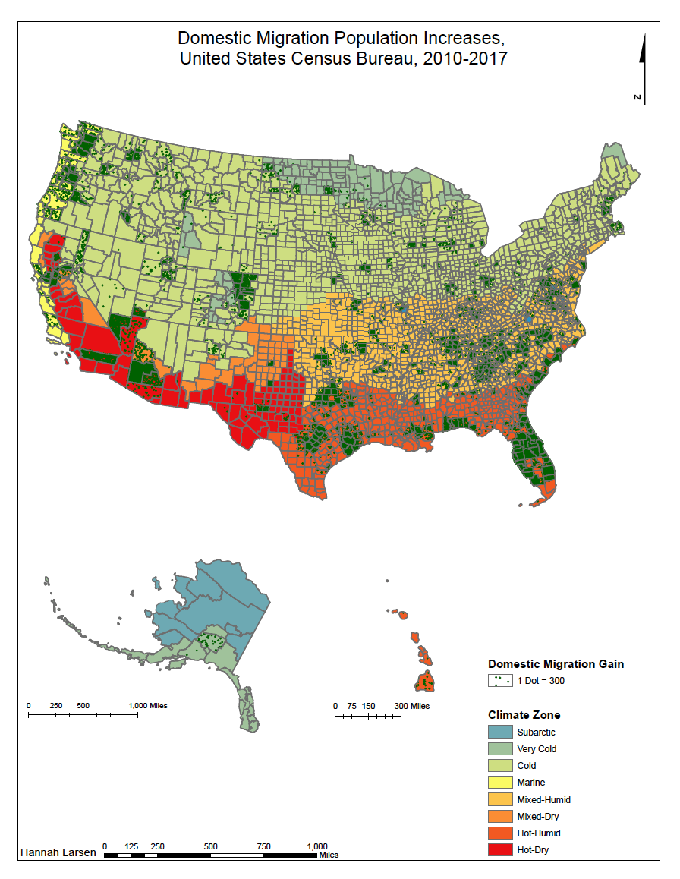
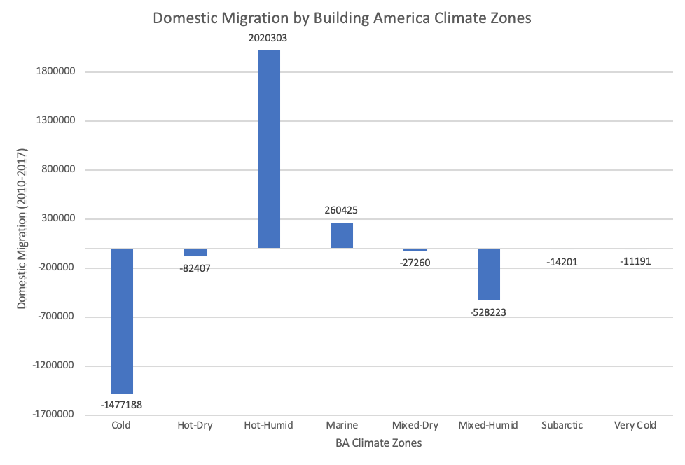
Is Domestic Migration Moving the United States Towards a Sustainable Energy Future?
Hannah Larsen, Supervisor: Mark D. Bjelland, Calvin University Grand Rapids, MI
Background
Results
The mean population center of the United States is shifting southwest where there is more renewable energy consumption
The movement of people domestically in the US shifts the total carbon dioxide emissions from non-renewable energy sources.
Renewable energy sources in the US are geothermal, hydroelectric, wind, solar, and biomass
Nuclear electric is neither renewable or non-renewable because of its byproducts
Figure 2: Non-Renewable Energy Consumption, 2016
Figure 3: Domestic Customer Change by Energy Source, 2016
Figure 6: Carbon Dioxide Emissions, 2016
Methods
The top energy sources in 2016 were all non-renewable except for South Carolina where it was nuclear (Figure 1)
Highest renewable energy consumption was concentrated in the west and South Carolina where non-renewable energy consumption was the lowest (Figure 2)
Non-renewable energy production lost 13,902 customers and renewable energy production gained 39,267 customers (Figure 3)
The highest carbon dioxide emissions were correlated with the highest non-renewable energy consumption (Figure 6)
States on the west coast and Florida in the warmest and driest climate zones, Hot-Dry and Mixed-Dry, gained the most domestic migrants (Figure 4,5)
Conclusions
Methods:
1. Data collected from the US Department of Energy and the US Energy Information Administration
2. Data analyzed in Excel and maps produced in ArcGIS 10.4
In 2016, non-renewable energy lost customers overall. A decrease in consumption of non-renewable energy through shifting energy production or through domestic migration will both move the United States towards a more sustainable energy future with decreases in carbon dioxide emissions. The specific states that people move in to matter as well for how much energy is consumed for air conditioning or heating based on climate zone.
References
Pachauri, R., & Meyer, L. (eds.). (2014). IPCC, 2014: Climate Change 2014: Synthesis Report. Contribution of Working Groups I, II and III to the Fifth Assessment Report of the Intergovernmental Panel on Climate Change. IPCC, Geneva, Switzerland. Retrieved from: https://www.ipcc.ch/report/ar5/syr/.
State Energy Consumption Estimates. (2016). U.S. Energy Information Administration, DOE/EIA-0214(2016). Retrieved from:
https://www.eia.gov/state/seds/sep_prod/SEDS_Production_Report.pdf.
Figure 1: Top Energy Production Method, 2016
Figure 4: Domestic Migration by Climate Zones
Figure 5: Domestic Migration by Climate Zone, 2010-2017

