Slide 1
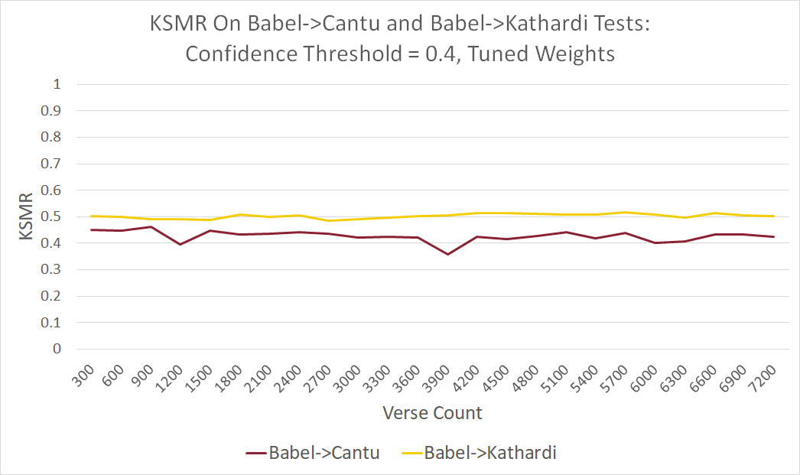
Evaluation of Computer Assisted Translation (CAT) for Documents Requiring High-Quality Translation in Low Resource Domains
Andrew Thomas and Dr. Keith VanderLinden
Computer Science
Project Thesis (or hypothesis)
Input text here
Background
Growth in AI over the last decade has spurred interest in potential applications for low resource language translation. AI is heavily data-dependent and solutions vary based on data type and scale. Low resource language contexts offer significantly less and linguistically unique data which leaves the viability of computational aid an open research question.
Key Findings (or Conclusions)
Expanding on previous research, CAT showed promise to be able to reduce the amount of work required to produce a translation in certain contexts. Work was estimated using key-stroke-mouse-action-ratio (KSMR), the number of keystrokes and mouse actions required to produce a translation over the total number of characters in that translation. The following graph displays the KSMR on the Y axis and the amount of training data on the X axis for two different translations with the same source. Language names are censored for sensitivity purposes.
In addition to demonstrating that CAT can reduce by over 50% the amount of work required to produce a translation, it discovered linguistic factors that make language pairs good and poor fits for current models.
Methods
Statistical models were trained on parallel corpora of previously completed translation data. A program imitating a translator then used the engine to translate another section of that work using the engine’s assistance only when it suggested text that matched the original translation. Various metrics were used to evaluate the effectiveness of computer aid.
Sources and Acknowledgements
Thank you to Professor Keith VanderLinden for guidance during project and for helping me complete it in half the usual timeframe. I would also like to thank my external mentors for teaching me the theoretical background and providing me a wealth of data.

